Slide 1
Describing perimeters Lesson 1 of 8
Mathematics
Miss Kidd-Rossiter

Slide 2
How many different shapes can you draw on a centimeter square grid that have a perimeter of 12 cm?

Slide 3
The perimeter of a shape is the length of its boundary.
The students are comparing the perimeters of A and B.
B
A
What’s the same/different about their responses?
Notes:
What’s the same/different about their responses? Some example comments:
cm and m are formal units, they are the same anywhere.
sticks and hands* are informal units, they depend on the stick or hand we chose.
The formal unit compare exactly: 300cm=3m and 250cm=2.5m
The relative sizes of A and B are measured differently with the sticks (A is 1 1/3 x B) compared to the hands and the m and cm (A is 1 1/5 x B).
* A ‘hand’ is a formal unit e.g. measuring the height of a horse. It is 4 inches (101.6mm). But here we are talking about the person’s actual hand.

Slide 4
Five squares and four isosceles triangles were combined.
Link the calculations to the perimeter:
Draw shapes for the following perimeter calculations:

Slide 5
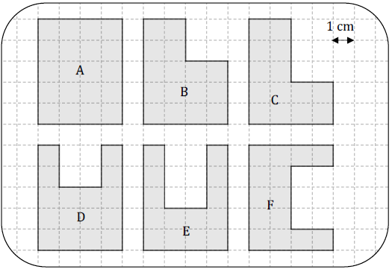
The shapes in the diagram to the right are drawn on a 1 cm grid. Write down the perimeters of the shapes.
What is the same or different about the shapes in Q1?
Hint: Compare the perimeters of the shapes in the top row to the bottom row.

Slide 6
A shape pattern is created by ‘cutting’ out a single 1 cm square and ‘pasting’ it as shown:
What are the perimeters of the shapes drawn above?
What will the perimeter of the next shape in the pattern be?
What will the perimeter of the sixth shape in the pattern be?

Slide 7
The grid below uses nine identical rectangles:
What is the perimeter of this shape?
Explore the effect on the perimeter when rectangles are removed:

