Slide 1
Manipulating Surds
Mathematics
Dr Rim Saada

Slide 2
Decide if the following equations are true or false

Slide 3
Decide if the following equations are true or false

Slide 4
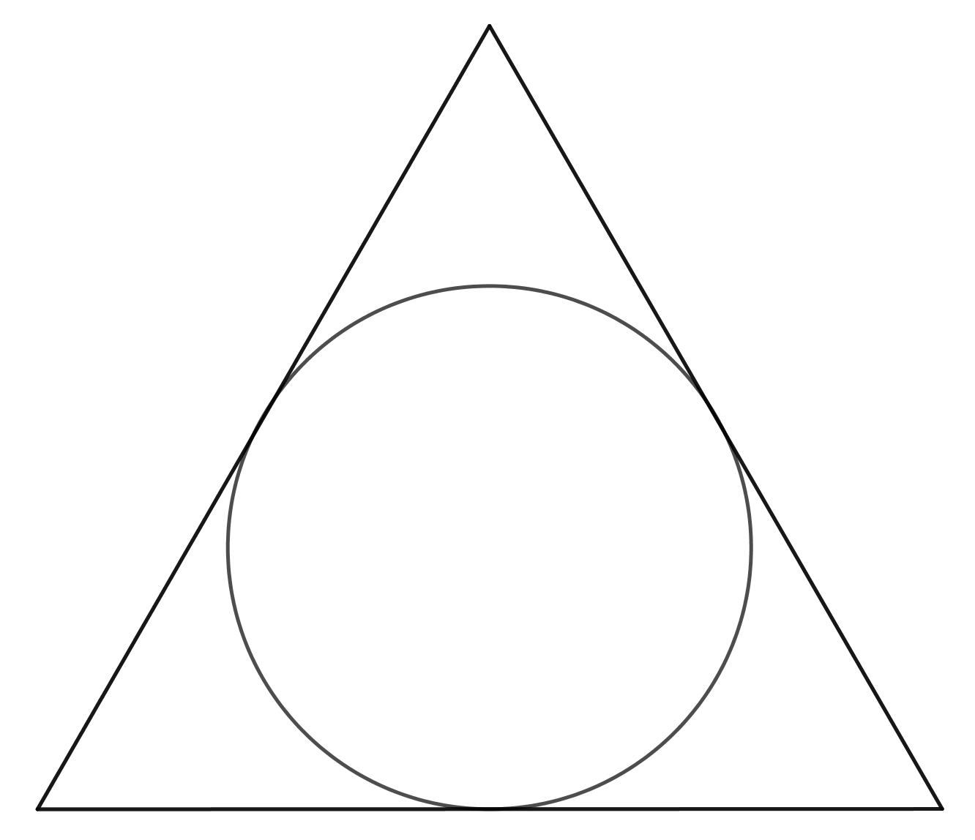
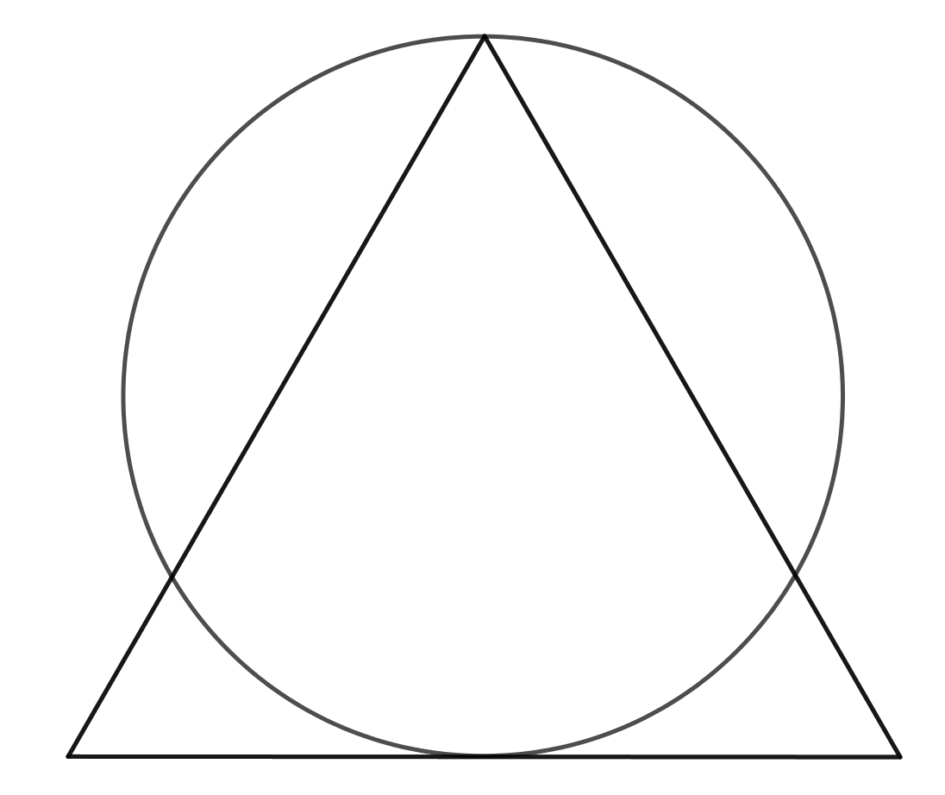
An equilateral triangle of side length 4 cm and a circle has been used to create the two images below. What are the areas of each circle?
Can you construct similar images?

