Slide 1
Calculate the perimeter of simple compound shapes.
Independent Task
Mathematics
Lesson 4 of 10
Miss Brinkworth

Slide 2
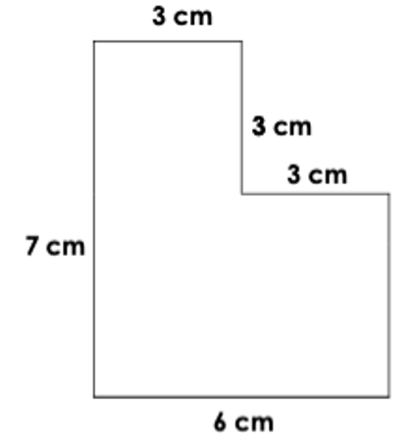
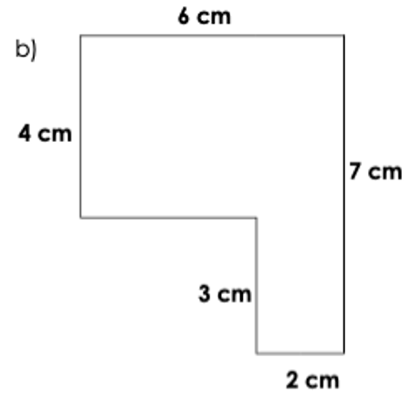
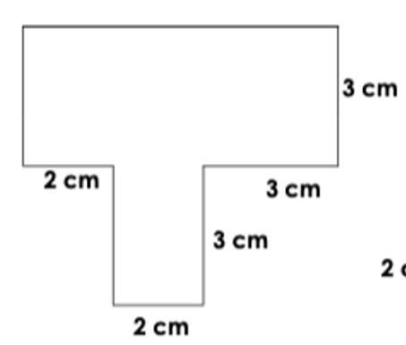
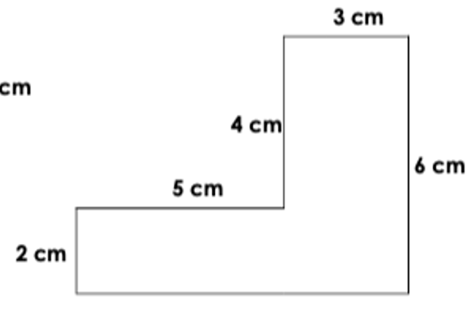
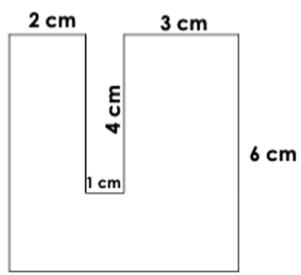
Calculate the perimeter of each composite shape.
C
B
A
D
E
Notes:
Lesson Agenda:

