Slide 1
Structures and bonding
Further Ionic Bonding
Worksheet
Combined science - Chemistry - Key Stage 4
Mr Robbins

Slide 2
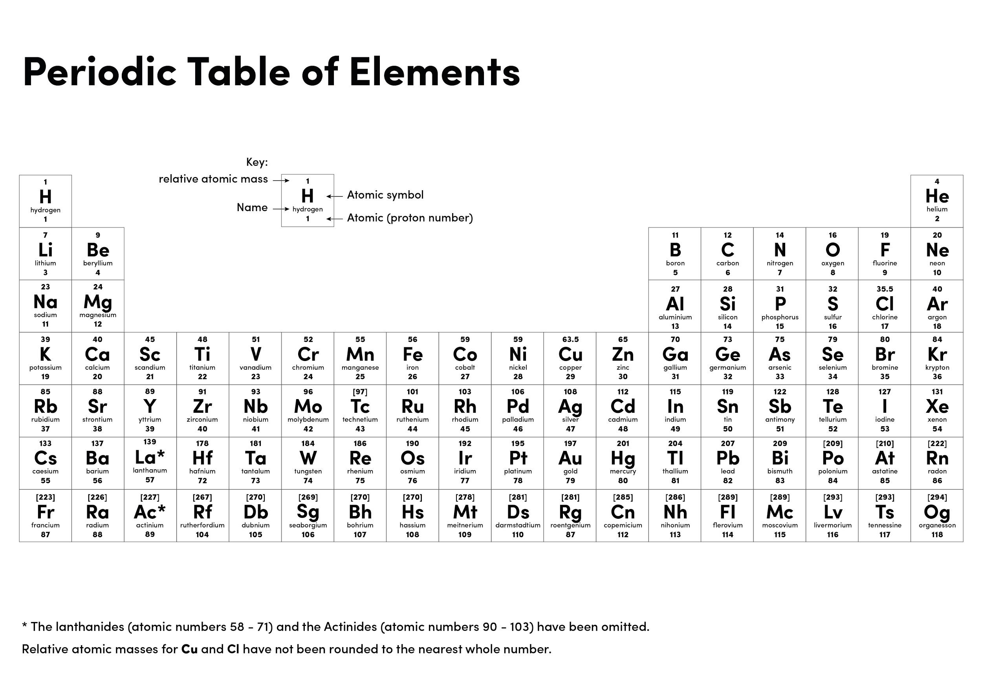

Slide 3
Draw a diagram to show what happens when Calcium (Ca) Reacts with Chlorine (Cl)
Show the atoms outside shells
Draw arrows to show how the electrons move
Draw the ions with brackets and charges
Ca is in group 2 and Cl is in group 7

Slide 4
Giant ionic lattice
Ionic compounds form giant ionic lattices
Giant = Big
Ionic = Made of oppositely charged ions
Lattice = Repeating structure
E.g. NaCl

Slide 5
Independent practice:
Copy and complete the table. The first one has been completed for you.
Name | Positive ion | Negative ion | Formula
sodium oxide | Na⁺ | O²⁻ | Na₂O
Magnesium oxide
Potassium iodide
Magnesium chloride
Aluminium chloride
Calcium chloride
Calcium oxide
Hint
Group No. | Ion charge
1 | +1
2 | +2
3 | +3
6 | -2
7 | -1

Slide 6
Your turn
Magnesium Oxide contains Magnesium (Mg²⁺) ions and Oxide (O2⁻) ions.
Describe in terms of electrons what happens when Magnesium reacts with Oxygen
Change in the metal
Change in the non-metal
Attraction between opposite charges
Ionic formula

Slide 7
Your Turn
Magnesium Bromide contains Magnesium (Mg²⁺) ions and Bromide (Br⁻) ions.
Describe in terms of electrons what happens when Magnesium reacts with Bromine
Change in the metal
Change in the non-metal
Attraction between opposite charges
Ionic formula

