Slide 1
Use the cosine rule to find a missing length
Mr Clasper
Maths

Slide 2
Use the cosine rule to find a missing length
1. Use the cosine rule to find the length of side YZ to three significant figures.
2. Calculate the length of AB to 2 decimal places.
21 m
A
B
Y
X
86⁰
112⁰
13 cm
12 cm
18 m
C
Z

Slide 3
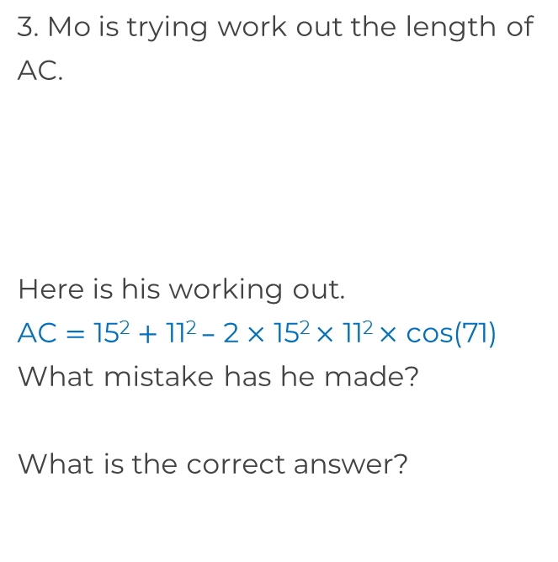
Use the cosine rule to find a missing length
4. Below is a diagram of a triangle.
Calculate the perimeter of the shape.
B
Y
11 cm
40 m
15 cm
71°
C
45°
A
X
Z
52 m

Slide 4
Answers

Slide 5
Use the cosine rule to find a missing length
1. Use the cosine rule to find the length of side YZ to three significant figures.
2. Calculate the length of AB to 2 decimal places.
21 m
B
a
c
A
B
Y
C
B
A
X
b
112⁰
c
86⁰
13 cm
12 cm
18 m
a
b
A
C
C
Z
AB = 20.73 m

Slide 6
Use the cosine rule to find a missing length
4. Below is a diagram of a triangle.
Calculate the perimeter of the shape.
B
Y
B
11 cm
40 m
15 cm
71°
c
a
C
45°
A
X
Z
A
52 m
b
C
He squared 15 cm and 11 cm twice.
15.4 cm

