Slide 1
Mean from a frequency table
Maths
Miss Davies

Slide 2
Mean from a frequency table
1. The ages of people in a drama club are recorded in the table in the below.
Calculate the mean age of the drama club.
2. A teacher records time spent, in hours, on coursework for two groups X and Y.
Group X Group Y
Calculate the mean to decide which group of students has spent the least amount of time on their coursework.
Age | Frequency
8 | 4
9 | 7
10 | 9
11 | 14
12 | 10
13 | 7
14 | 5
15 | 4
Time (H) | Frequency
5 | 3
6 | 4
7 | 5
8 | 2
9 | 1
10 | 1
Time (H) | Frequency
5 | 0
6 | 4
7 | 6
8 | 2
9 | 1
10 | 0

Slide 3
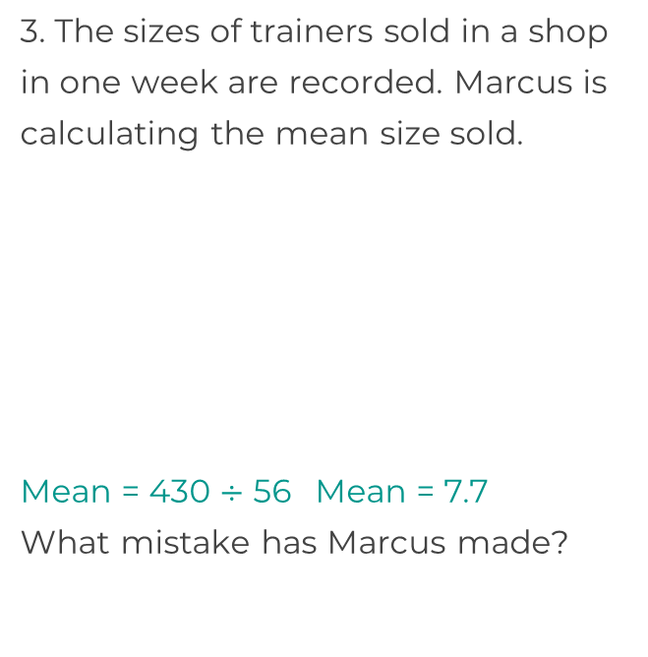
Mean from a frequency table
4. The time take to run a race are recorded to the nearest second.
a) Complete the missing values in the table.
b) What is the mean time taken?
Size | Frequency
5 | 3 | 15
6 | 5 | 30
7 | 5 | 35
8 | 8 | 64
9 | 9 | 81
10 | 15 | 150
11 | 5 | 55
56 |  | 430
Time (sec) | Frequency
 | 4 | 60
16 |  | 64
17 | 5
18 | 10
19 |  | 0
20 | 2
 | 25

Slide 4
Answers

Slide 5
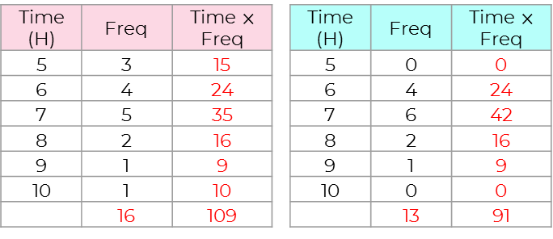
Mean from a frequency table
1. The ages of people in a drama club are recorded in the table in the below.
Calculate the mean age of the drama club.
2. A teacher records time spent, in hours, on coursework for two groups X and Y.
Group X Group Y
Calculate the mean to decide which group of students has spent the least amount of time on their coursework.
Age | Frequency
8 | 4 | 32
9 | 7 | 63
10 | 9 | 90
11 | 14 | 154
12 | 10 | 120
13 | 7 | 91
14 | 5 | 70
15 | 4 | 60
 | 60 | 680
X = 6.8 hours and Y = 7 hours

Slide 6
Mean from a frequency table
4. The time take to run a race are recorded to the nearest second.
a) Complete the missing values in the table.
b) What is the mean time taken?
Size | Frequency
5 | 3 | 15
6 | 5 | 30
7 | 5 | 35
8 | 8 | 64
9 | 9 | 81
10 | 15 | 150
11 | 5 | 55
56 |  | 430
Time (sec) | Frequency
15 | 4 | 60
16 | 4 | 64
17 | 5 | 85
18 | 10 | 180
19 | 0 | 0
20 | 2 | 40
 | 25 | 429
He didn’t divide by the sum of frequency.
17.16 seconds

