Slide 1
Combined Science - Chemistry - Key Stage 4
Atomic Structure & the Periodic Table
Atomic structure
Dr Patel

Slide 2
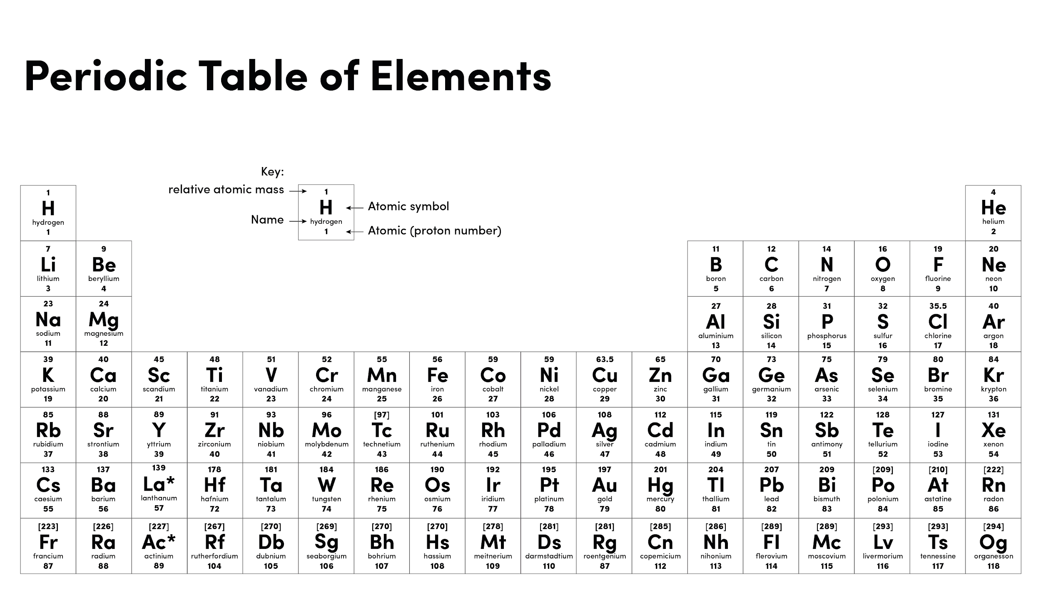

Slide 3
Independent practice (questions 1-5)
Write your answers using full sentences:
What does the word subatomic mean?
What are the three subatomic particles found inside an atom?
Which subatomic particles are found in the nucleus of an atom?
Which subatomic particles are found on shells orbiting the nucleus?
What is the mass of a proton?

Slide 4
Independent practice (questions 6-10)
Write your answers using full sentences:
6. What is the charge of a proton?
7. What is the mass of an electron?
8. What is the charge of an electron?
9. What is the mass of a neutron?
10. What is the charge of a neutron?

Slide 5
Independent practice
4. For the element shown in the diagram, answer the following questions:
State the atomic number of this element.
State the atomic mass of this element.
State the number of protons.
State the number of electrons
Calculate the number of neutrons
39
K
19

Slide 6
Exam style question (Extended writing)
Aluminium is a metal that used to make the bodies of aeroplanes.
An aluminium atom has an atomic number of 13 and
a mass number of 27.
Describe the atomic structure of aluminium.
Include in your answer:
The number of each type of each subatomic particle
The charges and mass of each subatomic particle
The location in the atom that each particle is found.

