Slide 1
How much do we rely on electricity?
Science
Miss Simkin

Slide 2
Electrical appliances
Draw this table:
Electrical appliances | Non-electrical appliances

Slide 3
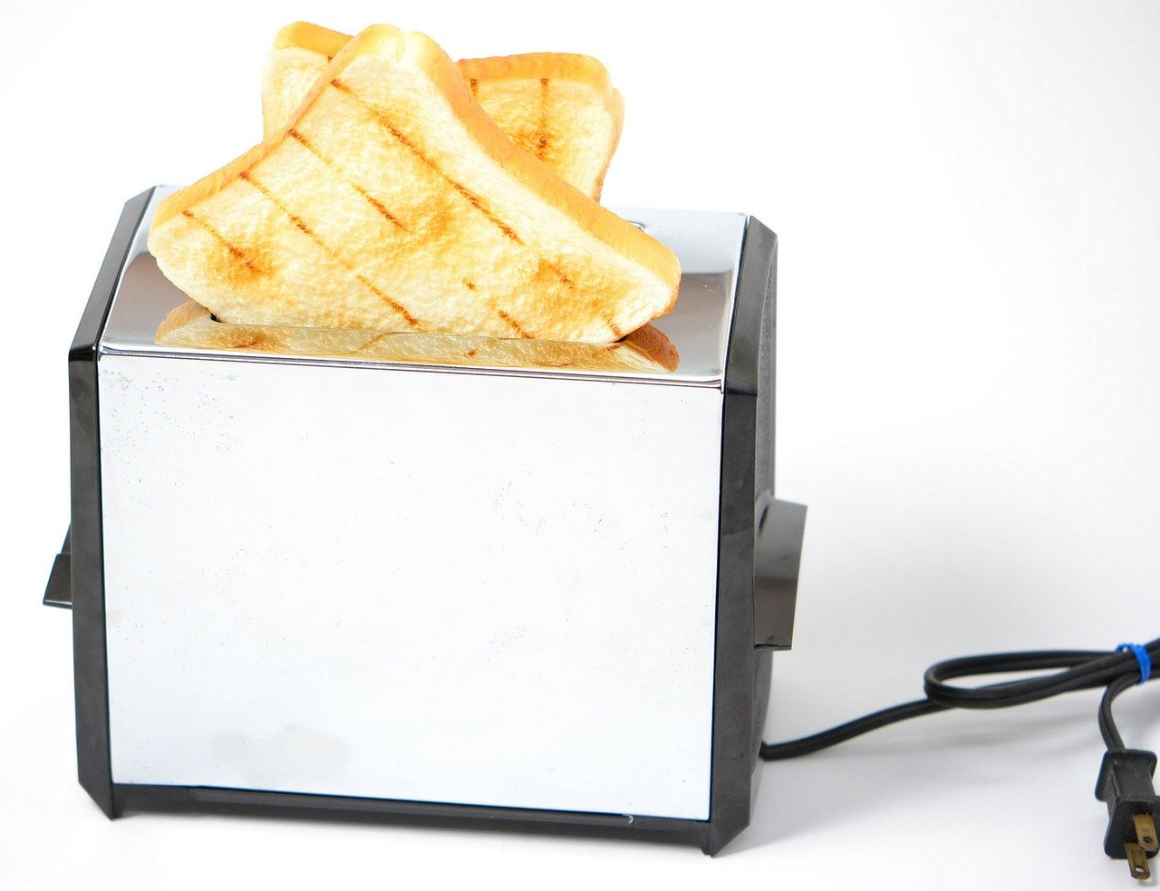
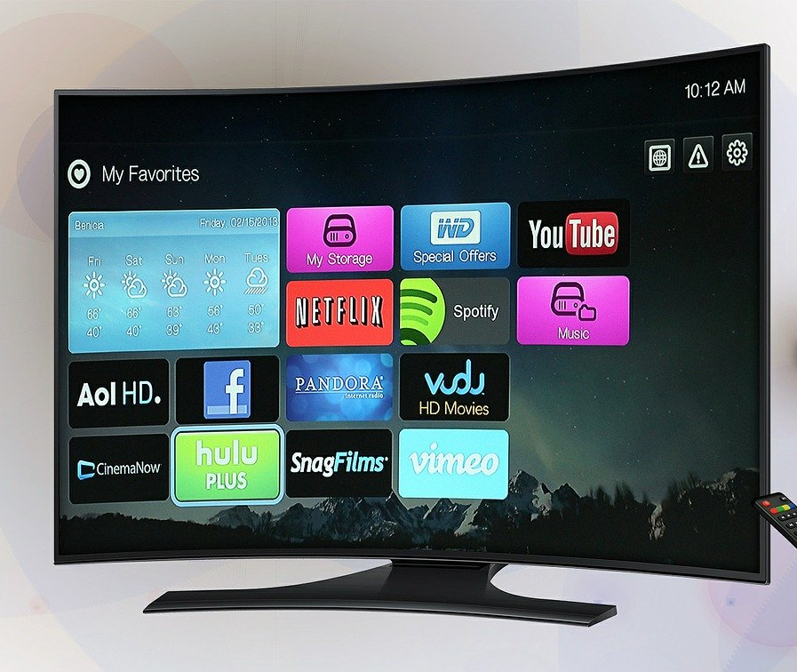
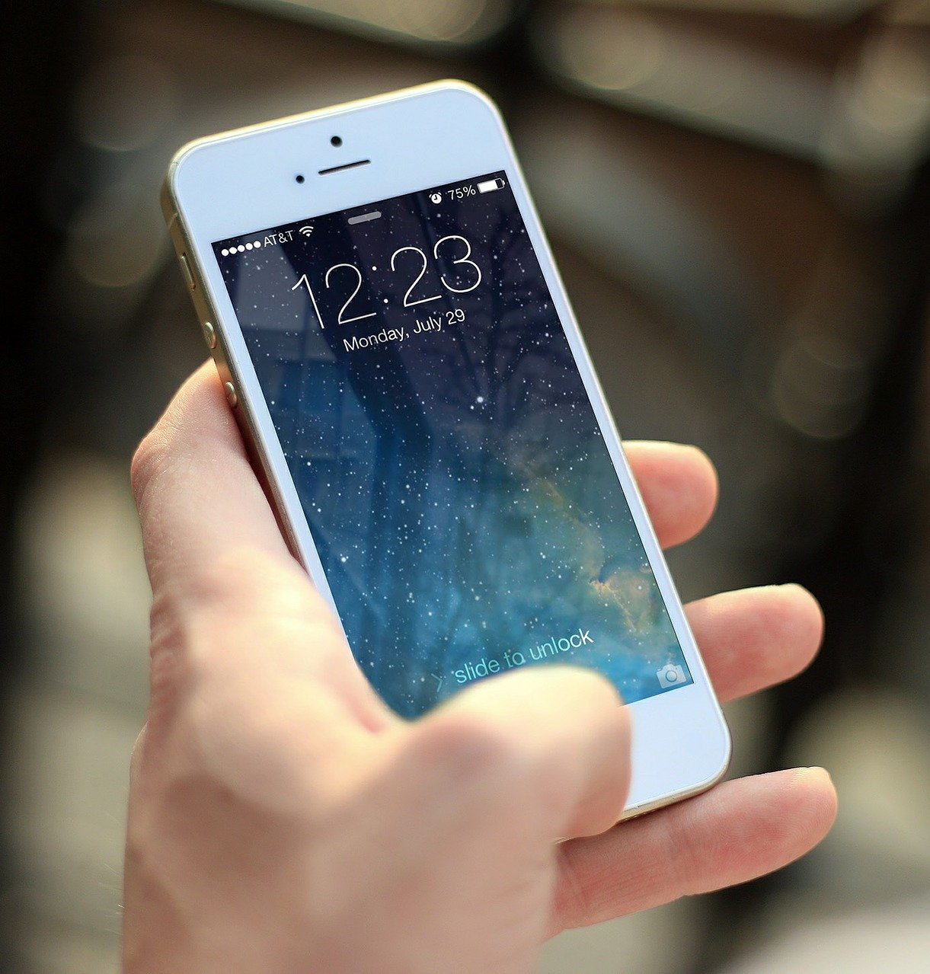
Electrical appliances
Sort these items:
Pixabay

Slide 4
Types of electricity
Fill in the gaps for each definition:
Battery electricity: | This type of electricity you need to insert a _________ into the _____________.
Mains electricity: | To use this type of electricity, you need to plug the ________________ into a __________________.
Notes:
Kerosene = airplane fuel

Slide 5
Sorting activity
Draw this table and categorise appliances you find around your home:
Mains powered appliances | Battery powered appliances
Notes:
Find items in your own hom

Slide 6
Life without electricity
Draw or write some ideas to this question:
What would life be like without electricity?
Notes:
Kerosene = airplane fuel

Slide 7
Life without electricity
Answer the question:
Are humans reliant on electricity?
Notes:
Kerosene = airplane fuel

