Slide 1
Lesson 1: Computer Systems and System Software
Computer Systems
Computing
Mac Bowley
Materials from the Teach Computing Curriculum created by the National Centre for Computing Education

Slide 2
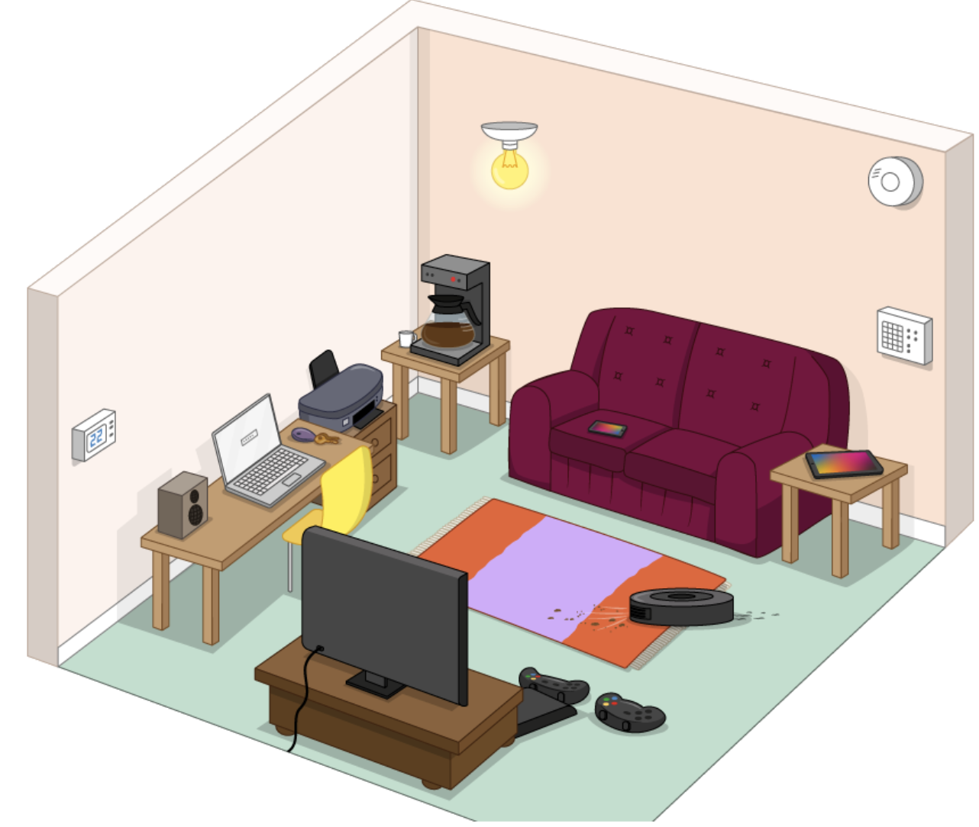
Task 1 - Spot the embedded systems
This room is full of computer systems.
Find as many devices as you can and sort them into 2 lists;
General purpose
Embedded systems

Slide 3
The startup sequence - Part 1
The CPU
RAM
ROM
Hard drive
BIOS
Contains all the basic code for controlling your computer hardware (such as the keyboard, mouse and monitor)
Read-Only Memory
A large chip inside the computer. The brains of the computer: it controls everything.
Random Access Memory
The main storage device in your computer.

Slide 4
The startup sequence - Part 2
1
2
3
4
5
6
7
8
The boot sequence begins
Operating system is fetched from secondary storage
Instructions from BIOS are loaded into RAM
BIOS starts up the monitor and keyboard
Operating system is loaded into RAM
BIOS checks the computer is working
CPU starts up and fetches the BIOS from ROM
The BIOS hands control over to the Operating system

Slide 5
Operating systems
What is an Operating system?
Operating system | Device

