Slide 1
Lesson 9 - Specialised cells
(Downloadable student document)
Science - Biology - Key Stage 3
Cells, Tissues and Organs
Miss Wickham

Slide 2
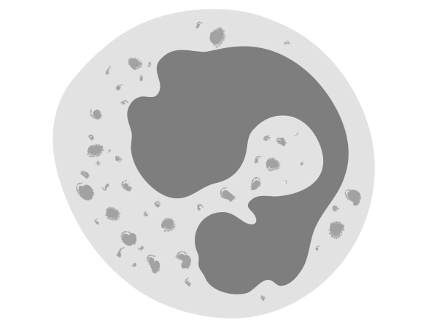
Other than a flexible shape, what is another adaptation of this cell?

Slide 3
Match up task
Name of cell
Palisade cell
Sperm cell
Red blood cell
Job of cell
Carry oxygen
Fertilise the egg
photosynthesis
Adaptations of cell
Lots of chloroplasts, transparent
Tail, lots of mitochondria, enzymes in the head, streamlined
Large surface area, no nucleus

Slide 4
Match up task
Name of cell
Palisade cell
Sperm cell
Red blood cell
Job of cell
Carry oxygen
Fertilise the egg
photosynthesis
Adaptations of cell
Lots of chloroplasts, transparent
Tail, lots of mitochondria, enzymes in the head, streamlined
Large surface area, no nucleus

Slide 5
Match up task
Name of cell
Root hair cell
Ciliated epithelial cell
Nerve cell
White blood cell
Job of cell
Fight pathogen
Sweep dust and bacteria out of airways
Carries electrical impulses
Absorb water and mineral ions
Adaptations of cell
Flexible shape, lots of ribosomes
Elongated for large surface area
Lots of cilia (hairs)
Long thin axon, dendrites, fatty sheath

Slide 6
Match up task
Name of cell
Root hair cell
Ciliated epithelial cell
Nerve cell
White blood cell
Job of cell
Fight pathogen
Sweep dust and bacteria out of airways
Carries electrical impulses
Absorb water and mineral ions
Adaptations of cell
Flexible shape, lots of ribosomes
Elongated for large surface area
Lots of cilia (hairs)
Long thin axon, dendrites, fatty sheath

Slide 7
Answer the following questions:
Why are nerve cells so long?
What is the palisade cell specialised to do?
The hairs on a ciliated cell are known as what?
Why do root hair cells not have chloroplasts?
Name the cell that contains lots of mitochondria and can contract and relax?
A sperm cell has a long tail. What is another adaptation of a sperm cell?
How are red blood cells different to white blood cells?

Slide 8
Mark your answers
Why are nerve cells so long?
To send fast impulses around the body
What is the palisade cell specialised to do?
Photosynthesis
The hairs on a ciliated cell are known as what?
cilia
Why do root hair cells not have chloroplasts?
Roots are underground, so no sunlight, therefore no photosynthesis
Name the cell that contains lots of mitochondria and can contract and relax?
Muscle cell
A sperm cell has a long tail. What is another adaptation of a sperm cell?
Lots of mitochondria, enzymes in the head to enter the egg, streamlined
How are red blood cells different to white blood cells?
Red blood cells carry oxygen around the body. They have no nucleus and a large surface area. A white blood cell has a flexible shape to engulf pathogens and lots of ribosomes

Slide 9
Describe the adaptations of the following specialised cells.
Xylem
The function of the xylem tissue is to transport water and mineral ions from the roots to cells around the plant. Looking at the image, what adaptations can you see that will help the cells to do that?
Support: think of a hose - what features would make a good hose?
H₂O
Transport of water
H₂O

Slide 10
Describe the adaptations of the following specialised cells.
Xylem
A good hose would be a hollow tube that is made of a strong material to cope with water pressure changes.
Therefore, the xylem cells make a hollow tube for the water to travel through and are made of a substance called lignin which makes the xylem strong to cope with the water pressure.
H₂O
Transport of water
H₂O

Slide 11
References
Slide [24, 28] - [Diagram of a white blood cell. ] - [Cancer Research UK] - [Wikimedia Commons]
Slide [34, 35] - [Biology ] - [CNX OpenStax] - [Wikimedia Commons]

