Slide 1
Pythagoras’s Theorem
Generalising Lesson 5 of 8
Downloadable Resource
Mathematics
Dr Rim Saada

Slide 2
How many numbers 1-100 can be expressed as the sum of 2 square numbers
(you can use the same number twice!)
1 | 2 | 3 | 4 | 5 | 6 | 7 | 8 | 9 | 10
11 | 12 | 13 | 14 | 15 | 16 | 17 | 18 | 19 | 20
21 | 22 | 23 | 24 | 25 | 26 | 27 | 28 | 29 | 30
31 | 32 | 33 | 34 | 35 | 36 | 37 | 38 | 39 | 40
41 | 42 | 43 | 44 | 45 | 46 | 47 | 48 | 49 | 50
51 | 52 | 53 | 54 | 55 | 56 | 57 | 58 | 59 | 60
61 | 62 | 63 | 64 | 65 | 66 | 67 | 68 | 69 | 70
71 | 72 | 73 | 74 | 75 | 76 | 77 | 78 | 79 | 80
81 | 82 | 83 | 84 | 85 | 86 | 87 | 88 | 89 | 90
91 | 92 | 93 | 94 | 95 | 96 | 97 | 98 | 99 | 100

Slide 3
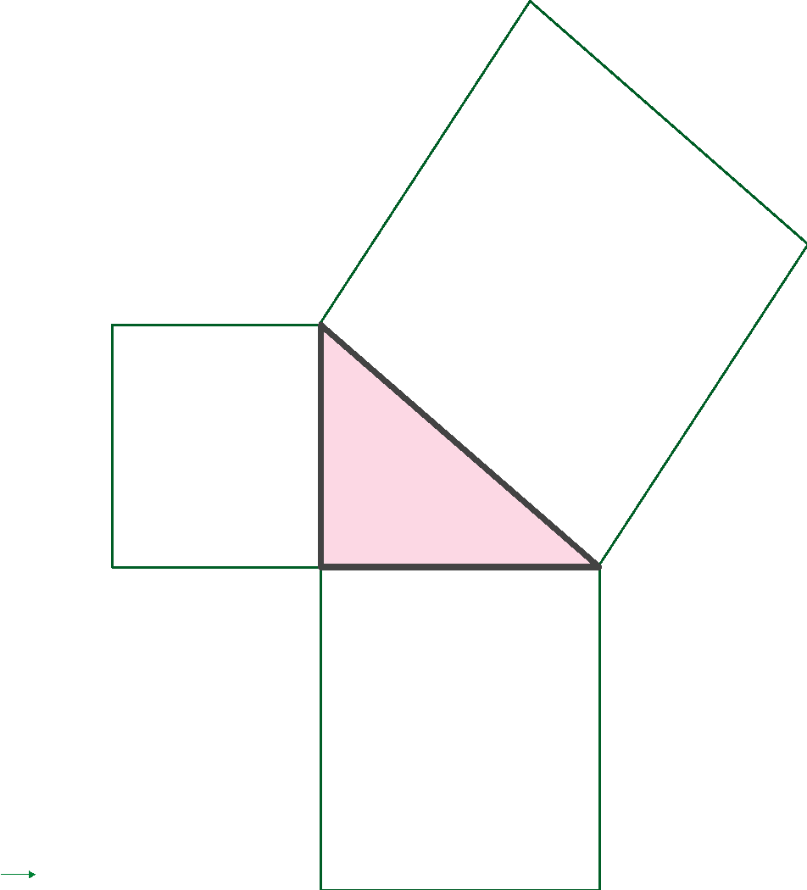
1) Mark the hypotenuse on each of the following right angled triangles:
2) Fill in the gaps on the diagrams below:
80
?
?
25
?
?
3) Find the length of the missing side in each triangle:
3 cm
? cm
2 cm
? cm
4 cm
5 cm

Slide 4
Solutions

Slide 5
- Answers
How many numbers 1-100 can be expressed as the sum of 2 square numbers
(you can use the same number twice!)
1 | 2 | 3 | 4 | 5 | 6 | 7 | 8 | 9 | 10
11 | 12 | 13 | 14 | 15 | 16 | 17 | 18 | 19 | 20
21 | 22 | 23 | 24 | 25 | 26 | 27 | 28 | 29 | 30
31 | 32 | 33 | 34 | 35 | 36 | 37 | 38 | 39 | 40
41 | 42 | 43 | 44 | 45 | 46 | 47 | 48 | 49 | 50
51 | 52 | 53 | 54 | 55 | 56 | 57 | 58 | 59 | 60
61 | 62 | 63 | 64 | 65 | 66 | 67 | 68 | 69 | 70
71 | 72 | 73 | 74 | 75 | 76 | 77 | 78 | 79 | 80
81 | 82 | 83 | 84 | 85 | 86 | 87 | 88 | 89 | 90
91 | 92 | 93 | 94 | 95 | 96 | 97 | 98 | 99 | 100
Lots of possible answers.

Slide 6
- Answers
1) Mark the hypotenuse on each of the following right angled triangles:
2) Fill in the gaps on the diagrams below:
MN is the hypotenuse.
48
80
?
12
35
?
QR is the hypotenuse.
?
36
?
45
Lots of possible answers for Q2.
3) Find the length of the missing side in each triangle:
3 cm
? cm
2 cm
? cm
4 cm
5 cm

Slide 7
- Answers
3 cm
? cm
2 cm
? cm
4 cm
5 cm

Slide 8
- Answers
For each right-angled triangle, write some equations relating side lengths
f
q
r
d
e
p
m
What do these dashes mean?
k
6
n
j

Slide 9
Share your work with Oak National
If you'd like to, please ask your parent or carer to share your work on Twitter tagging @OakNational and #LearnwithOak

