Slide 1
Lesson 5: Mixing it up!
Physical Computing
Computing
Allen Heard
Materials from the Teach Computing Curriculum created by the National Centre for Computing Education

Slide 2
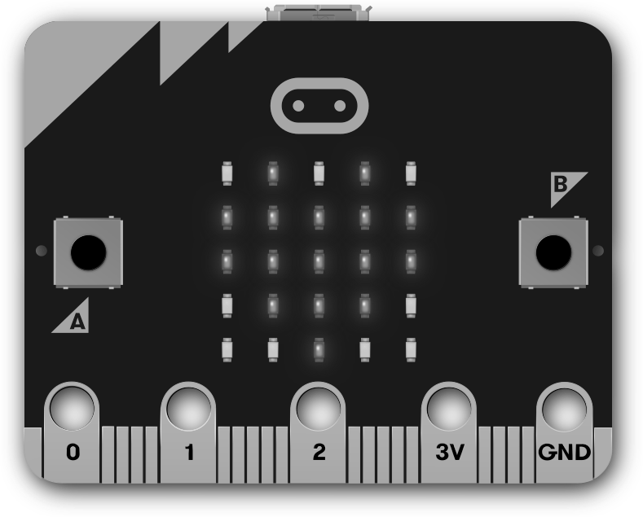
Task 1 - Decompose the ‘Guess the number’ game
You will create a ‘guess the number’ game on the micro:bit. The user will think of a number up to 100 and the device will be doing the guessing.
Using the downloadable resource break down the problem into subproblems that will needed to be solved in order to create the game.
Credit: micro:bit Foundation

Slide 3
Task 1 - Decompose the ‘Guess the number’ game
What are the individual sub-problems that need solving in order to produce a working game?
Description of sub-problem

Slide 4
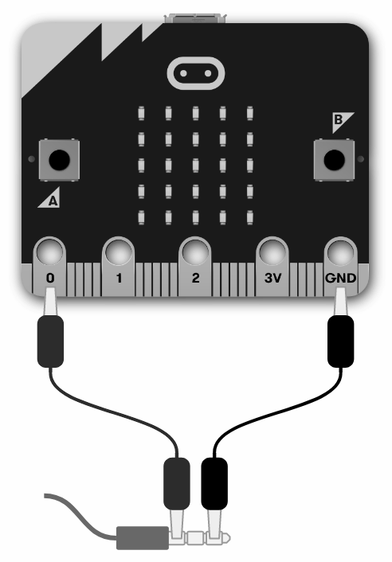
Activity 1
Task 2 - Coding the guess the number game
Your task now is to code your game using the skills learned throughout this unit.
If you need a reminder on how to solve some of the sub-problems, refer back to some of the previous lessons in this unit.
Tip: Code small sections at a time and test regularly.
Credit: micro:bit Foundation
Speaker: Pixabay

Slide 5
Activity 1
Task 2 - Coding the guess the number game - tips
Starting the game: An arrow towards button A will blink on the display (output), to indicate that the button needs to be pressed in order for the game to start. The program will check if the button was pressed (input and processing).

Slide 6
Activity 1
Task 2 - Coding the guess the number game - tips
Playing the game: The program will keep track of two numbers, the lowest and highest possible values for the secret number it needs to guess. These start at 1 and 100. The program picks the middle of the range between these two numbers and displays it as a guess (output). It then waits for the user’s reply, checking the buttons for specific input. The user can indicate that the secret number is lower by pressing button A, higher by pressing button B, or that the guess is correct by shaking. Having detected one of these inputs, the program will update the range accordingly. It will terminate the game if the number has been guessed (processing).
Outcome: The outcome of the game will be displayed (output) and sound played (optional).

Slide 7
Activity 1
Guess the number game - solution
Here is a link to a possible solution to the guess the number game.
Credit: micro:bit Foundation
Speaker: Pixabay

Slide 8
Click here to download additional assets for this lesson

