Slide 1
Solve quadratic inequalities (a = 1)
Maths
Miss Parnham

Slide 2
Solve quadratic inequalities (a = 1)

Slide 3
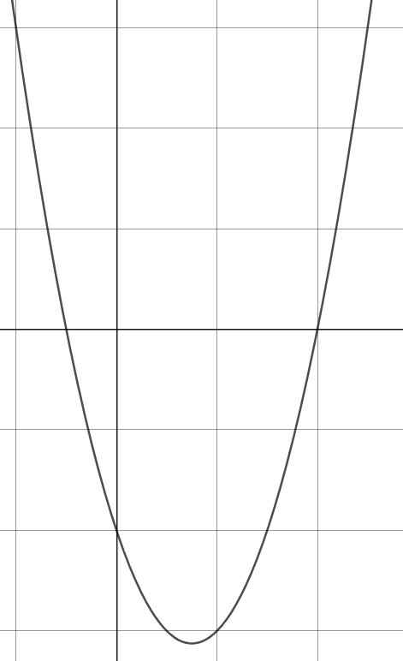
Solve quadratic inequalities (a = 1)
(4, 0)

Slide 4
Answers

Slide 5
Solve quadratic inequalities (a = 1)

Slide 6
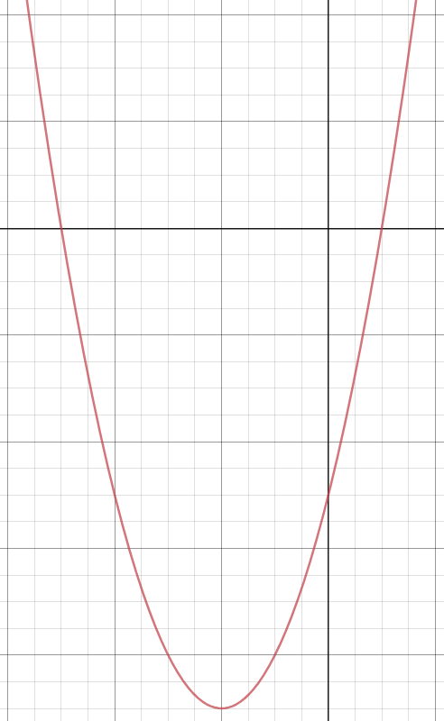
Solve quadratic inequalities (a = 1)
(1, 0)
(4, 0)

