Slide 1
Lesson 3: How search results are ranked
Computing systems and networks - Communication
Computing
Jane Adamson
Materials from the Teach Computing Curriculum created by the National Centre for Computing Education

Slide 2
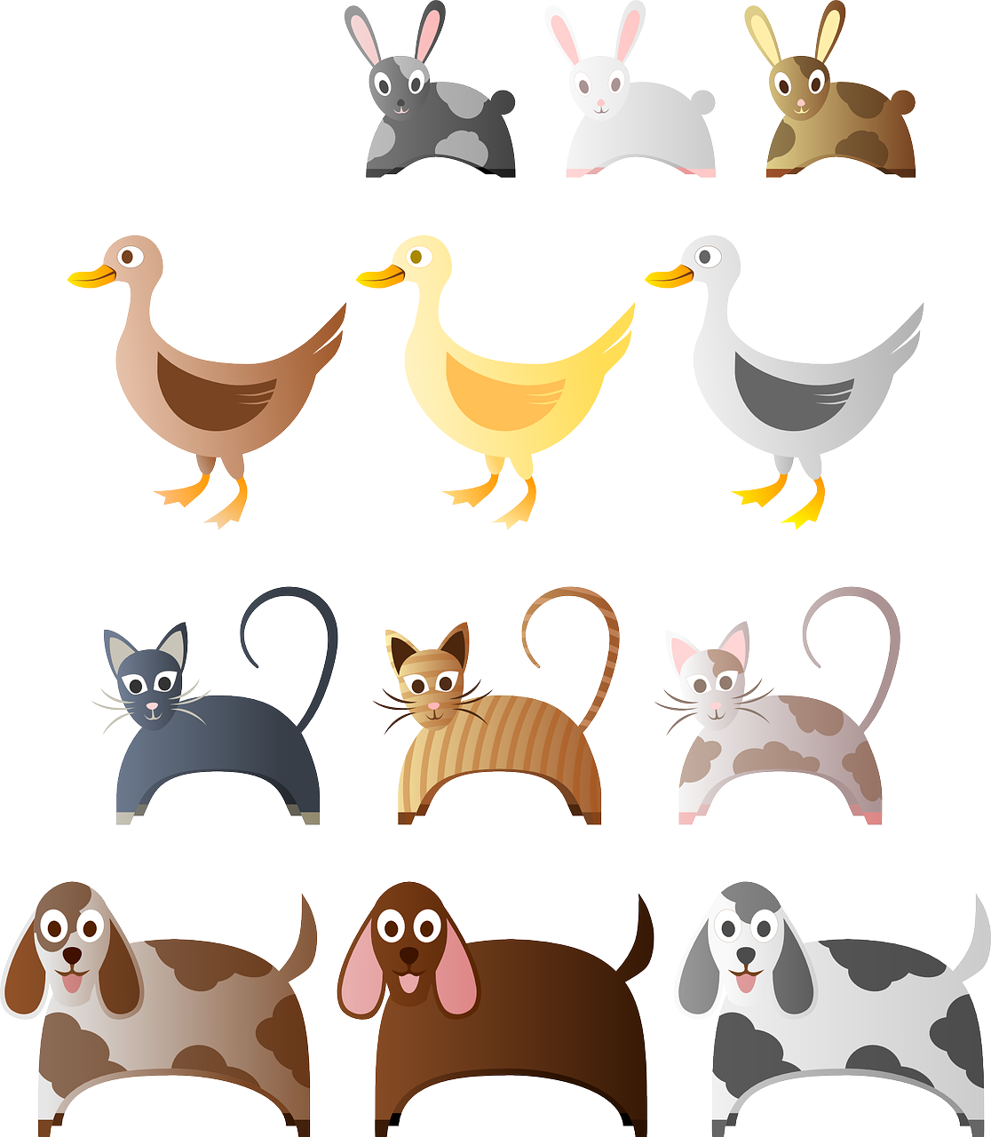
Task 1 - Create your own web page
Create your own web page
On a piece of paper, you are going to create your own web page around the theme of animals.
Your web page should include:
A web address (URL)
A heading
Subheadings
Paragraphs of information
Some pictures or diagrams
Links to other websites
Try to include as much content as you can.
Please the next slide for the template.
Credit: Pixabay

Slide 3
Task 1: Create your own web page (template)
Web page address
URL: e.g. www.
Web page heading
Subheadings
Paragraphs of information
Pictures or diagrams
Links
Link:
Credit: Pixabay

Slide 4
Task 2 - Rank your paper web page
Select a keyword for your search on your website.
Complete the second column in the table ‘Your website before changes’
Score your web page based on the following criteria:
Receive 1 point for each time the search term appears in the paragraphs of text
Receive 5 points for each time the keyword appears in the subheadings
Receive 10 points if the search term appears in the heading
Receive 20 points if the search term appears in the URL
 | Your Website before changes (Points)
Keyword in paragraph
Keyword in subheading
Keyword in heading
Keyword in URL

Slide 5
Task 2 (cont) - Rank your paper web page
Now make changes to your website to improve its ranking.
Use the scoring criteria for your improved website after the changes.
Complete the third column in the table.
What did you do to increase its ranking?
Scoring criteria:
Receive 1 point for each time the search term appears in the paragraphs of text.
Receive 5 points for each time the keyword appears in the subheadings.
Receive 10 points if the search term appears in the heading.
Receive 20 points if the search term appears in the URL.
 | Your Website before changes (Points) | Your Website after changes (Points)
Keyword in paragraph
Keyword in subheading
Keyword in heading
Keyword in URL

