Slide 1
Mathematics
Multiplying Non-Unit Fractions with Integers
Downloadable Resource
Mr Langton

Slide 2
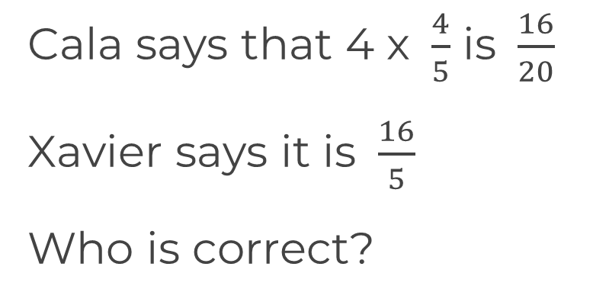
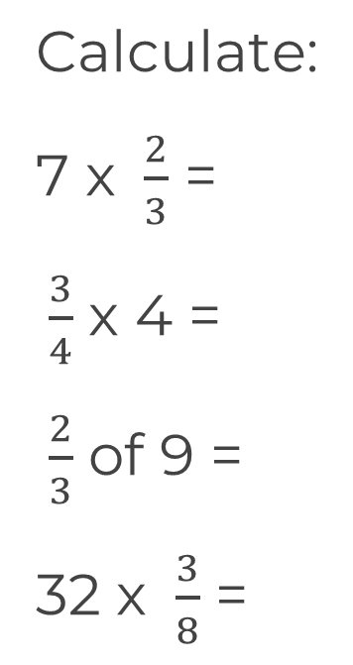
Multiplying non-unit fractions with integers

