Slide 1
Laws of indices worksheet
Mathematics
Miss Oreyomi
Miss Oreyomi

Slide 2
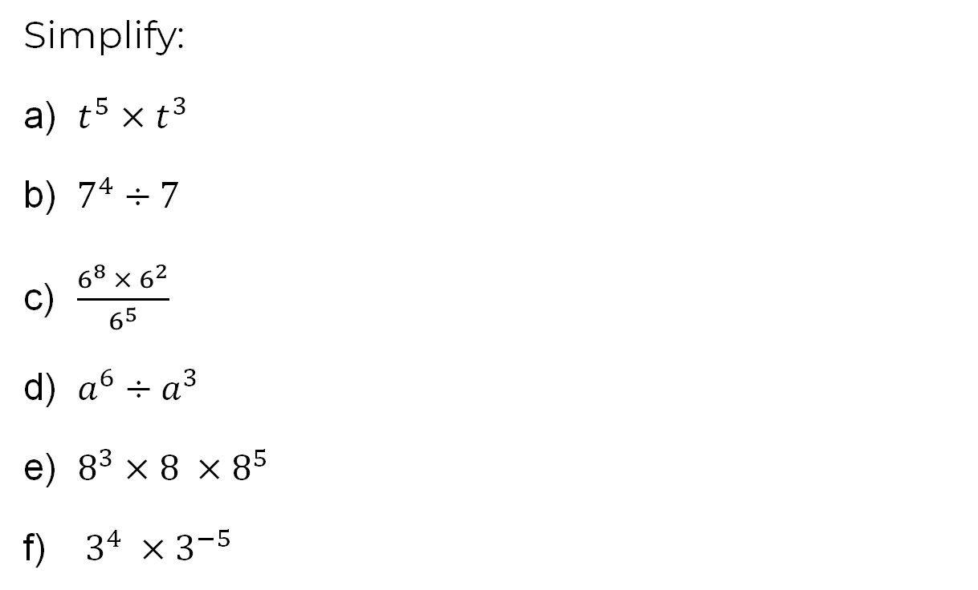
Questions

Slide 3
Questions

