Slide 1
Integer Addition and Subtraction: Rounding to estimate
Mathematics
Ms Jeremy

Slide 2
Pause the video to complete your task
Resume once you’re finished
Can you round 183 625 to:
i) the nearest 10 000?
ii) the nearest 1000?
183 625
183 625 is approximately 180 000 (n.m. 10 000)
183 625 is approximately 184 000 (n.m. 1000)

Slide 3
Pause the video to complete your task
Resume once you’re finished
Can you use rounding to the nearest
10 000 and 1000 to estimate an answer?
580 000 + 230 000 = 810 000
582 000 + 234 000 = 816 000

Slide 4
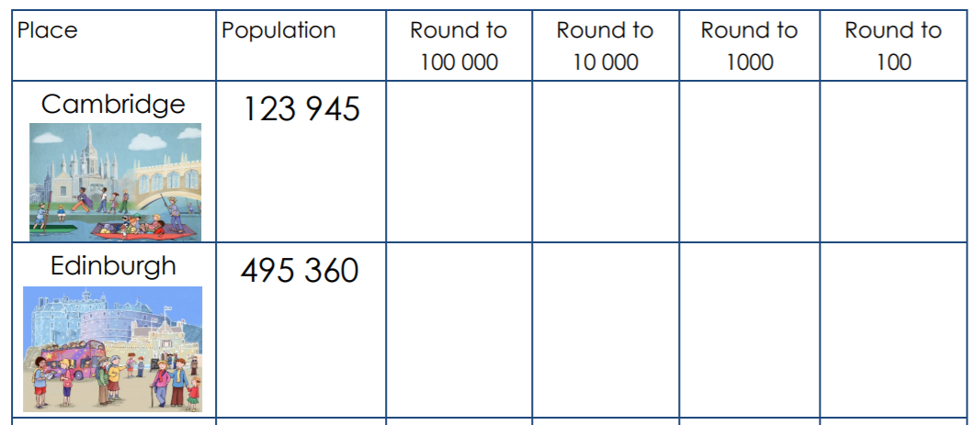
Pause the video to complete your task
Resume once you’re finished
What is the total approximate population of Cambridge and Edinburgh?

Slide 5
Pause the video to complete your task
Resume once you’re finished
Independent Task
Use rounding (n.m. 10 000 and 1000 ) to estimate the answers to the following:
563 219 + 144 832 =
623 914 + 182 453 =
791 201 + 128 522 =
612 733 + 335 029 =
Would you be more likely to round to the nearest 10 000 or 1000 when estimating? Why?

