Slide 1
Comparing and matching items based on the size and properties:
Lesson 4 of 4
Numeracy: Measurement - Building Understanding
James

Slide 2
Lesson Structure
Welcome!
Get your resources
Model
Activity

Slide 3
What am I learning today?
Objectives
To sort and organise items based on their size.
Vocabulary
big bigger
small smaller

Slide 4
For this lesson, you will need:
Recycling materials
Space to organise
Notes:
This can be anything that you have in your home

Slide 5
Let’s get ready
Find a quiet space to work away from distractions
Ensure that your learner is comfortable
Make sure your resources are nearby

Slide 6
Which is the big bottle?
Credit: Pixabay

Slide 7
Which is the bigger box?
Credit: Pixabay

Slide 8
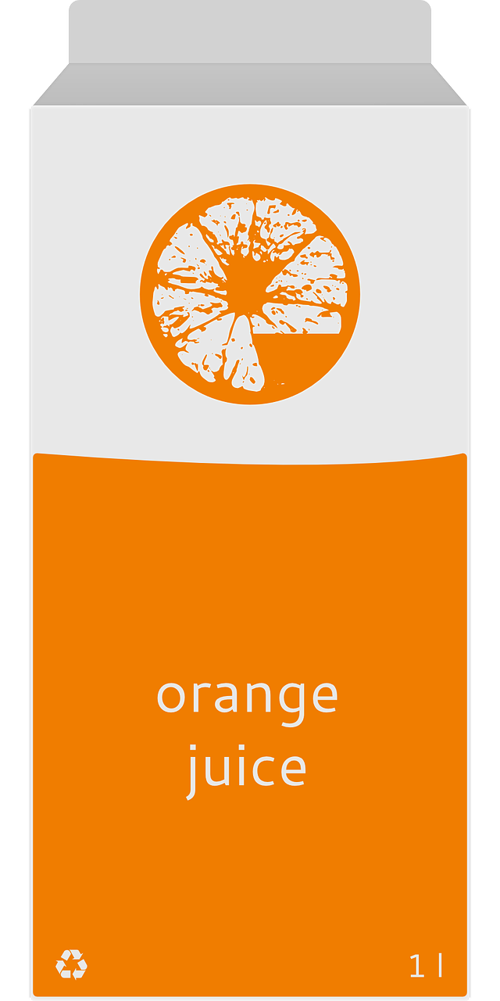
Which is the small carton?
Credit: Pixabay

Slide 9
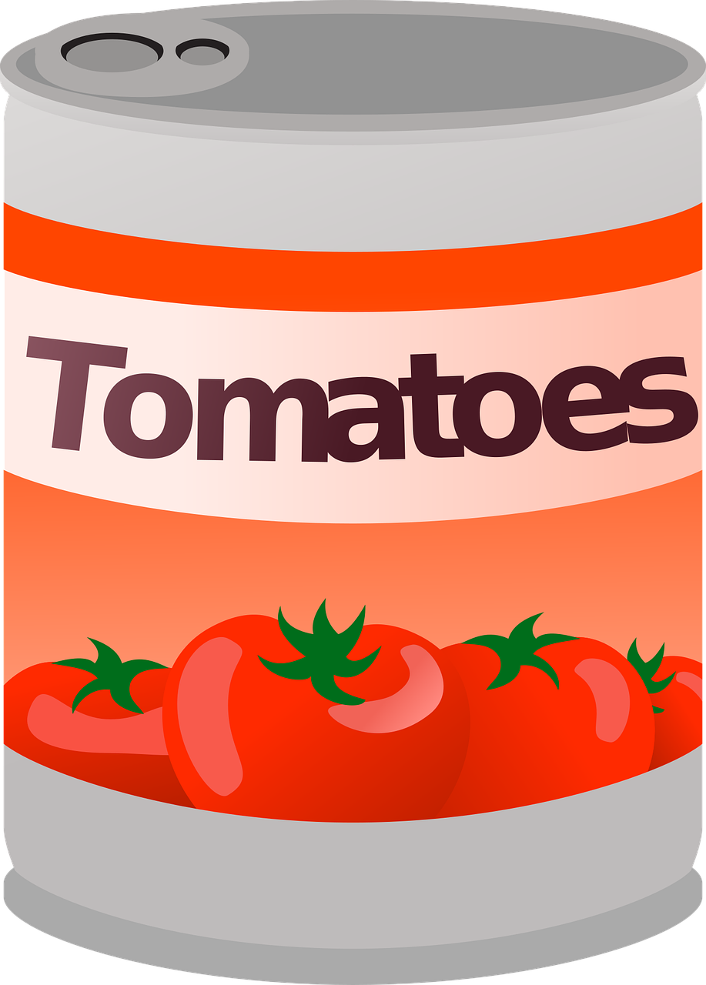
Which is the smaller tin?
Credit: Pixabay

Slide 10
Challenge: Sorting the recycling
Instructions:
When organising the recycling, can you sort the big and small items into two piles?
Can you put the big items at the bottom of the recycling and place the smaller ones around them when filling your containers?
Can you respond to the adjectives ‘big’ and ‘small’ to place items in the correct piles?

Slide 11
Measurement
Lesson 4: Comparing and matching items based on the size and properties
Make it easier
Make it harder
More ideas
Try comparing and sorting items with very obvious size differences to reinforce the terms ‘bigger’ and ‘smaller’.
Try comparing and sorting items which are closer in size.
Begin to include more measurement language to compare the size of items.
Help to organise kitchen cupboards - can you place the bigger items on the bottom?
Can you stack items appropriately? Make sure that smaller items go at the top of the stack.

Slide 12
Share your work with Oak National
If you'd like to, please ask your parent or carer to share your work on Instagram, Facebook or Twitter tagging @OakNational and #LearnwithOak

