Slide 1
Furthering Problem Solving Strategies
Mathematics
Lesson 10 of 10
Ms.Dobrowolski

Slide 2
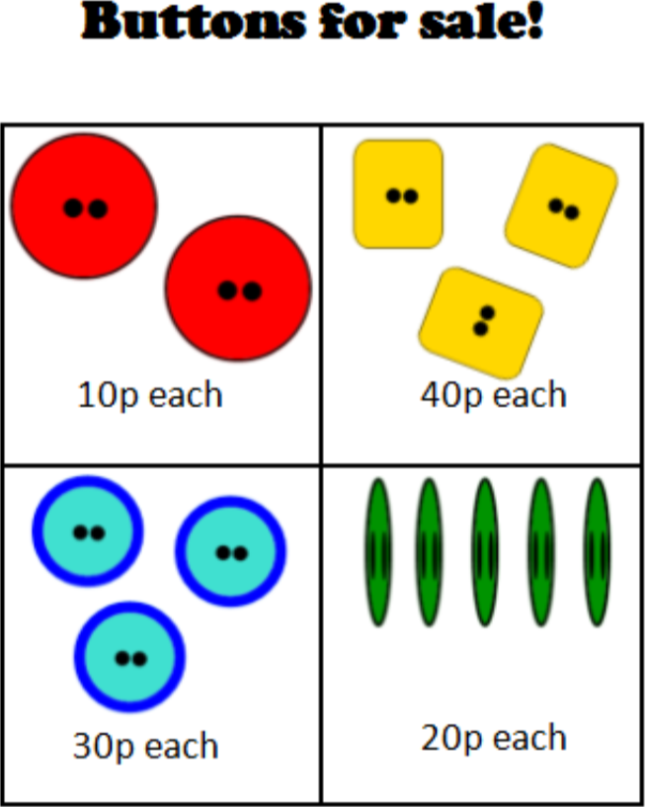
Independent task
George had 50p.
George’s mum gave him an extra 10p to spend at Morrissums.
How much money does he have altogether?
What buttons can he buy now if he wants to spend all of his money?

