Slide 1
Find probabilities from a histogram
Maths
Miss Parnham

Slide 2
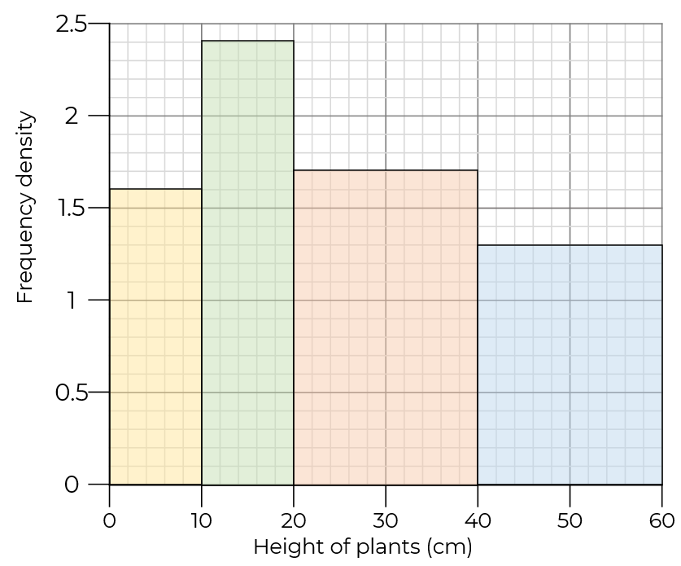
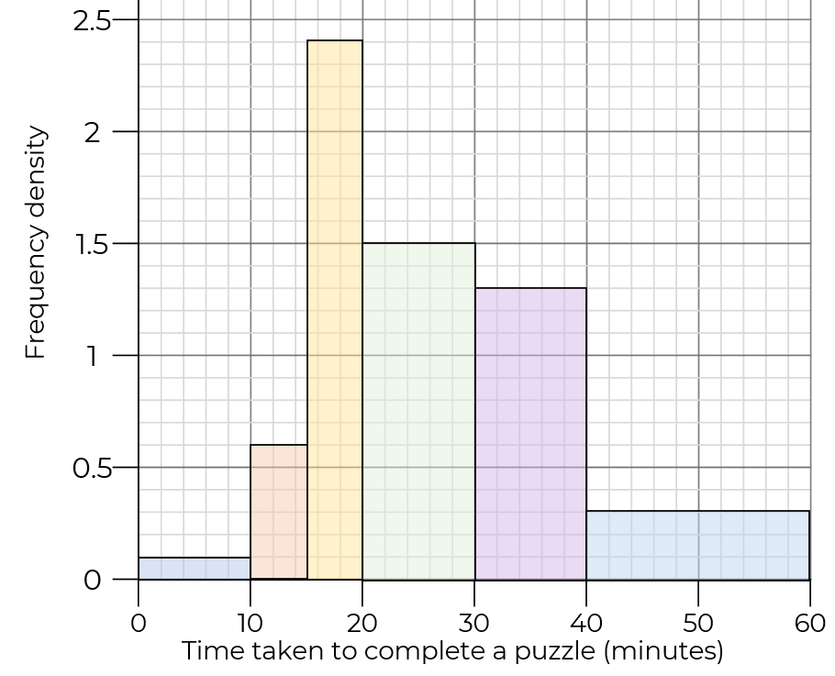
Find probabilities from a histogram
1. A plant is chosen at random. Find the probability it is under 20 cm tall.
2. A person is chosen at random, what is the probability that they took more than half an hour to solve the puzzle?

Slide 3
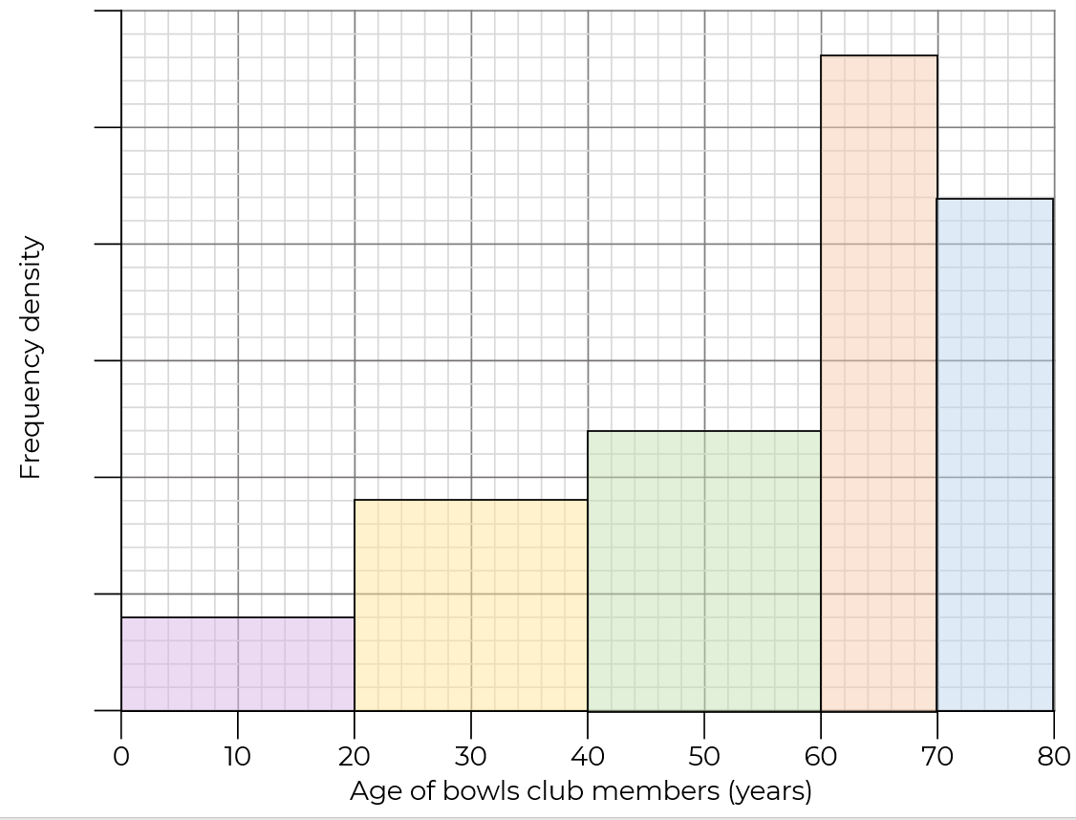
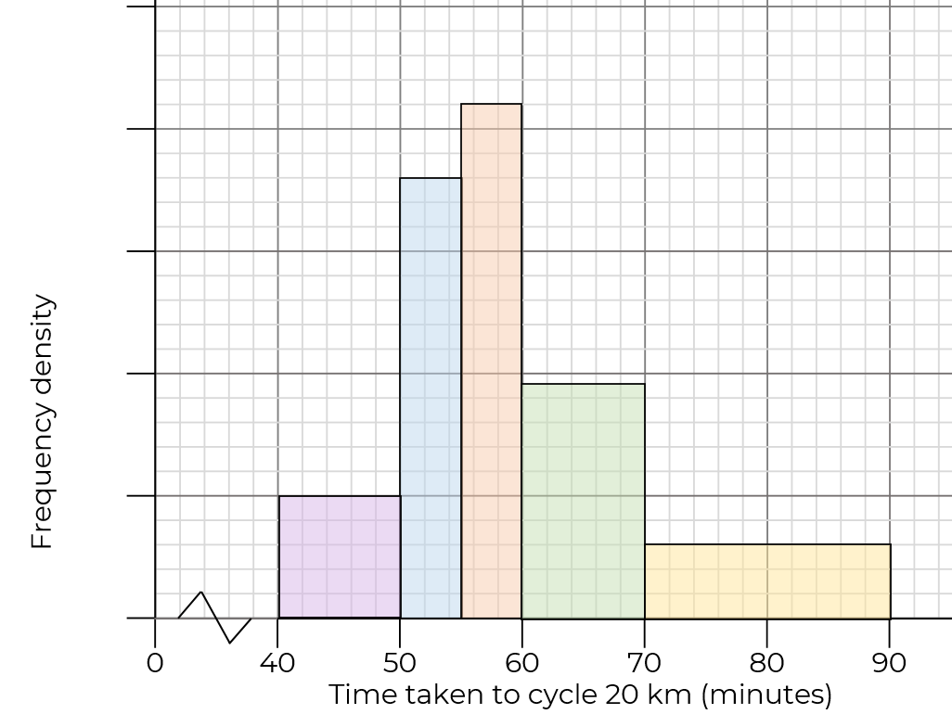
Find probabilities from a histogram
3. There are 28 members of the bowls club aged between 60 and 70
A person is chosen at random, what is the probability they are aged between 30 and 50?
4. 10 people completed the race in under 50 minutes. What is the probability a person took more than 65 minutes to cycle 20 km?

Slide 4
Answers

Slide 5
Find probabilities from a histogram
1. A plant is chosen at random. Find the probability it is under 20 cm tall.
2. A person is chosen at random, what is the probability that they took more than half an hour to solve the puzzle?
24
12
16
34
26
15
13
3
6
1

Slide 6
Find probabilities from a histogram
3. There are 28 members of the bowls club aged between 60 and 70
A person is chosen at random, what is the probability they are aged between 30 and 50?
4. 10 people completed the race in under 50 minutes. What is the probability a person took more than 65 minutes to cycle 20 km?
3
28
22
2
5
24
21
18
4
18
1
8
3
0
2
19
1
10
12
0

