Slide 1
Fractions of Quantities 2
Worksheet
Mathematics
Mr Kelsall

Slide 2
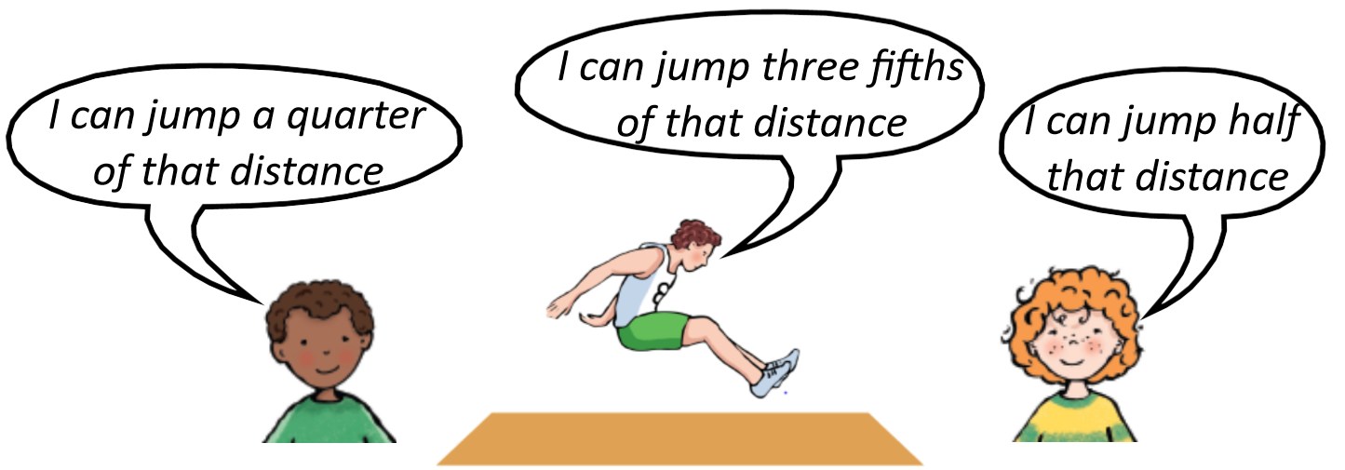
New learning: context
In the long jump, Jessica Ennis jumped a distance of 6 m 40 cm.

Slide 3
New learning: context

Slide 4
Develop learning: problems
On his first throw Alfie threw the javelin 38m.
After working hard on his throw, he was able throw half that distance again.
How far did he manage to throw the javelin?

Slide 5
Develop learning: problems
On his first try, Sven threw the shot put 10m 50cm.
After weeks of training he could throw a further of this distance.
How far did he throw the shot put?

Slide 6
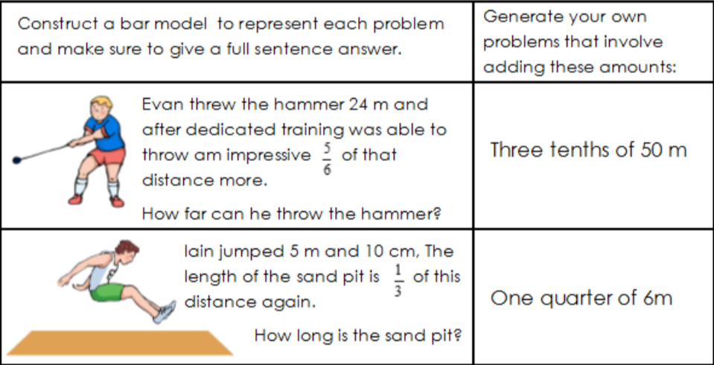
Independent task
Solve these questions.

Slide 7
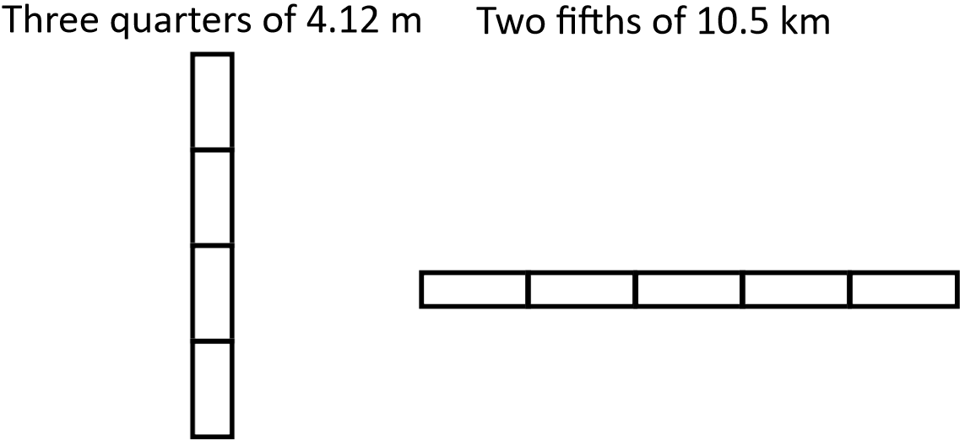
Independent task
Label the bar models and then calculate. Generate a word problem for each.

