Slide 1
Oak Specialist
Independent Living Unit 6- Staying Safe
Applying Learning

Slide 2
Unit 6- Staying Safe
Lesson 1 - Online Safety
Lesson 2 - Safety in the home
How can we stay safe online? What information should we share online?
What hazards are there at home? How can we minimise those hazards?
Option 3
Lesson 3 - Community safety
Option 4
Lesson 4 - Road safety
Who do we interact with during our day, and what do we share with them?
How can we make sure we are safe on the road? What precautions can we take?
Lesson 5 - Safety on transport
Option 3
Option 4
Lesson 6 - Safe relationships
Planning for safe travel on public transport.
Staying safe in close and intimate relationships.

Slide 3
Lesson 2 - Safety in the home

Slide 4
Unit 6 lessons contain safety messages and discussions around potentially sensitive topics. Please ensure all lessons are delivered by a parent/carer or teacher.

Slide 5
Teacher notes- Lesson 2
-Learning Intention: To understand what can be done to stay safe at home.
Look at the images of the home and discuss what hazards there are in each image.
Learners write down hazards they have in their home on the paper, in a spider diagram.
Next to each hazard, learners write what they can do to reduce each risk in their own home e.g. keep kitchen surfaces dry near toasters etc.
You will need: Pen, paper.
Notes:
This is the equivalent to a loose lesson plan/overview for teachers before starting the lesson.

Slide 6
Staying Safe
Safety in the home
Applying Learning

Slide 7
Lesson Activity Stages
Spot the hazards
Hazards in your home
How to make your home safe
Notes:
Talk through each of the activity stages, clearly stating what happens first, second and last.

Slide 8
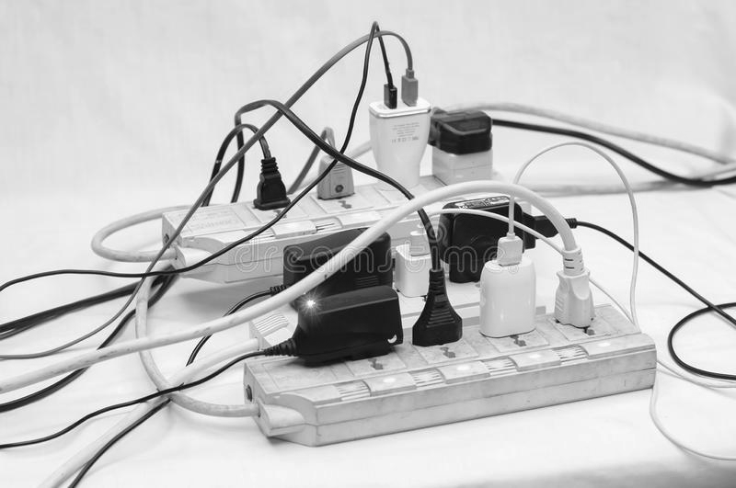
Can you find the hazards in these pictures?
Can you make them safer?
Notes:
Learners can label each of the hazards verbally, before they tell you how they would prevent them or reduce them.
Unplug some of the plugs.

Slide 9
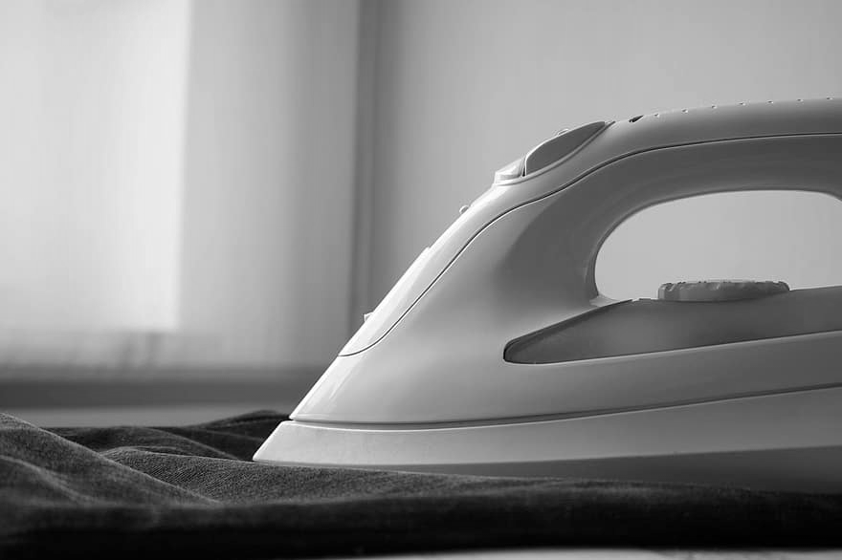
Can you find the hazards in these pictures?
Can you make them safer?
Notes:
Learners can label each of the hazards verbally, before they tell you how they would prevent them or reduce them..
Rest the iron on its base.

Slide 10
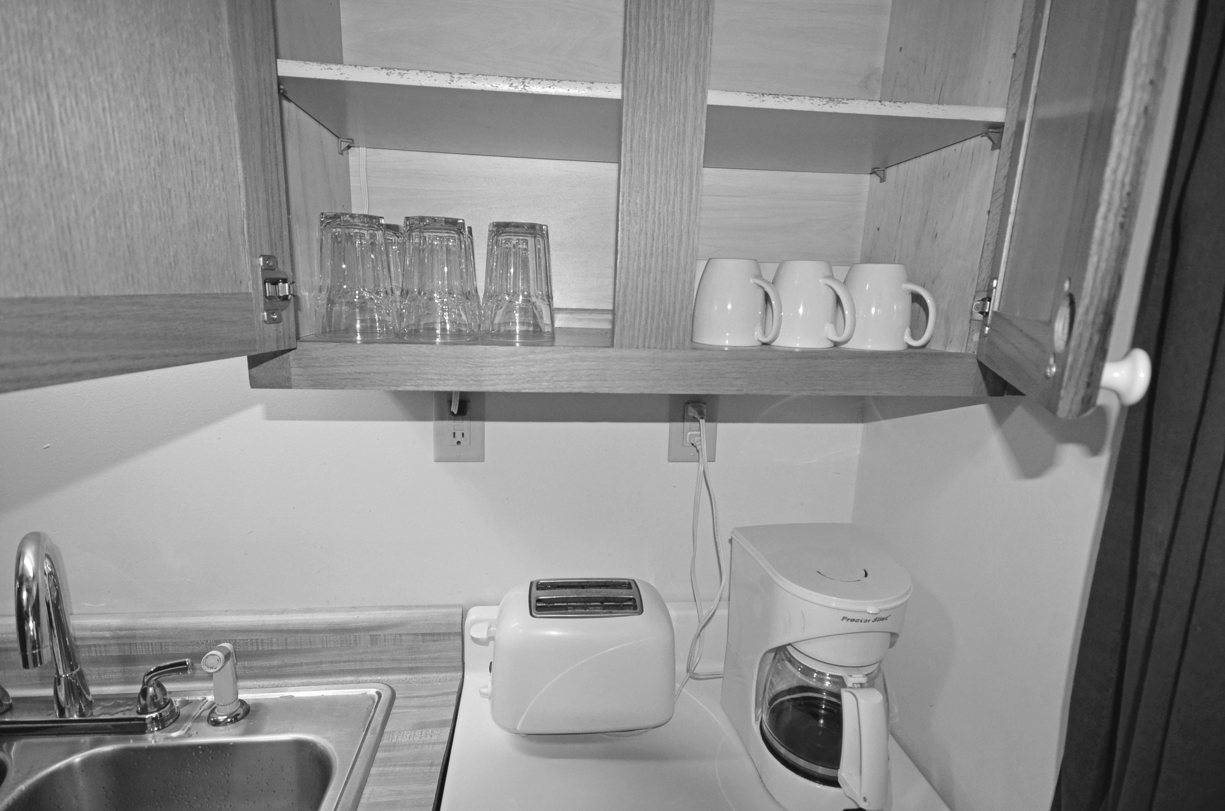
Can you find the hazards in these pictures?
Can you make them safer?
Notes:
Learners can label each of the hazards verbally, before they tell you how they would prevent them or reduce them.
Move the toaster away from the sink, perhaps swap with the coffee machine.

Slide 11
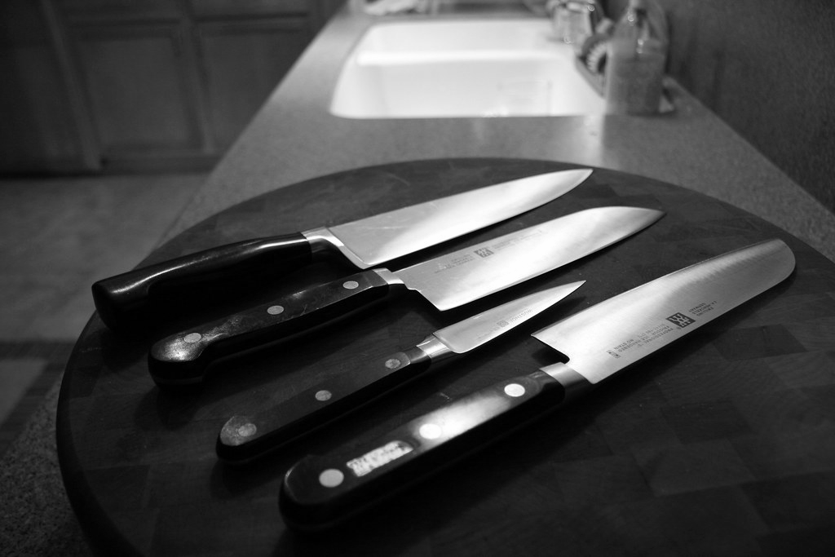
Can you find the hazards in these pictures?
Can you make them safer?
Notes:
Learners can label each of the hazards verbally, before they tell you how they would prevent them or reduce them.
Tidy the sharp knives away / be very careful when chopping / ask an adult to help chop.

Slide 12
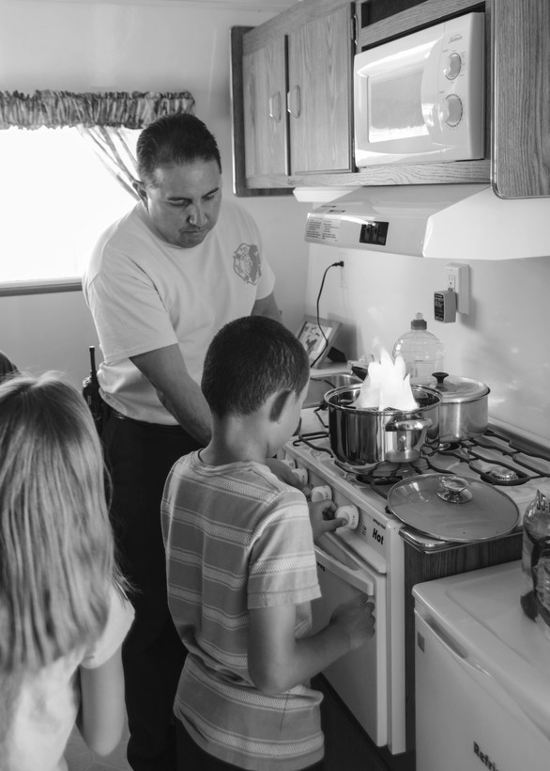
Can you find the hazards in these pictures?
Can you make them safer?
Notes:
Learners can Label each of the hazards verbally, before they tell you how they would prevent them or reduce them.
Fire in the pan - Make sure you have a fire alarm installed / Keep the kitchen calm and with few people when cooking.

Slide 13
Can you find the hazards in these pictures?
Can you make them safer?
Notes:
Learners can Label each of the hazards verbally, before they tell you how they would prevent them or reduce them.
Water on bathroom floor tiles - Make sure you dry the floor with a towel after washing.

Slide 14
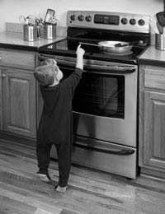
Can you find the hazards in these pictures?
Can you make them safer?
Notes:
Learners can Label each of the hazards verbally, before they tell you how they would prevent them or reduce them.
Child in the kitchen - Make sure children are never alone in the kitchen / Keep hot pans on the hob rings furthest away from the edge.

Slide 15
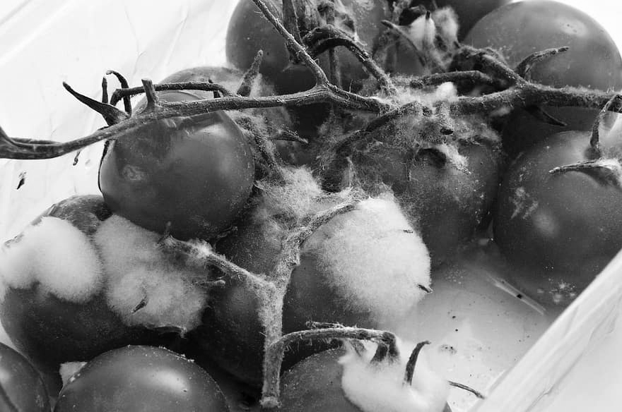
Can you find the hazards in these pictures?
Can you make them safer?
Notes:
Learners can label each of the hazards verbally, before they tell you how they would prevent them or reduce them.
Mould on food or rotting food - Read instructions and sell by dates.

Slide 16
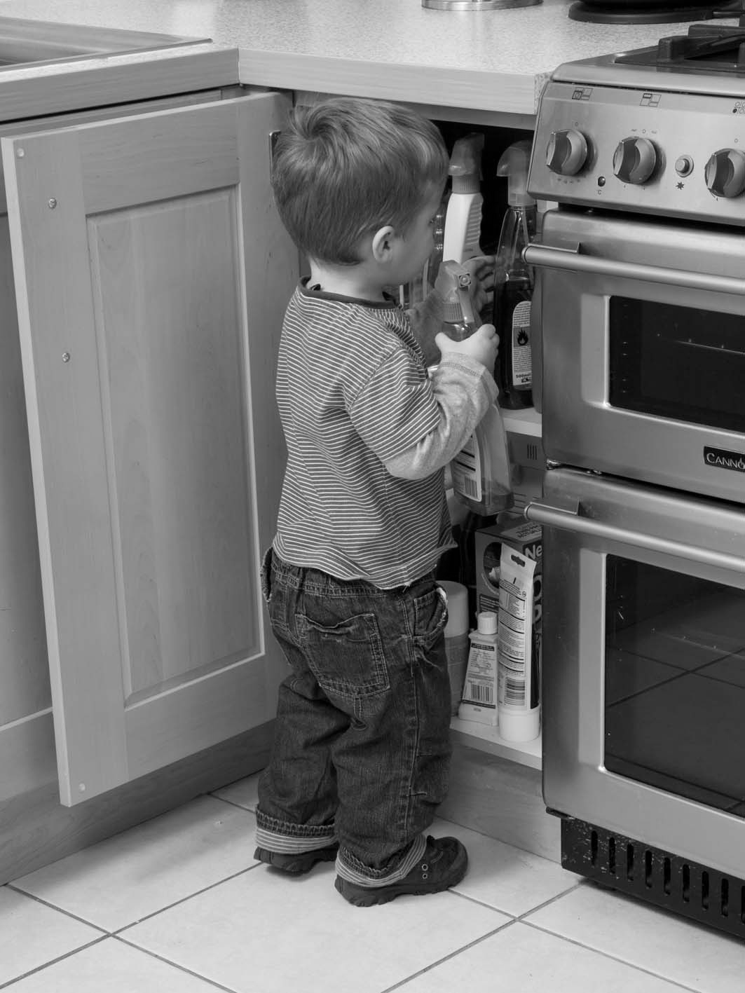
Can you find the hazards in these pictures?
Can you make them safer?
Notes:
Learners can label each of the hazards verbally, before they tell you how they would prevent them or reduce them.
Child looking at cleaning products - Check labels to see what items are hazardous / Put hazardous chemicals out of reach of young children.

Slide 17
Take a look around your home - what hazards can you see?

Slide 18
Make a spider diagram of hazards using your pen and paper.
Tripping on stairs
Wet plug sockets
Hazards at home
Wet bathroom floor
Sharp knives
Notes:
Here is a brief example of what the spider diagram could look like. The learner can use their pen and paper to write different hazards they see around their home. It would work best if they space out each hazard, as in the next section they will write how to prevent or limit the hazard next to each one.

Slide 19
How can you make it safer? Write down on your paper.
Dry hands before using plugs
Wet plug sockets
Tripping on stairs
Tidy up
Hazards at home
Chop slowly and carefully
Dry the floor after washing
Wet bathroom floor
Sharp knives
Notes:
Now is the chance for the learner to think about and discuss how the hazard could be prevented or reduced, before then writing it on their page next to the corresponding hazard.

Slide 20
Independent Living
Staying Safe
Safety in the home
Make it easier
Make it harder
More ideas
Take photos of hazards at home
Take photos of how the hazard has been made safer
Make a safety leaflet with pictures - ‘Staying safe at home’
Research who to call or what to do in an emergency e.g. fire service if there’s a fire
Draw a picture of a room with lots of hazards in it
Notes:
Read through the different ways the session could be made easier, harder, as well as some more ideas for the session.

Slide 21
Further Learning with Oak National
Independent Living:
Applying Learning- Using the kitchen safely (Unit 1)
Notes:
Insert info for subject/lesson name/stage (if appropriate)

Slide 22
References
Slide 8- Many electrical cords connected to a single power strip or extension block, Roland Mayo, Dreamstime
Slide 9- Iron, Pikist
Slide 10- Kitchen cabinets cups coffee maker toaster sink cabin 14 Douthat State Park Virginia (28029414370), Vastateparksstaff, Wikimedia Commons
Slide 11- A Sharp Knife Is A Safe Knife, Tracy27, Flickr Attribution-NonCommercial-NoDerivs 2.0 Generic (CC BY-NC-ND 2.0)
Slide 12- Fire prevention week, Rebecca Amber, Edwards Air Force Base
Slide 13- Wet floor, Pxhere
Slide 14- Child Safety Around Household Appliances, Denise Tyler, Safe Kids
Slide 15- Mouldy tomatoes, Pikist
Slide 16- Hidden Dangers at Home: Chemicals, Hend Fathy, Eye on Science

