Slide 1
Mathematics
Comparing algebraic and graphical methods for solving simultaneous equations
Independent Task
Ms Jones

Slide 2
Solve the following simultaneous equations using an algebraic method.

Slide 3
Solve the following simultaneous equations algebraically and graphically:
y = 4x - 1 and y = -x + 4
x + y = 10 and y = 5x - 2
y - 2x = 1 and y + 4x = 5
Why do y = -4x + 5 and y + 4x = 12 have no solution when solved simultaneously?

Slide 4
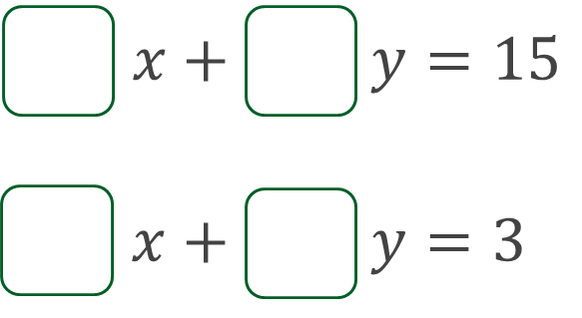
What could the coefficients of x and y be in each equation to make the point of intersection (3,-2)?

