Slide 1
Comparing what you do now with what you used to do (Part 1/2)
Using the perfect tense and comparing with the present
Downloadable Resource
German
Herr Scales

Slide 2
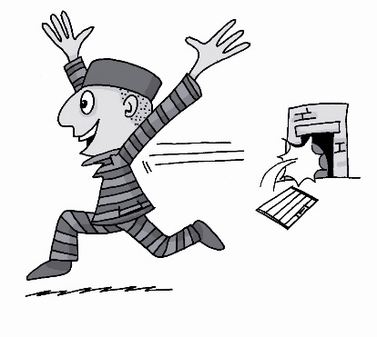
ei
leider
ein
[unfortunately]
/a
frei
klein
allein
sein
[to be]
Rachel Hawkes
Notes:
Introduce and elicit the pronunciation of the individual SSC ‘ei’ and then the source word again (with gesture, if using). Then present and elicit the pronunciation of the five cluster words. The cluster words have been chosen for their high-frequency, from a range of word classes, with the SSC (where possible) positioned within a variety of syllables within the words (e.g. initial, 2nd, final etc.). Additionally, we have tried to use words that build cumulatively on previously taught SSCs (see the Phonics Teaching Sequence document) and do not include new SSCs. Where new SSCs are used, they are often consonants which have a similar symbol-sound correspondence in English.
Word frequency rankings (1 is the most common word in German): frei [318]; leider [642] ein [5]; klein [114]; sein [3]; allein [258]. Source: Jones, R.L. & Tschirner, E. (2006). A frequency dictionary of German: core vocabulary for learners. Routledge

Slide 3
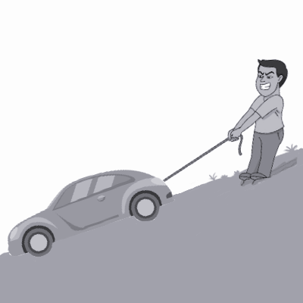
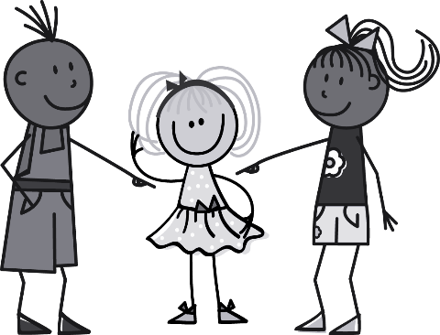
ie
ziehen
sie
Liebe
tief
Brief
liegen
2000 Kilometer
Rachel Hawkes
Notes:
Introduce and elicit the pronunciation of the individual SSC ‘ie’ and then the source word again (with gesture, if using). Then present and elicit the pronunciation of the five cluster words. The cluster words have been chosen for their high-frequency, from a range of word classes, with the SSC (where possible) positioned within a variety of syllables within the words (e.g. initial, 2nd, final etc.). Additionally, we have tried to use words that build cumulatively on previously taught SSCs (see the Phonics Teaching Sequence document) and do not include new SSCs. Where new SSCs are used, they are often consonants which have a similar symbol-sound correspondence in English.
Word frequency rankings (1 is the most common word in German): Liebe [843]; ziehen[266] sie [10]; tief [506]; liegen [118]; Brief [813]. Source: Jones, R.L. & Tschirner, E. (2006). A frequency dictionary of German: core vocabulary for learners. Routledge

Slide 4
[ei] [ie]
Bein
dein
Wein
leg
your
wine
Biene
Dienstag
Wien
bee
Tuesday
Vienna

Slide 5
[ei] [ie]
bleiben
schreiben
leihen
to stay
to write
to lend
geblieben
geschrieben
geliehen
stayed
wrote
lent

Slide 6
Ein Zungenbrecher!
Wiener Weiber wollen Weißwein aus Wien!

Slide 7
erklären | to explain
erlauben | to allow
erzählen | to tell (stories)
sich sonnen | to sunbathe
helfen | to help
tragen | to wear/carry
schreiben | to write
schicken | to send
draußen | outside
drinnen | inside

Slide 8
For most verbs, it is best to use the perfect tense when putting them into the past tense
Remember, the perfect tense has two parts; the auxiliary verb(haben or sein) plus the past participle, which goes to the end of the clause
To form the past participle of a regular verb, you take the infinitive, take off the -en and add ge to the front and t to the end
schicken(to send)
schick
geschickt
spielen (to play)
spiel
gespielt

Slide 9
For reflexive verbs, don't forget to change the reflexive pronoun
In this lesson we have sich sonnen = to sunbathe
Present tense: Ich sonne mich = I sunbathe
Perfect tense: Ich habe mich gesonnt = I sunbathed
And some verbs have separable prefixes eg. aufwachen= to wake up
These verbs have a sandwich style past participle with ge in the middle
Ich bin um 7 Uhr aufgewacht = I woke up at 7 am

Slide 10
However, not all verbs follow this pattern
For example, verbs with infinitives that begin be, er, ent, emp, ver, zer, miss do not add ge to the front. In this lesson, we have some verbs with infinitives beginning with er
To form the past participle of these verbs, you take the infinitive, take off the -en, but do not add ge to the front. Just add t to the end
erklärt
erklären (to explain)
erklär
erzählen (to tell)
erzähl
erzählt

Slide 11
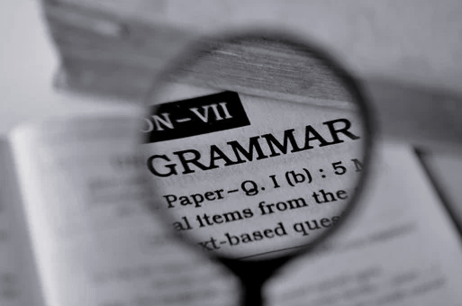
And some verbs, known as strong verbs, are completely irregular!
In this lesson we have bleiben = to stay, gehen = to go, fahren = to travel, sehen = to see, kommen = to come, essen = to eat, trinken = to drink lesen = to read helfen = to help tragen = to wear schreiben = to write
There are unfortunately no shortcuts, these verbs need to be learnt by heart...😓 Check your textbook or a grammar reference book. The past participles for the strong verbs used in this lesson are as follows:

Slide 12
bleiben | geblieben*
schreiben | geschrieben
helfen | geholfen
essen | gegessen
trinken | getrunken
tragen | getragen
lesen | gelesen
sehen | gesehen
fahren | gefahren*
gehen | gegangen*
*Takes sein as auxiliary verb!

Slide 13
So, as you have seen, a number of verbs take "sein" as their auxiliary verb, instead of "haben". Most verbs showing movement from one place to another do this, but the safest thing is to learn by heart 😓 which verbs will take sein!
ich (I)
du (you)
er/sie/es/man(he/she/it/one)
bin
bist
ist
The wir(we), sie(they) and Sie(you) forms are identical
wir (we)
sie (they)
Sie (you)
sind
sind
sind
z.B. Ich bin nach London gefahren = I travelled to London
Wir sind nach London gefahren = We travelled to London

Slide 14
Here is a quick reminder of the present tense of "haben"
ich (I)
du (you)
er/sie/es/man(he/she/it/one)
habe
hast
hat
The wir(we), sie(they) and Sie(you) forms are identical!
wir (we)
sie (they)
Sie (you)
haben
haben
haben
z.B. Ich habe Bücher gelesen = I read books
Wir haben Bücher gelesen = We read books

Slide 15
Adverbs of time and manner can be added to sentences in the perfect tense as follows:
Ich habe früher Tennis gespielt.
subject
auxiliary
verb
adverb
object
past participle
I have played previously tennis.
verb
verb
subject
auxiliary verb
past participle
adverb
object
= I used to play tennis

Slide 16
Just as with the present tense, you can start with the adverb
Früher habe ich Tennis gespielt.
adverb
auxiliary
verb
subject
object
past participle
Previously have I played tennis.
verb
verb
adverb
auxiliary verb
subject
past participle
object
= I used to play tennis

Slide 17
Summary of learning
In German, perfect tense is normally formed using using the auxiliary verb ( or ) plus the past participle. The past participle goes
sein
haben
to the end
Verbs with infinitives beginning with be, er, ent, emp, ver, zer, miss do not add ge to the front eg. erklären
erklärt
Most verbs showing movement from one place to another take _______ as their auxiliary verb. But this is also true of some verbs which do not show movement eg. bleiben
sein
to stay
Strong verbs are irregular and have to be
learnt by heart

