Slide 1
How can we successfully create rhythmic music without instruments?
Music Unit 1 Lesson 7
Miss Al-Hanoush

Slide 2
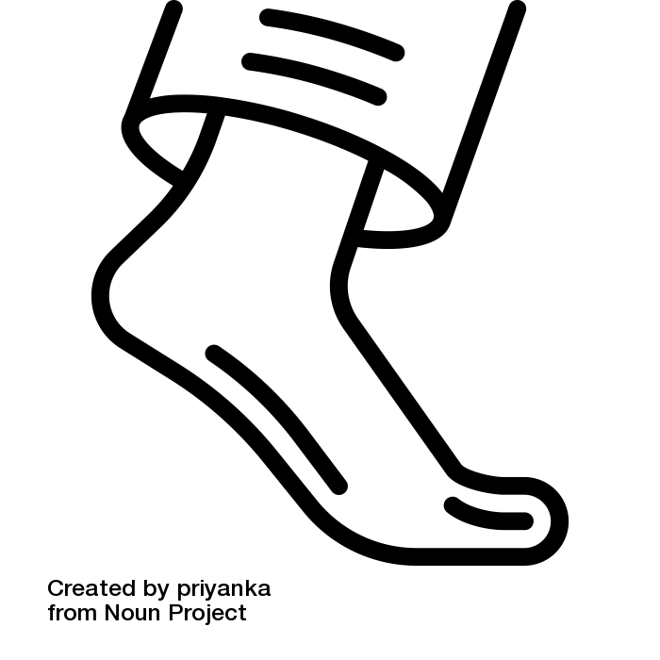
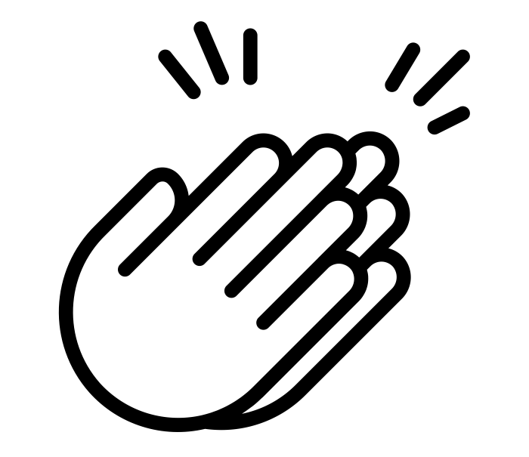
Intro / outro example
1 | 2 | 3 | 4 | 5 | 6 | 7 | 8
9 | 10 | 11 | 12 | 13 | 14 | 15 | 16

Slide 3
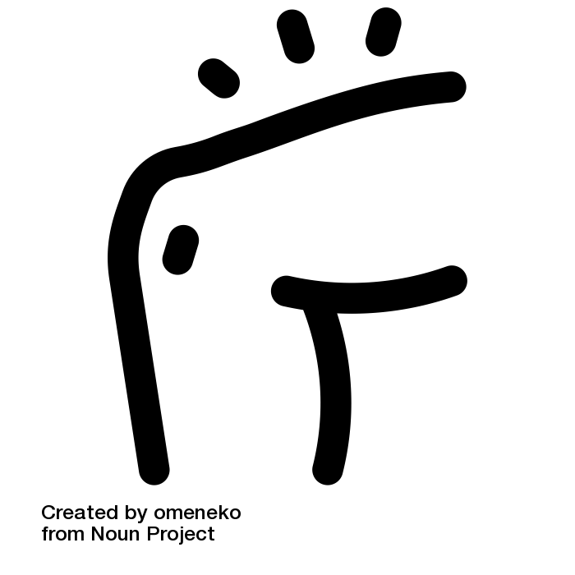
Body Groove example
1 | 2 | 3 | 4 | 5 | 6 | 7 | 8

Slide 4
Intro / outro
1 | 2 | 3 | 4 | 5 | 6 | 7 | 8
9 | 10 | 11 | 12 | 13 | 14 | 15 | 16

Slide 5
Body Groove
1 | 2 | 3 | 4 | 5 | 6 | 7 | 8

Slide 6
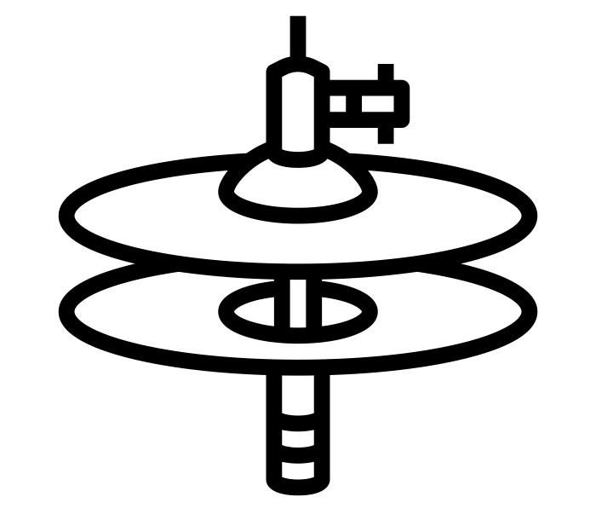
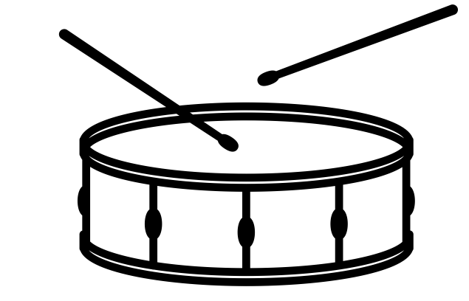
Vocal Groove example
P |  | P
T | TT | T | TT
 | K |  | K
1 + | 2 + | 3 + | 4 +
Notes:
Here is an example, this time I’ve added extra hi-hat sounds
This is how it sounds now.
Try this on your own

Slide 7
Vocal Groove
1 + | 2 + | 3 + | 4 +
Notes:
Here is an example, this time I’ve added extra hi-hat sounds
This is how it sounds now.
Try this on your own

Slide 8
Performing a vocal and body percussion piece
Structuring your performance
Intro
Body Groove
Vocal Groove
Outro

Slide 9
References
Slide [2, 3] - [The Noun Project] - [Berkah Icon] - [clap]
Slide [2, 3] - [The Noun Project] - [priyanka] - [foot]
Slide [3] - [The Noun Project] -[omeneko] - [thigh]
Slide [6, 7] - [The Noun Project] - [Creaticca Creative Agency] - [bass drum]
Slide [6, 7] - [The Noun Project] - [Marta Ambrosetti] - [Snare Drum]
Slide [6, 7] - [The Noun Project] - [mynamepong] - [Hi-hat cymbal]

