Slide 1
Bar charts
Maths
Miss Davies

Slide 2
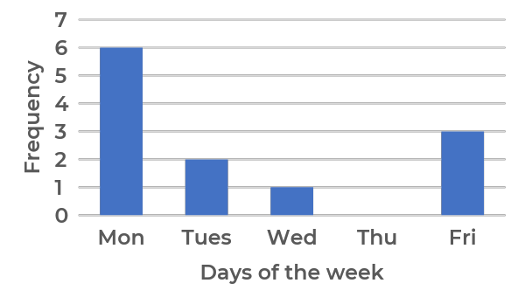
Bar charts
1. Harry recorded how often each of the members of his gym visited his gym last week in this frequency table. Draw a bar chart to represent this data.
2. Claire recorded how many students were late to school in her class each day. This is a bar chart of her results.
What is the total number of lates?
What day is the mode?
Why do you think this is?
Number of visits | Frequency
0 | 9
1 | 10
2 | 6
3 | 7
4 | 8
5 | 6
6 | 5
7 | 1
‹#›

Slide 3
Answers

Slide 4
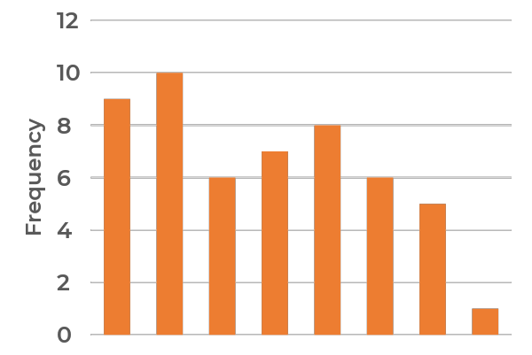
Bar charts
2. Claire recorded how many students were late to school in her class each day. This is a bar chart of her results.
What is the total number of lates?
What day is the mode?
Why do you think this is?
1. Harry recorded how often each of the members of his gym visited his gym last week in this frequency table. Draw a bar chart to represent this data.
12
Monday
0 1 2 3 4 5 6 7
Number of visits
Students do not sleep well on Sunday
‹#›

