Slide 1
Combined Science - Chemistry - Key Stage 4
Atomic Structure & the Periodic Table
Mixtures, Filtration and Crystallisation
Dr Patel

Slide 2
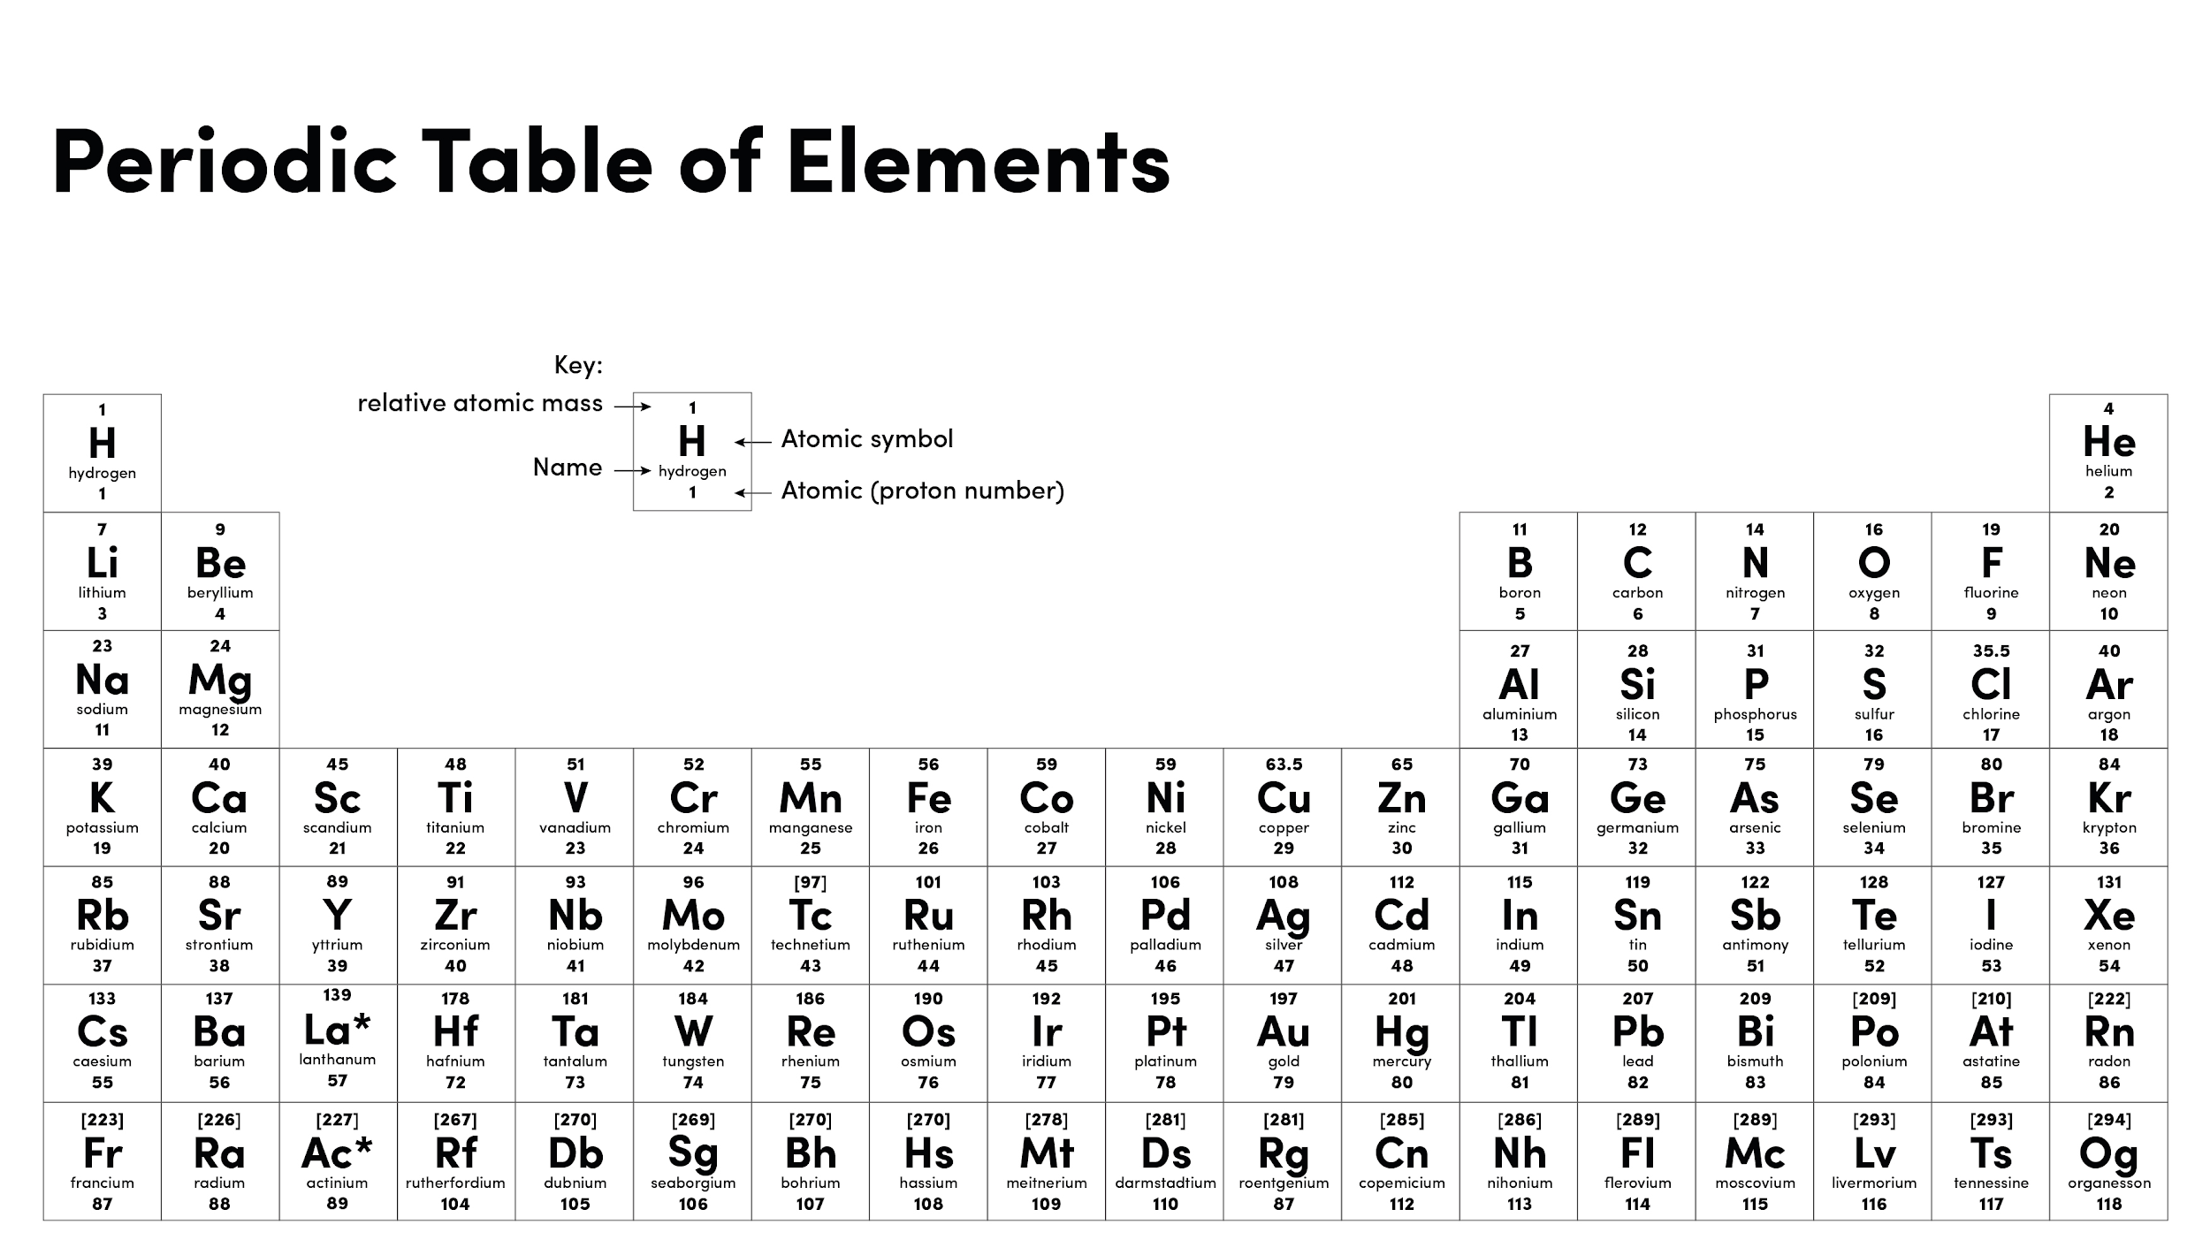

Slide 3
Warm up
What is a compound?
What is an element?
Name the process that happens when a liquid turns into a gas.

Slide 4
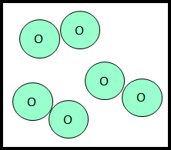
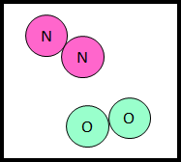
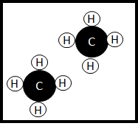
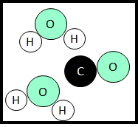
Independent task
Define the term mixture.
State the different type of mixtures you can get.
For each image below:
State whether the image represents a mixture or not.
Explain your answer (i.e. I know this because…)
Source of image: Dr Patel

Slide 5
Independent task - part 1
Copper sulfate is a blue soluble salt.
A student accidentally mixes copper sulfate with insoluble sand. Describe a method the student should use to separate the sand and copper sulfate. You must refer to the apparatus the student should use in your answer.
Dissolve
Place… into a….
Add...until….
Filter
Place…into...
Pour….into….until...
Crystalise
Pour...into…
Heat…. using...until

Slide 6
Independent practice - Part 2
Description of stage | Why it is needed/what it achieves
1.Filter the mixture using a filter funnel and paper
3.Carefully unfold the filter paper and put it in a drying oven
4.Pour the filtrate into an evaporating dish and place in the drying oven

