Slide 1
To share a total equally and find the number of groups
Independent Task
Maths
Miss Charlton, Mrs Bramble and Miss Sidhu

Slide 2
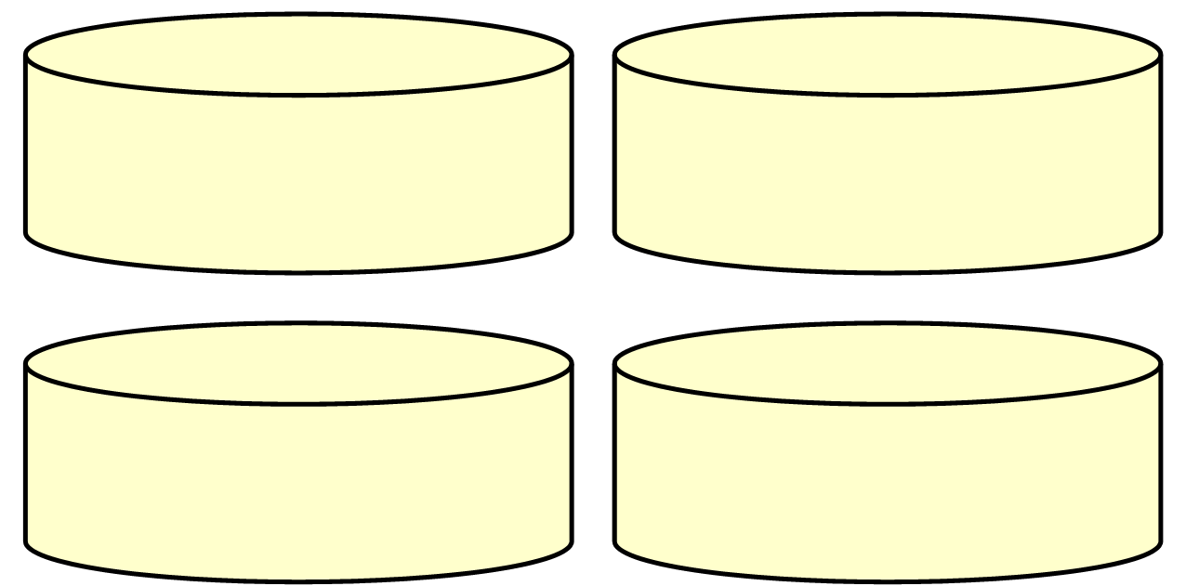
Independent Task cakes

Slide 3
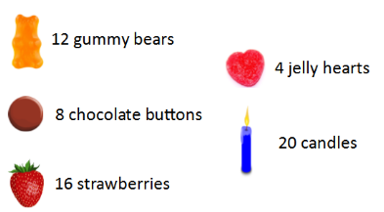
Independent Task 1 decorations

Slide 4
Independent Task 2 decorations

Slide 5
Independent Task 1 answers

Slide 6
Independent Task 2 answers
2 on each cake and 1 left over
4 on each cake and 3 left over
5 on each cake and 2 left over

Slide 7
Number line for support

