Slide 1
Exploring the value of pounds using coins and notes
Lesson 2 of 10
Mathematics
Ms.Dobrowolski

Slide 2
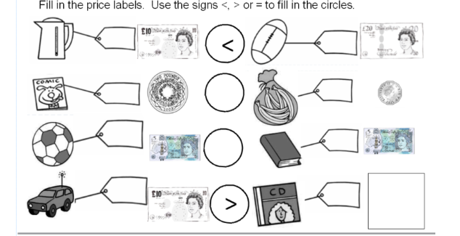
Independent Task

