Slide 1
Combined Science - Biology - Key stage 4
Ecology
Global Warming
Dr Clapp

Slide 2
Independent practice
Name the three main greenhouse gases.
What type of radiation is emitted from the sun (include the wavelength)?
What happens to the radiation from the sun when it reaches Earth?
How is the wavelength of the radiation emitted from the sun different from that reflected from the Earth’s surface?
What happens to the reflected radiation?
Notes:
Please pause the lesson here

Slide 3
Independent practice - answers
Name the three main greenhouse gases.
Carbon dioxide, methane and water vapour
What type of radiation is emitted from the sun (include the wavelength)?
Short wavelength infrared radiation
What happens to the radiation from the sun when it reaches Earth?
Some of it is absorbed by the Earth and some of it is reflected
Notes:
Please pause the lesson here

Slide 4
Independent practice - answers
4. How is the wavelength of the radiation emitted from the sun different from that reflected from the Earth’s surface?
The radiation reflected from the Earth’s surface has a longer wavelength than that emitted from the sun
5. What happens to the reflected radiation?
It gets trapped in the Earth’s atmosphere
Notes:
Please pause the lesson here

Slide 5
Independent practice
What is the human enhanced greenhouse effect?
Why is it difficult to make predictions about future climate change?
State two reasons why carbon dioxide levels are increasing.
State two reasons why methane levels are increasing.
Give two effects of global warming other than rising sea levels.
State a consequence of rising sea levels.
Notes:
Please pause the lesson here

Slide 6
Independent practice - answers
What is the enhanced greenhouse effect?
An increase in the greenhouse effect caused by rising levels of greenhouse gases (caused in turn by human activity)
Why is it difficult to make predictions about future climate change?
Because the global climate is very complex and lots of things are changing at once
State two reasons why carbon dioxide levels are increasing.
Burning fossil fuels/deforestation/burning peat

Slide 7
Independent practice - answers
4. State two reasons why methane levels are increasing.
Increased cattle farming and increased rice production
5. Give two effects of global warming other than rising sea levels.
Melting ice caps/more extreme weather/increased land and ocean temperatures
6. State a consequence of rising sea levels.
Loss of habitat

Slide 8
Exam question
ExamBuilder: OCR, B712/01, January 2013
This question is about the greenhouse effect and global warming.
Some scientists say that an increase in global warming is part of a natural cycle.
Other scientists think that an increase in global warming will be disastrous for the world. They think that the surface temperature of the Earth is increasing and that this is because more fossil fuels are being burned.
Burning fossil fuels makes a lot of carbon dioxide.
Look at the graphs.
They show how the amount of carbon dioxide in the air and the temperature of the Earth have changed over the last 160 000 years.
Notes:
Read through the text with the students

Slide 9
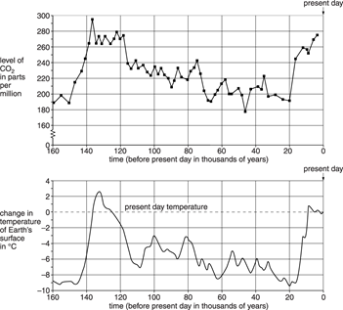
Exam question
ExamBuilder: OCR, B712/01, January 2013
Notes:
Talk through the graphs

Slide 10
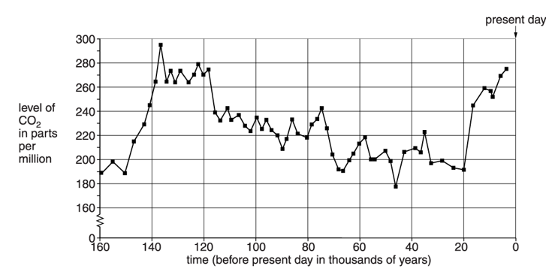
Exam question
ExamBuilder: OCR, B712/01, January 2013
Notes:
Larger copy of graph

Slide 11
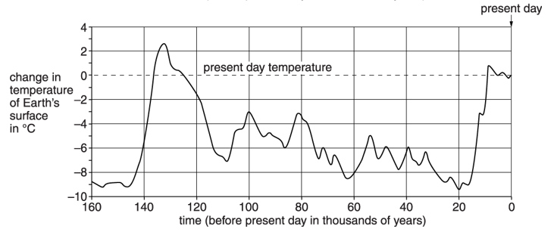
Exam question
ExamBuilder: OCR, B712/01, January 2013
Notes:
Larger copy of graph

Slide 12
Exam question - independent practice
ExamBuilder: OCR, B712/01, January 2013
ai. What is the highest level of carbon dioxide in the air during the last 160 000 years? [1]
aii. Describe what has happened to the surface temperature of the Earth in the last 160 000 years. [2]
aiii. Is there a link between the surface temperature of the Earth and the level of carbon dioxide in the air? Explain your answer. Use information from the graphs. [2]
Notes:
Please pause the lesson here

Slide 13
Exam question - answers
ExamBuilder: OCR, B712/01, January 2013
ai. What is the highest level of carbon dioxide in the air during the last 160 000 years? [1]
292-298 parts per million
Notes:
Please pause the lesson here

Slide 14
Exam question - answers
ExamBuilder: OCR, B712/01, January 2013
aii. Describe what has happened to the surface temperature of the Earth in the last 160 000 years. [2]
Any two from:
Initially the temperature increased up to 130,000
Between 130,000 and 20,000 the temperature fell
Gradual increase from 20,000 to the current time
Notes:
Please pause the lesson here

Slide 15
Exam question - answers
ExamBuilder: OCR, B712/01, January 2013
aiii. Is there a link between the surface temperature of the Earth and the level of carbon dioxide in the air? Explain your answer. Use information from the graphs. [2]
Yes, as carbon dioxide levels increase so does temperature (1) and the peaks mostly coincide (1)
OR
There is no direct link (1) because the peaks do not coincide exactly (1)
Notes:
Please pause the lesson here

Slide 16
Exam question
ExamBuilder: OCR, B712/01, January 2013
Look at the table. It shows the carbon dioxide emissions for some countries in 2003.
It also shows the population for these countries in 2003.

Slide 17
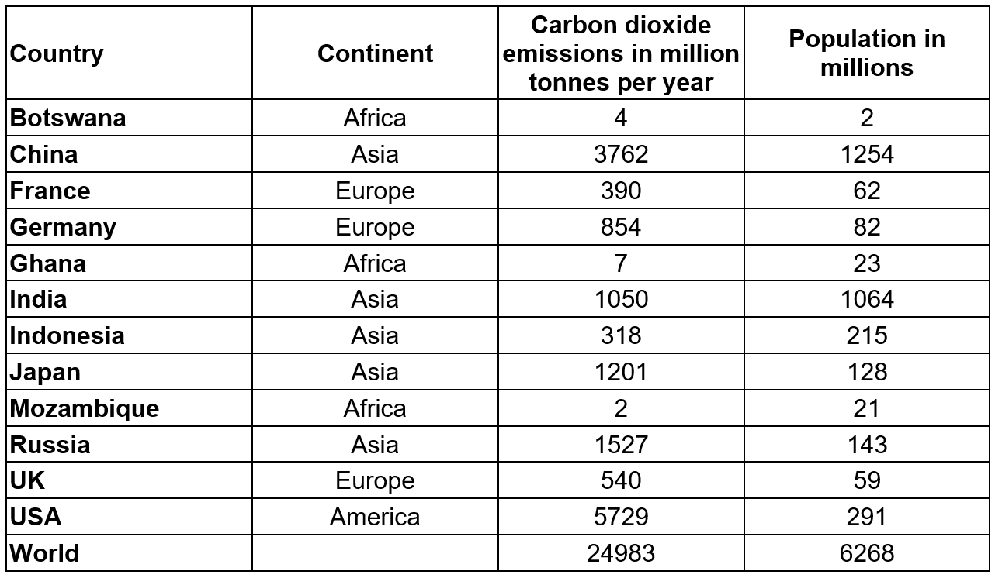
Exam question
ExamBuilder: OCR, B712/01, January 2013

Slide 18
Exam question - independent practice
ExamBuilder: OCR, B712/01, January 2013
bi. Which three countries had the lowest carbon dioxide emissions in 2003? Suggest why. [2]
bii. Show that the percentage of the world emissions of carbon dioxide in 2003 made by the USA was 22.9%. [1]
biii. In 2003, about 4.6% of the world’s population lived in the USA. 22.9% of the world's emissions of carbon dioxide came from the USA. Some other countries are concerned about the difference between these two percentages. Suggest why. [2]
Notes:
Please pause the lesson here

Slide 19
Exam question - answers
ExamBuilder: OCR, B712/01, January 2013
bi. Which three countries had the lowest carbon dioxide emissions in 2003? Suggest why. [2]
Botswana, Ghana and Mozambique (1)
They are all developing (poor) countries/they have the lowest populations (1)

Slide 20
Exam question - answers
ExamBuilder: OCR, B712/01, January 2013
bii. Show that the percentage of the world emissions of carbon dioxide in 2003 made by the USA was 22.9%. [1]
(5729 ÷ 24983) x 100 = 22.9%

Slide 21
Exam question - answers
ExamBuilder: OCR, B712/01, January 2013
biii. In 2003, about 4.6% of the world’s population lived in the USA. 22.9% of the world's emissions of carbon dioxide came from the USA. Some other countries are concerned about the difference between these two percentages. Suggest why. [2]
any two from:
idea that USA uses more than its fair share of resources (1)
idea that they produce more pollution than they should (1)
idea that they have a relatively low population (compared to the emissions) (1)
USA should contribute 4.6% of carbon dioxide emissions (1)

