Slide 1
Reading and writing the time to o’clock
Mathematics
Mrs Bramble and Miss Sidhu

Slide 2
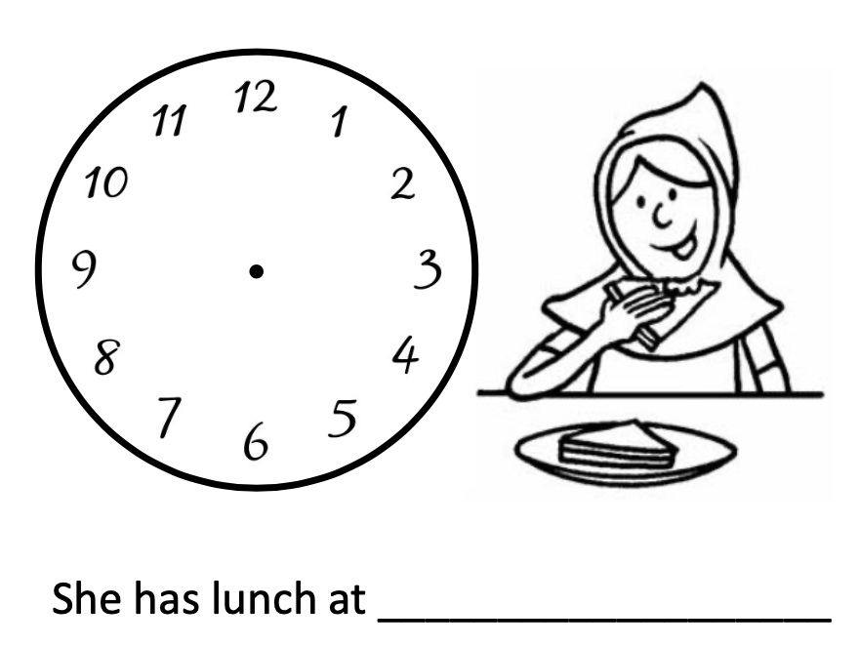

Slide 3
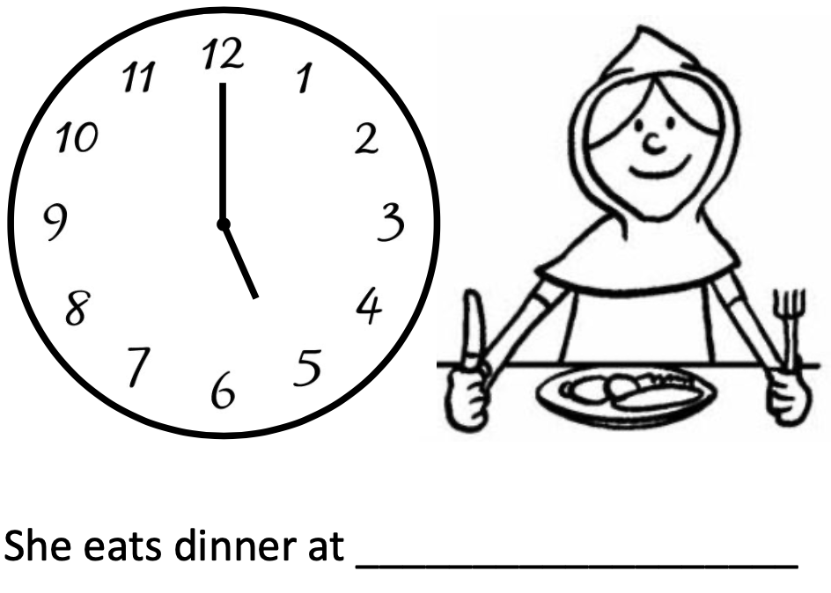

Slide 4
