Slide 1
Angles
Downloadable Resource – Exploring intersections.
Mathematics
Mr. Thomas

Slide 2
Try this
A
A quadrilateral with two pairs of parallel sides.
B
A pentagon with two pairs of parallel sides.
C
A triangle with one pair of parallel sides.
D
A hexagon with exactly three parallel sides.

Slide 3
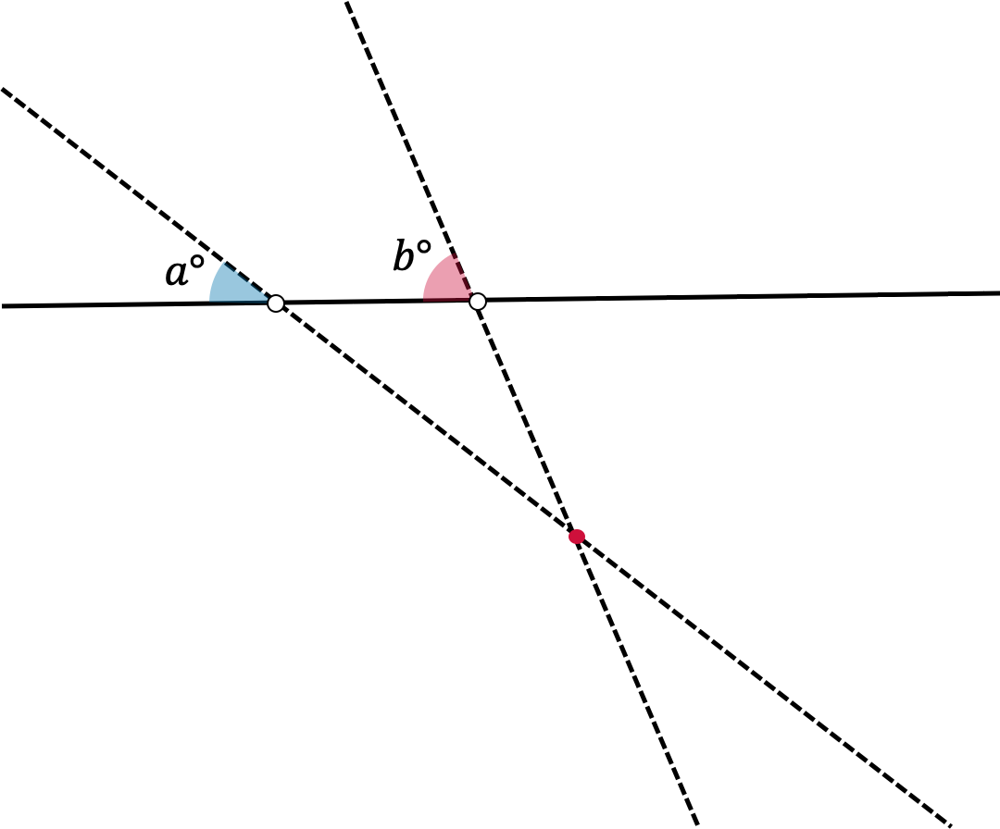
Connect
Parallel lines are defined as lines that do not intersect.
Sketch different examples of diagrams for each of the other two cases:
In which of the cases are the lines parallel?

Slide 4
Connect
Parallel lines are defined as lines that do not intersect.
Sketch different examples of diagrams for each of the other cases:
In which of the cases are the lines parallel?

Slide 5
Connect
Parallel lines are defined as lines that do not intersect.
Sketch different examples of diagrams for each of the other cases:
In which of the cases are the lines parallel?

Slide 6
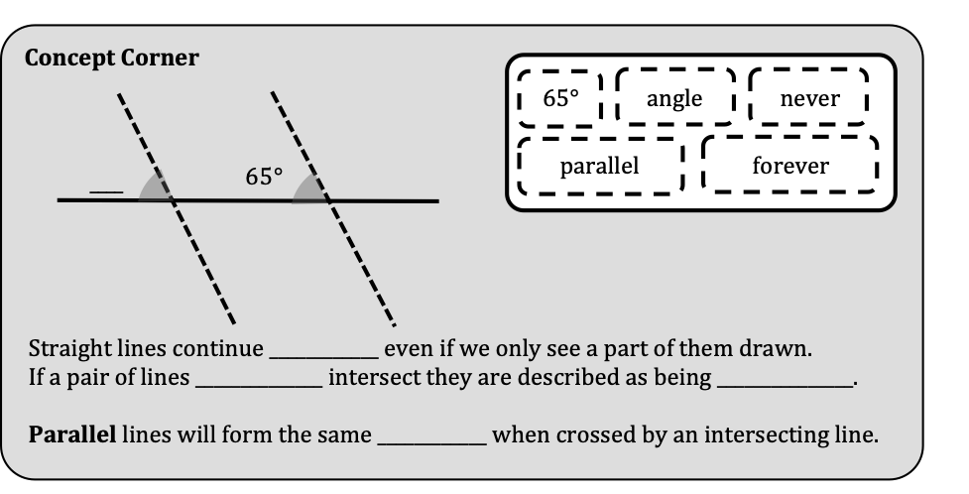
Fill in the blanks for the following exercise. You may want to go back in the video for some help.
Independent Task

Slide 7
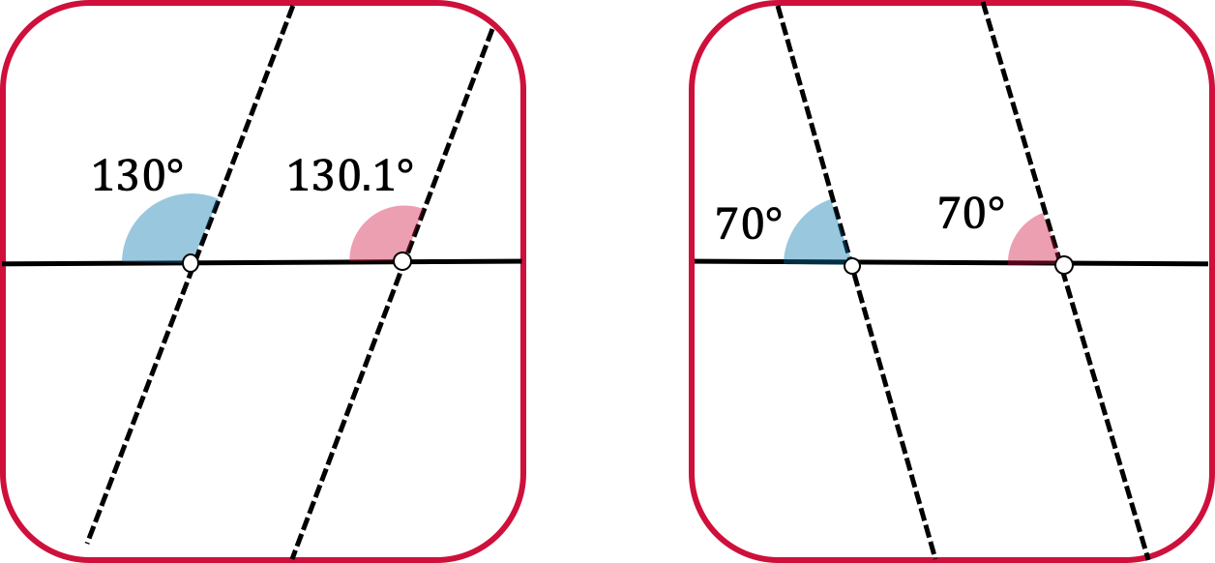
Explore
Decide whether each of the pairs of lines will intersect or not. If they do intersect, describe their point of intersection.

