Slide 1
Review Lesson
Triple
Triple - Chemistry - Key Stage 4
Quantitative Chemistry
Mrs Begum

Slide 2
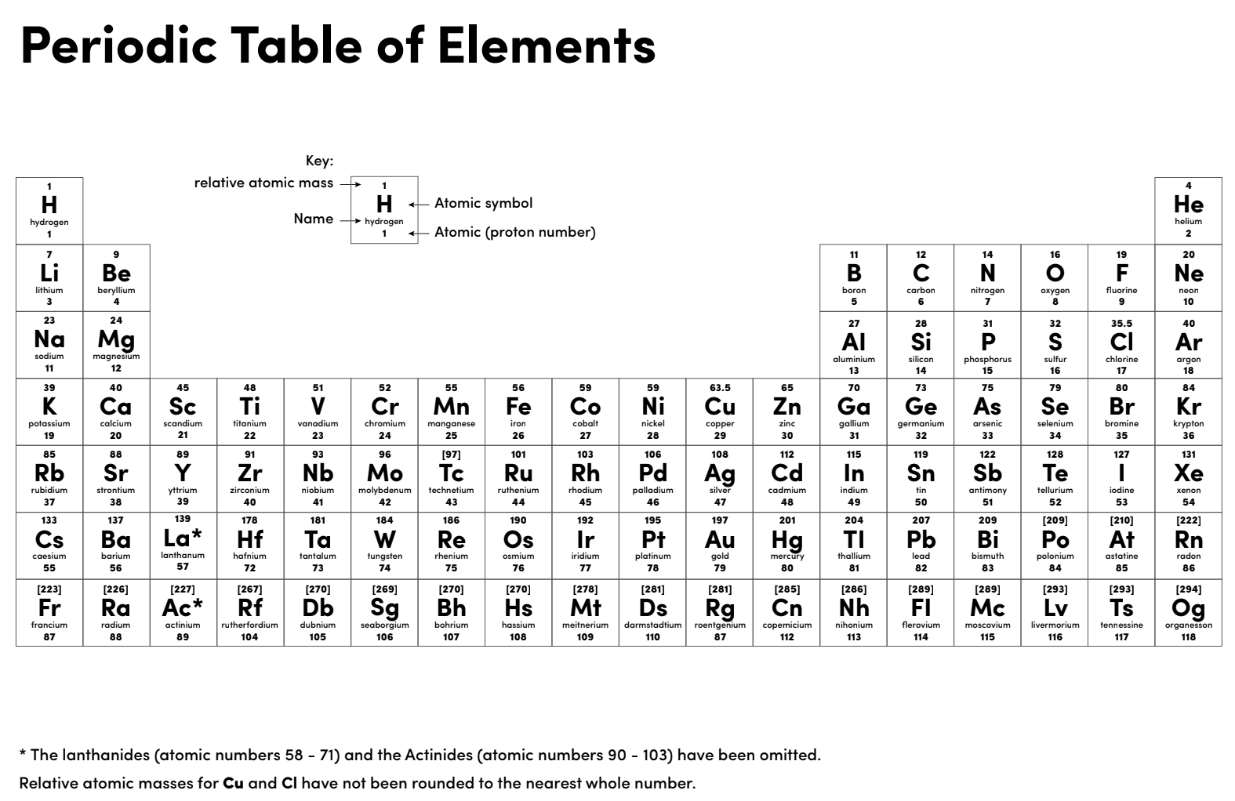

Slide 3
Independent practice 1
Calcium nitrate can be made by reacting calcium carbonate with nitric acid.
CaCO₃ + HNO₃ Ca(NO₃)₂ + H₂O + CO₂
What is the maximum theoretical yield that can be made from 500 tonnes of calcium carbonate?
What is the percentage yield if the actual yield is 720 tonnes?

Slide 4
Independent practice 2
Ethanol is manufactured in two ways:
Reaction 1: C₆H₁₂O₆(aq) 2C₂H₅OH(aq) + 2CO₂(g)
Reaction 2: C₂H₄(g) + H₂O(g) C₂H₅OH(l)
Calculate the atom economy for both reactions. Show your working out.
Which method should they choose based purely on atom economy?

Slide 5
Independent practice 3
2NaOH + H₂SO₄ Na₂SO₄ + 2H₂O
A student added 20.0 cm³ of sodium hydroxide of unknown concentration to a conical flask.
The student carried out a titration to find out the volume of 0.200 mol/dm³ sulfuric acid needed to neutralise the sodium hydroxide.
The student carried out five titrations. His results are shown in the table.
Concordant results are within 0.10 cm³ of each other.
Titration | 1 | 2 | 3 | 4 | 5
Volume of 0.100 mol/dm³ sulfuric acid in cm³ | 17.40 | 18.15 | 17.05 | 17.15 | 17.15
Use the student’s concordant results to work out the mean volume of 0.100 mol / dm³ sulfuric acid added.
Calculate the concentration of the sodium hydroxide.
Give your answer to three significant figures.

Slide 6
Independent practice 4
1. What volume do the following take up at room temp and pressure:
10 g methane (CH₄)
1000 g of carbon dioxide (CO₂)
2. Calculate the number of moles in :
14 dm³ of nitrogen (N₂)
2.4 dm³ of methane (CH₄)

Slide 7
Independent practice 5
The reaction that takes place in a car’s catalytic converter is shown below. What volume of nitrogen oxide (NO) reacts completely with 50 g of carbon monoxide (CO) at rtp?
2CO + 2NO 2CO₂ + N₂

Slide 8
Independent practice 1 answers
Calcium nitrate can be made by reacting calcium carbonate with nitric acid.
What is the maximum theoretical yield that can be made from 500 tonnes of calcium carbonate? 820 tonnes of Ca(NO₃)₂ can be made from 5 tonnes of calcium carbonate
What is the percentage yield if the actual yield is 720 tonnes? (720 / 820) x 100 = 87.8%

Slide 9
Independent practice 2 answers
Ethanol is manufactured in two ways:
Reaction 1: C₆H₁₂O₆ 2C₂H₅OH + 2CO₂
Reaction 2: C₂H₄ + H₂O C₂H₅OH Calculate the atom economy for both reactions. Show your working out.
Reaction 1: (92 / 180) x 100 = 51.1%
Reaction 2: (92 / 92) x 100 = 100%
Which method should they choose based purely on atom economy? Reaction 2 as it has 100% atom economy.
Notes:
Also mention why method might not be the best method

Slide 10
Independent practice 2 answers
2NaOH + H₂SO₄ Na₂SO₄ + 2H₂O
Concentration:
?
0.02 mol/(dm³)
Volume:
20cm³
17.12 cm³
17.12 / 1000 = 0.01712 dm³
Find the number of moles in solution of known concentration:
Moles = 0.02 x 0.01712 dm³
= 0.0003424 mol
Ratio:
2 : 1
Use the ratio to find the number of moles in the solution of unknown concentration:
0.0006848 : 0.0003424

Slide 11
2NaOH + H₂SO₄ Na₂SO₄ + 2H₂O
20 cm³
0.0006848 : 0.0003424
Calculate the concentration of the unknown solution:
Concentration = moles / volume (dm³)
(mol/dm³)
Volume NaOH in dm³ = 20 / 1000 = 0.02 dm³
Concentration NaOH = 0.0006848 / 0.02 = 0.034 mol/dm³

Slide 12
Independent practice 4 answers
1. What volume do the following take up at room temp and pressure:
10 g methane (CH₄) 10/16 = 0.625. Volume of gas = 0.625 x 24 dm³ = 15 dm³
1000 g of carbon dioxide (CO₂) 100/44 = 22.73. Volume of gas = 22.73 x 24 dm³ = 545.5 dm³
2. Calculate the number of moles in:
14 dm³ of nitrogen (N₂) 14 dm³ / 24 dm³ = 0.58 moles
2.4 dm³ of methane (CH₄) 2.4 dm³ / 24 dm³ = 0.1 moles

Slide 13
Independent practice 5 answers
The reaction that takes place in a car’s catalytic converter is shown below. What volume of nitrogen oxide (NO) reacts completely with 50g of carbon monoxide (CO) at rtp?
2CO + 2NO → 2CO₂ + N₂
Balanced symbol equation
M_{r} of CO = 28
M_{r} of carbon monoxide
Calculate the number of moles of CO burned
50/28 = 1.79 moles
Look at the ratio to work out the moles of NO
Ratio is 1 : 1 so there are 1.79 moles of NO
Calculate the volume of NO needed
Volume = 1.79 x 24 = 42.96 dm³

