Slide 1
Structures and Bonding
Nanoparticles
Worksheet
Separate Science - Chemistry - Key Stage 4
Mr Robbins

Slide 2
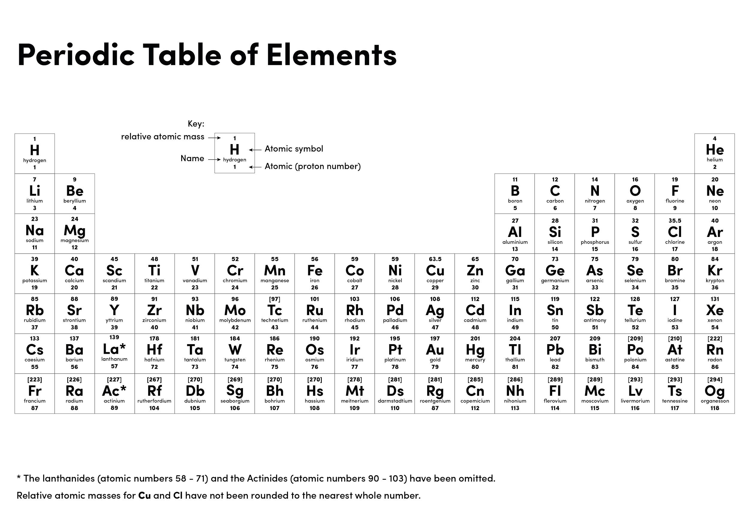

Slide 3
A student says “A virus is 80 nm wide so it must be a nanoparticle.” Are they correct? Give a reason.
A nanocoated tennis ball lasts 10 times longer than a normal tennis ball. Why can the manufacturer advertise it as “the environmentally friendly tennis ball”?
Fine particles are between 100 nm and 2500 nm. How big are they in metres?
Coarse particles are between 1 × 10⁻⁵ m and 2.5 × 10⁻⁶ m. How big are they in nanometres?
Air pollution consists of very small particles suspended in the air. This is called particulate matter, often abbreviated to ‘PM’. When scientists are describing particulate matter, they add a number to show the size of the particles. ‘PM2.5’ means that the particles are 2.5 micrometres.
One micrometre is 1 × 10⁻⁶ m.
Knowing the size of airborne pollution particles is important to health departments because particles smaller than 1 × 10⁻⁵ m can enter the lungs, lodge there and have harmful effects.
a) What does ‘PM10’ mean?
b) How big are PM10 particles in nanometres?
c) Write 1 × 10⁻⁴ as a PM number.

Slide 4
Answers
Yes because it is less than 100 nm
It does not have to be replaced so often
1x10⁻⁷ - 2.5x10⁻⁶ m
2500 nm - 10,000 nm
a) Particulates are 10 μm wide
b) 10,000 nm
c) PM₁₀₀

Slide 5
Quick check
2m
Calculate the volume of the cube
Calculate the surface area of the cube
Calculate the surface area to volume ratio.
2m
2m

Slide 6
Independent task
Silver exists as nanocrystals. Each crystal is a cube and is 20 nm wide.
Convert 20 nm to m. Give your answer in standard form
Calculate the volume of the cube. Give your answer in standard form
Calculate the surface area of the cube. Give your answer in standard form
Calculate the surface area to volume ratio of the silver nanocrystal

Slide 7
Independent task
2. A company want to put nanocrystal of silver into their socks
a) Give a reason why they would prefer nanocrystals over coarse grains of silver?
b) Some of the public are worried about nanotechnology and potential health concerns. What could the company do to reduce the customers concerns?

