Slide 1
Hazards of Radiation
(Physics only)
Physics - Key stage 4 - Atomic Structure
Mr van Hoek

Slide 2
Exam Question
A teacher notices that the count rate behind a lead barrier ranges from 20 to 24.
Give two reasons why there are a wide range of results around 22 counts per minute. [2 marks]
OCR, June 2018, J249/02

Slide 3
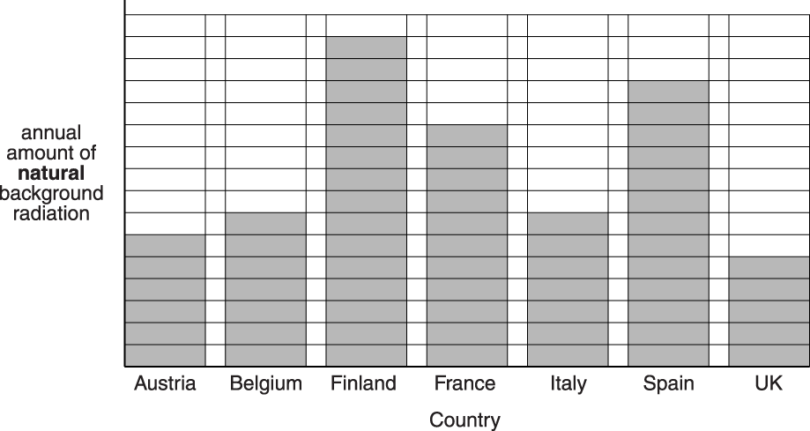
Exam Question
This question is about natural and artificial background radiation.
Ben finds information on the internet about natural background radiation in different countries.
What does the data show about the natural background radiation in different countries? [1]
Suggest why Finland has a high annual amount of natural background radiation. [1]
OCR, June 2014, B752/01

Slide 4
Exam Question
The teacher notices that the count rate behind the lead barrier ranges from 20 to 24.
Give two reasons why there are a wide range of results around 22 counts per minute.
OCR, June 2018, J249/02

Slide 5
Contamination and Irradiation
What is meant by contamination?
Contamination occurs when radioactive ______________________ is __________________ the body / object
What is meant by irradiation?
Irradiation occurs when object is ________________________________ radiation from _____________________ of the body / object.

Slide 6
Is it contamination or irradiation?
Treating fruit with gamma rays to kill bacteria | Drinking tea contaminated with radioactive atoms
Using gamma rays to kill tumours | Treating dental and surgical instruments with gamma radiations
Fish living in the sea around the nuclear power station at Fukushima | Touching radioactive uranium salts
Breathing in Radon gas (an alpha emitter) | Being injected with a radioactive isotope

Slide 7
Precautions
In a hospital, radioactive isotopes are used for a variety of purposes.
Explain how hazards presented by contamination and irradiation from these isotopes can be reduced.

Slide 8
Half-life and hazard
Isotope | Half-life | Radiation emitted
Americium – 241 | 431 years | Alpha
Uranium-235 | 70 million years | Alpha
Carbon-14 | 5,730 years | Beta
Carbon-11 | 20.3 minutes | Beta
Iodine-131 | 8.04 days | Beta
Sodium-24 | 15 hours | Beta
Technetium-99m | 6.02 hours | Beta
Sodium 24 | 14.9 hours | Gamma
Barium 137 | 2.6 minutes | Gamma
Radioactive isotopes can be used a medical tracers by injecting them into patients within solutions and then monitoring the radiation that comes from different parts of the body.
Compare the level of risk when deciding between the use of sodium-24 and iodine-131 for use as such a tracer.

Slide 9
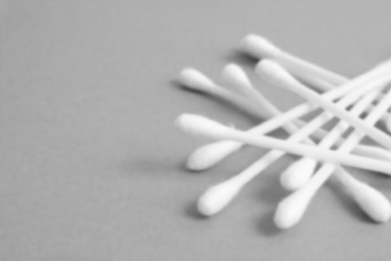
Exam Question - Irradiation and Contamination
These cotton wool buds have been treated with gamma rays.
The cotton wool buds have been irradiated but not contaminated.
Describe the difference between irradiated and contaminated.
[3 marks]
OCR, Specimen, J250/06

Slide 10
Exam Question - Precautions
Polly and Oliver were talking about the factory that is near their home.
Polly said that the factory produces dangerous radioactive waste.
Oliver said that if the waste was put into thick aluminium cans it could be stored safely.
Is Oliver correct? _ _ _ _ _ _ _ _ _ _ _ _ _ _ _ _ _ _ _ _ _ _ _ _
Explain your answer. [2marks]
OCR, June 2016, B712/02 Science Modules B2, C2, P2

Slide 11
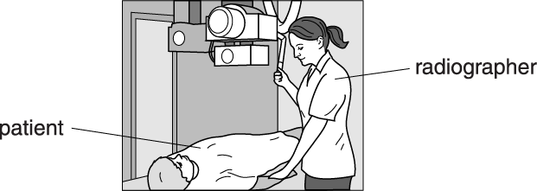
Exam Question - Precautions
Radiographers use nuclear radiation in hospitals.
Look at the radiographer. She is preparing a patient for treatment.
Suggest two different ways the radiographer can remain safe when the radiation is being emitted. [2marks]
OCR, June 2016, B752/01

