Slide 1
Expanding Double Brackets
Mathematics
Mrs Buckmire
Notes:
Pen and paper and encourage to pause

Slide 2
Try this
What’s the same and what’s different?

Slide 3
Independent task
Match the equivalent expressions.

Slide 4
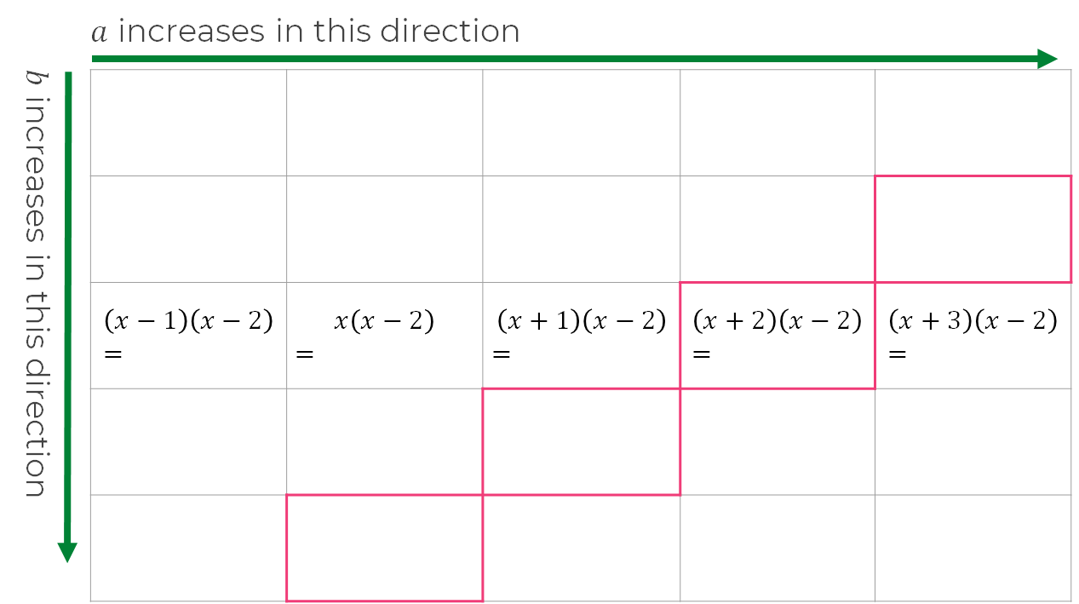
Explore
Fill out the rest of the grid and give the expanded form of each expression.
What do you notice about the highlighted cells?
Can you create similar examples to those highlighted?

Slide 5
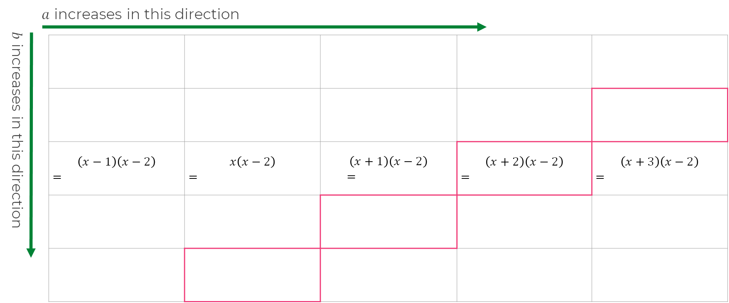
Explore
What do you notice about the highlighted cells?
Can you create similar examples to those highlighted?

