Slide 1
Worksheet Lesson 6 - Comparing population pyramids
Geography
Miss Lowes

Slide 2
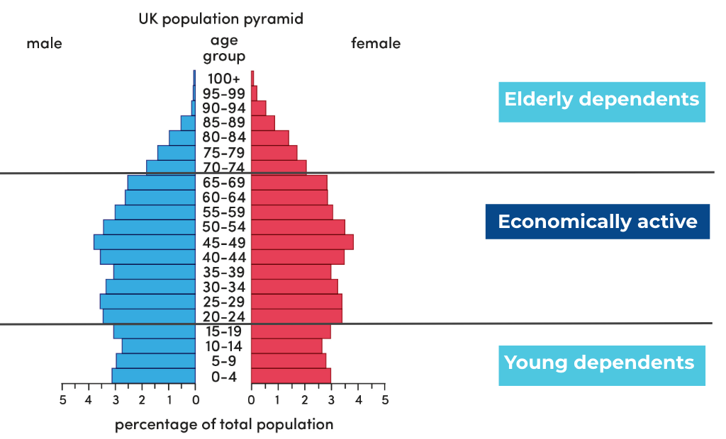
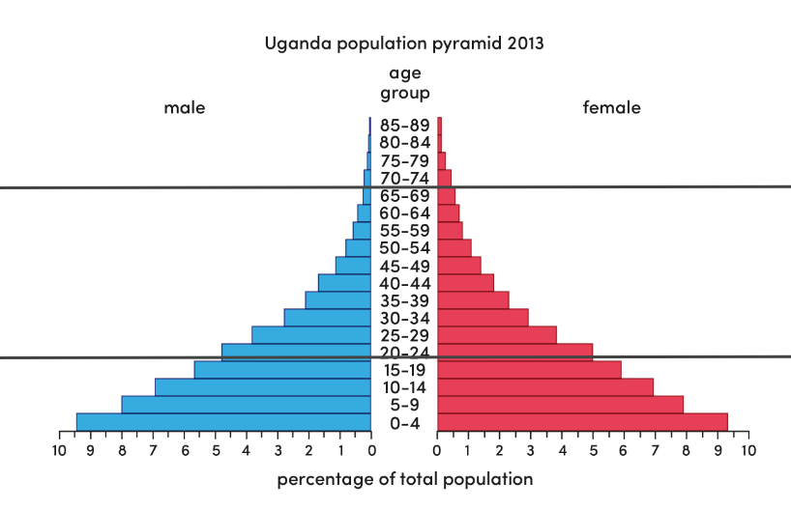
Compare the population pyramids for Uganda and the UK. Suggests ways in which the population structures are different.
Source: Oak National Academy

