Slide 1
Identifying enough and not enough with coins :
Lesson 3 of 4
Numeracy: Money - Applying Learning
James

Slide 2
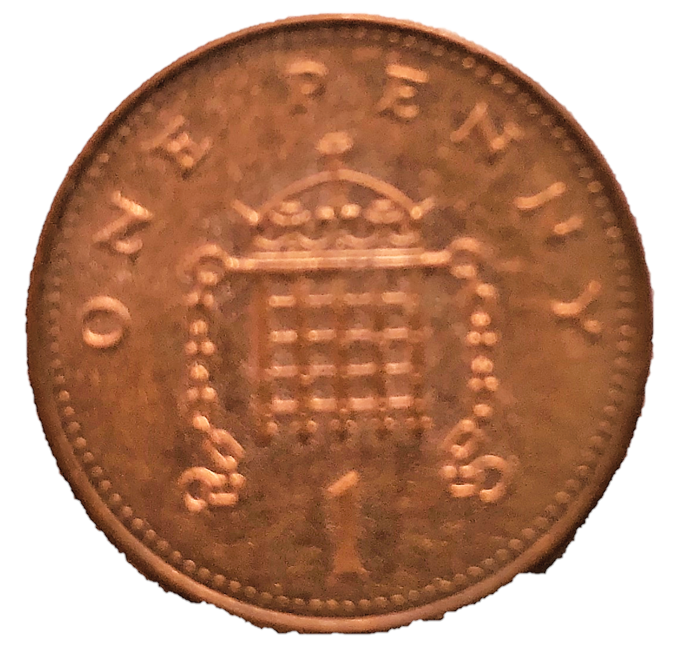
What am I learning today?
Objectives
To identify if you have enough or not enough money.
Vocabulary
penny price
enough not enough

Slide 3
For this lesson, you will need:
Pennies
Price Tags
Items from your home
Notes:
This can be anything that you have in your home

Slide 4
Let’s get ready
Find a quiet space to work away from distractions
Ensure that your learner is comfortable
Make sure your resources are nearby

Slide 5
Understanding enough and not enough

Slide 6
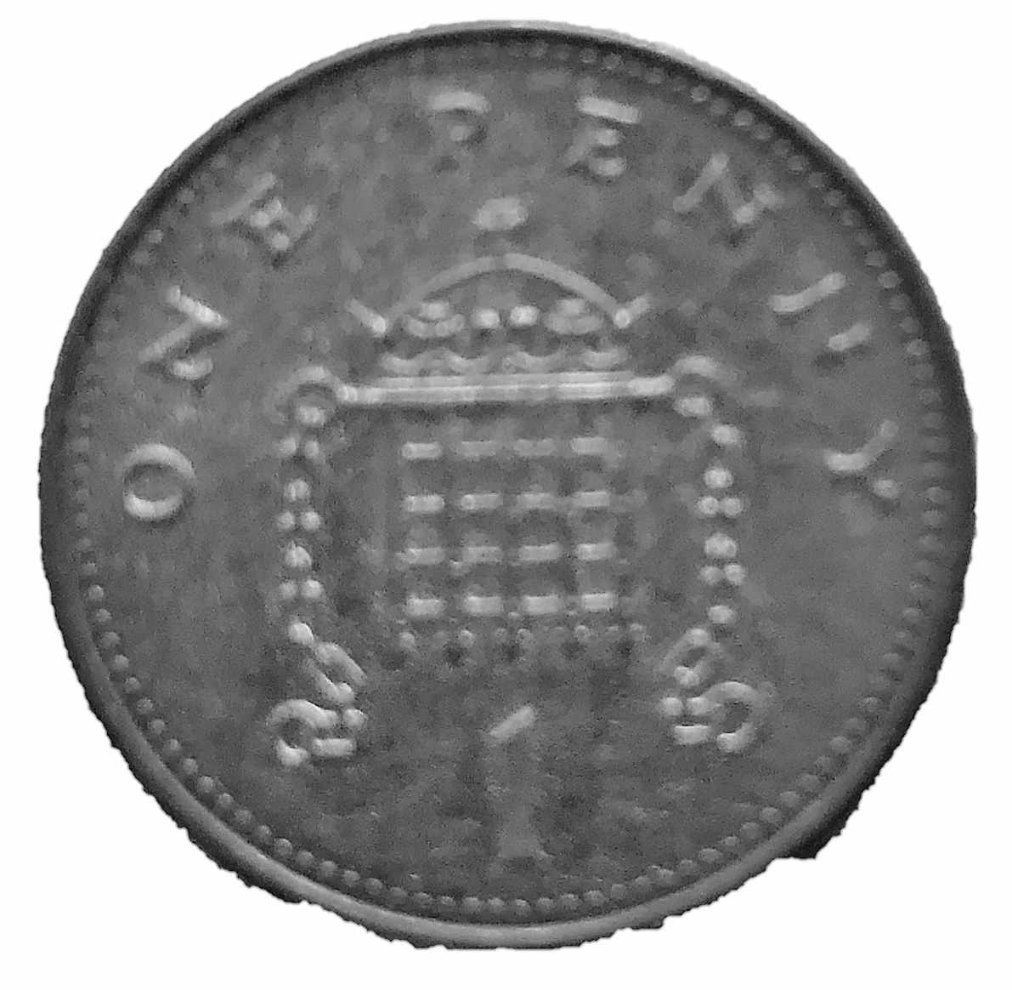
Let’s see if we have enough!
1
2
3
4
5
6
7
8
9
7p
Credit: Pixabay & Teacher owned image

Slide 7
Let’s see if we have enough!
1
2
3
4
5
6
7
8
9
3p
Credit: Pixabay & Teacher owned image

Slide 8
Who has enough money to buy the orange?
3p
Credit: Oak National Academy, Pixabay & Teacher owned image

Slide 9
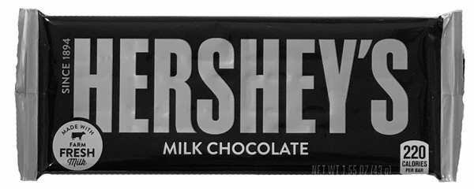
Who has enough money to buy the chocolate?
8p
Credit: Oak National Academy, Pixabay & Teacher owned image

Slide 10
Now it’s time to complete your task
If a parent or carer gives you some pennies, can you choose an item that you have enough money for?
Enough and Not Enough

Slide 11
Money
Lesson 3: Identifying ‘enough’ and ‘not enough’ with coins.
Make it easier
Make it harder
More ideas
Use a counting frame to support matching coins to boxes to count accurately.
Count coins on a numberline in order to match them to the value of the item.
Compare more items when looking at which item costs more or less. Recap the terms ‘most’ and ‘least’.
Have characters with more coins than is necessary when looking at who has enough.
Begin to explore money by setting up a role play area in the home. Children can ‘buy’ items using coins that they have and the printable price tags.

Slide 12
1p
2p
3p

Slide 13
4p
5p
6p

Slide 14
7p
8p
9p

