Slide 1
Independent Living Unit 4 - Community Living
Lesson 4 - Familiar health services
Oak Specialist
Building Understanding

Slide 2
Unit 4- Community Living
Lesson 1- Knowing which shop to buy from
Lesson 2- Shopping in the supermarket
Which shops sell what items? Matching shopping to shops.
Writing a shopping list, choosing the correct isle and counting money.
Lesson 3- What’s on the high street?
Lesson 4- Familiar health services
Recognising and locating places of interest on a high street.
Recognising familiar health professionals and matching jobs to their roles.
Lesson 5- Transport
Lesson 6- Travel in the community
Identifying transport modes and choosing correct mode for type of travel.
Planning a simple journey.

Slide 3
Teacher notes- Familiar health services
Learning Intention- To label health professionals, recognise their places of work and job roles.
Name the job titles of the familiar health professionals. How can you tell who is who? What are they wearing?
Name the places they work at. Who works at each place?
Discuss and identify what happens at each place. What job roles do the professionals do? Have you experienced any of these?
Additional resources- none
Notes:
This is the equivalent to a loose lesson plan/overview for teachers before starting the lesson.

Slide 4
Lesson activity stages
Familiar health professionals
Familiar health services
Health professional roles
Notes:
People 2. Hospital 3.

Slide 5
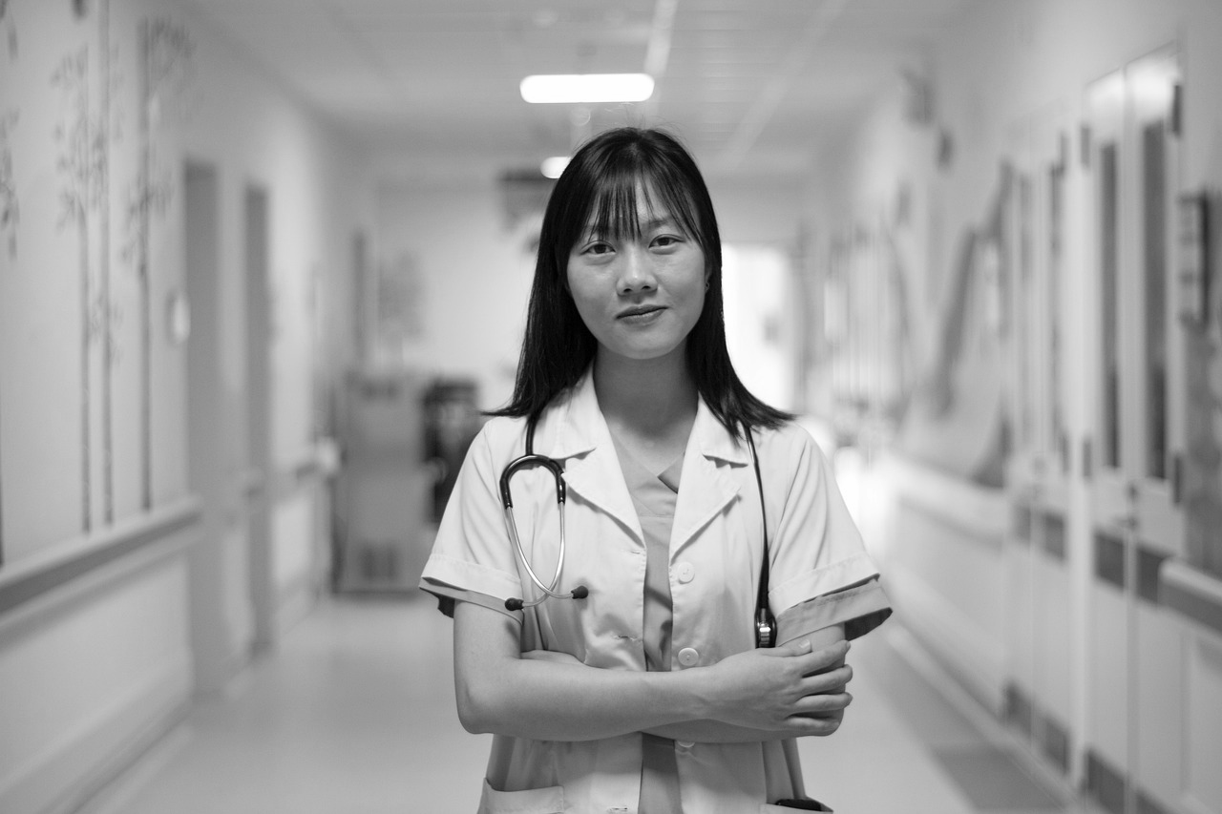
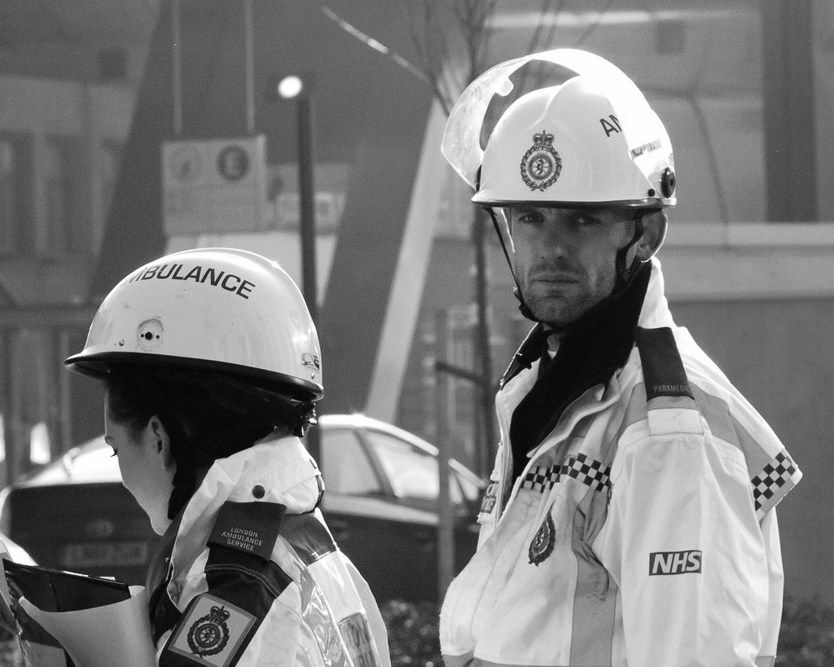
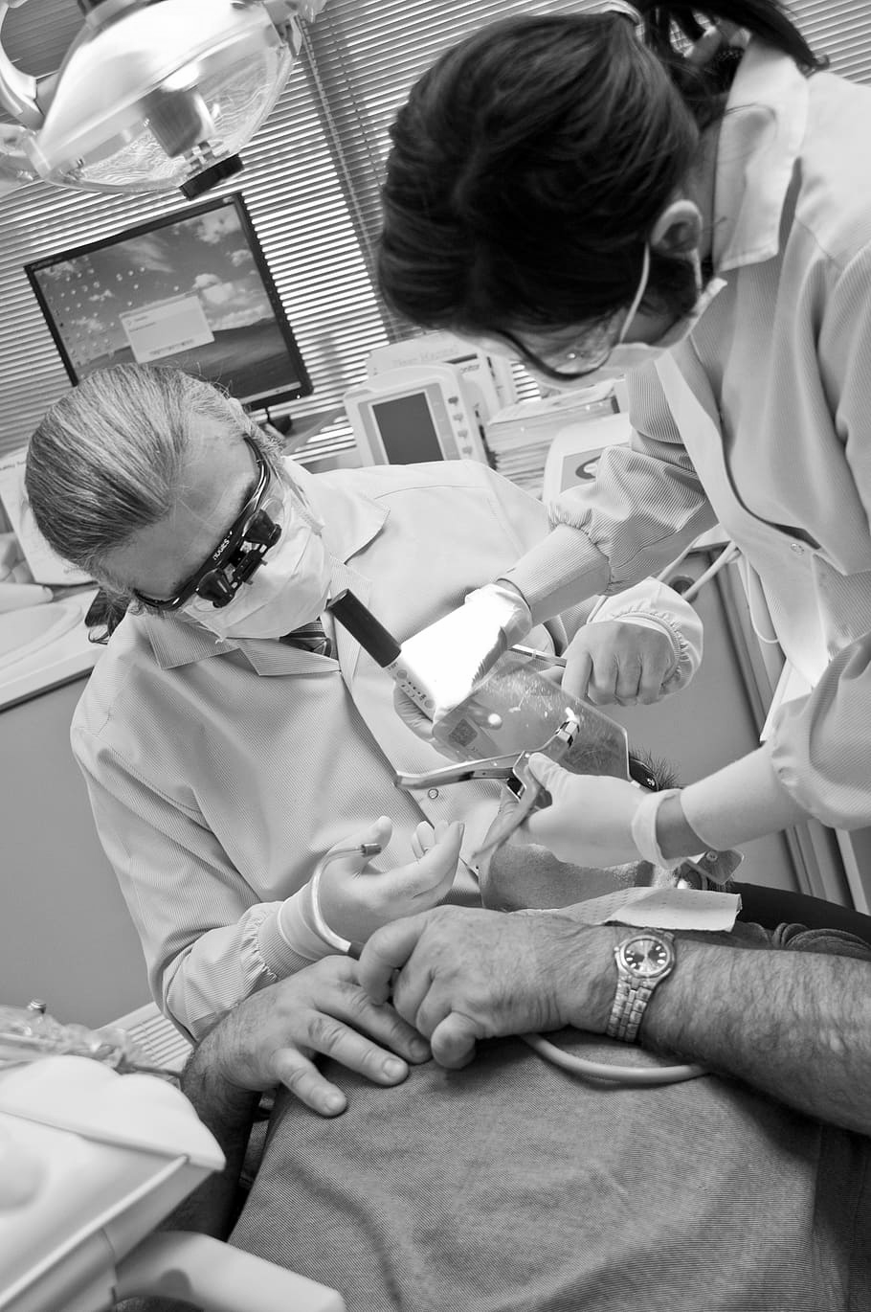
Can you name these health professionals?
Use symbols or real images to support understanding.
Ask - “Who can you see?”
“What are their job titles?”.
Notes:
Use symbols to support understanding. “Who can you see?” “What are their job titles?”

Slide 6
Doctor
Notes:
This lady is a doctor. Can you see her stethoscope? What does a doctor do?

Slide 7
Nurse
Notes:
This is a nurse. What colour is her uniform? What does a nurse do?

Slide 8
Paramedic
Notes:
This is a paramedic. Do you know the name of his van? What does a paramedic do?

Slide 9
Dentist
Notes:
This man is a dentist. What is he wearing on his face?

Slide 10
Where do these people work?
Notes:
Note: add in images or symbols that will best support your learner.

Slide 11
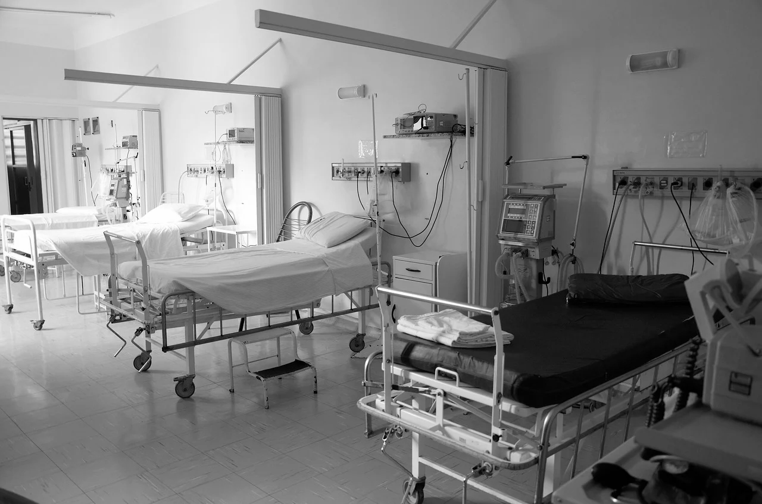
What place is this?
Notes:
What place is this? What can you see in the photo? Who works at the hospital?

Slide 12
Who works at the hospital?
Doctor
Nurse
Paramedic
Notes:
Doctors, nurses and paramedics work at the hospital. Can you think of anyone else who works in the hospital?

Slide 13
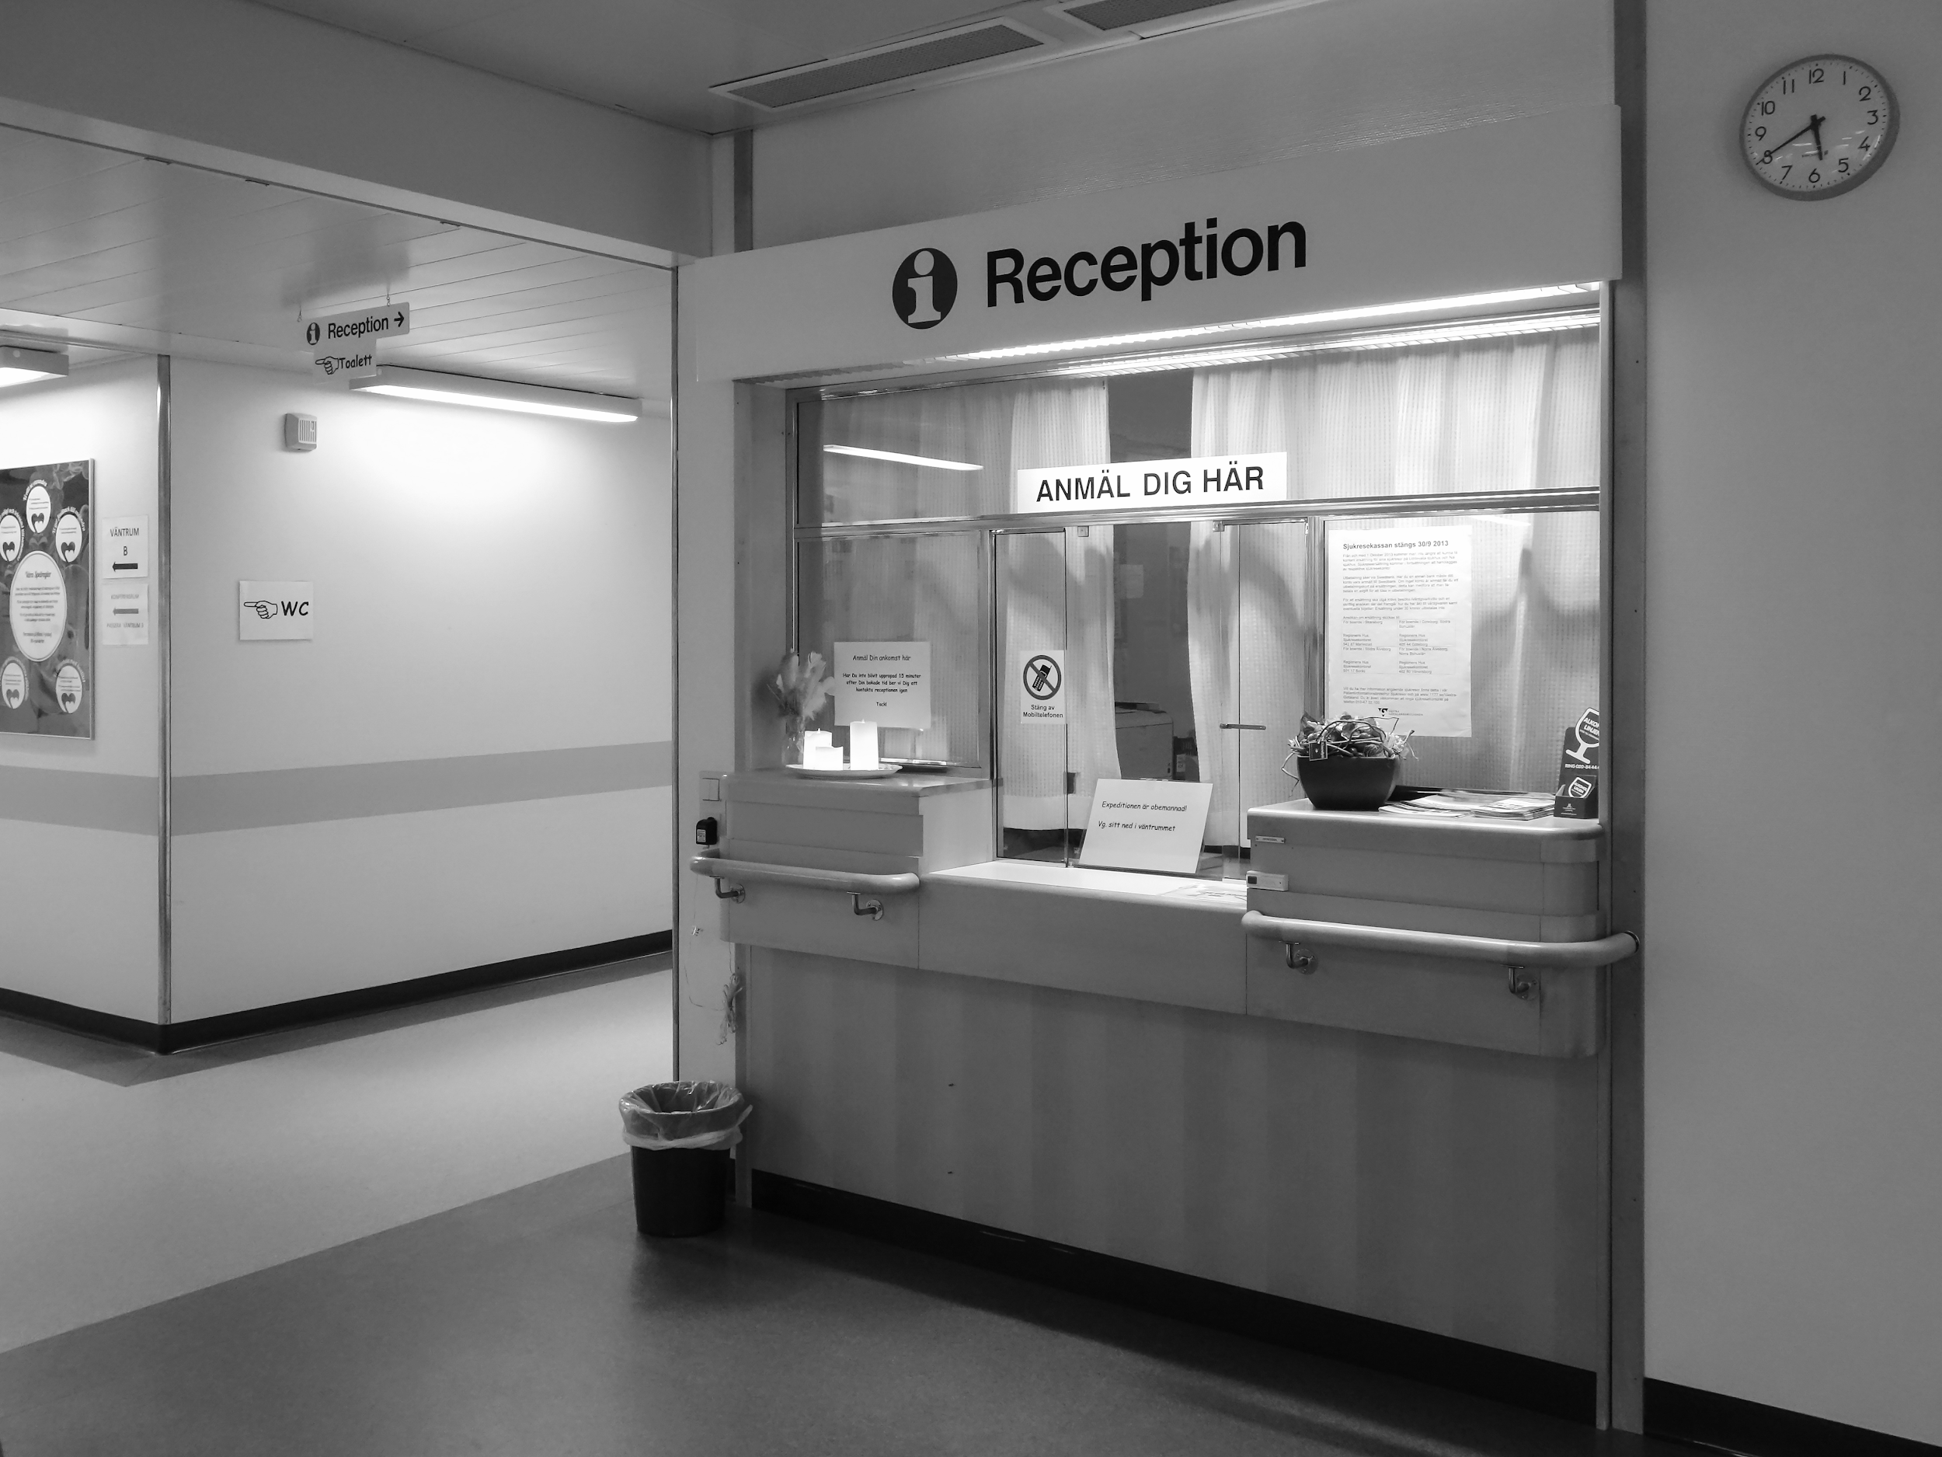
What place is this?
Notes:
What place is this? What can you see in the photo? Who works at the doctors?

Slide 14
Who works at the doctors surgery?
Doctor
Nurse
Notes:
Doctors and nurses work at the doctors surgery. Can you think of anyone else who works in the doctors surgery?

Slide 15
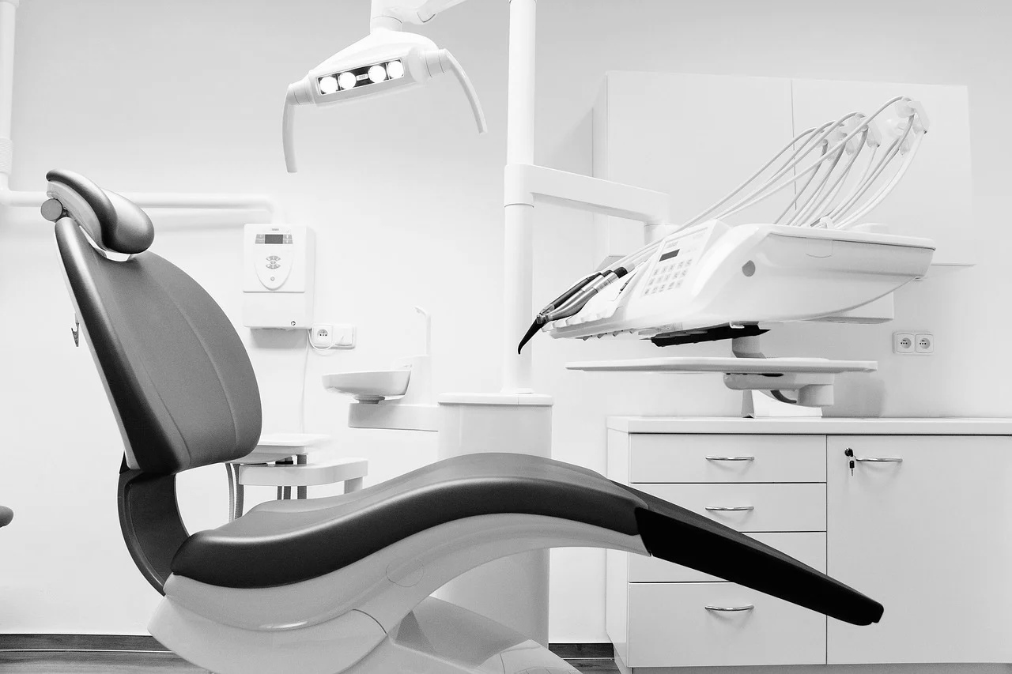
What place is this?
Notes:
What place is this? What can you see in the photo? Who works at the dentist?

Slide 16
Who works at the dentist?
Dentist
Notes:
Dentists work at the dentist. Can you think of anyone else who works at the dentist?

Slide 17
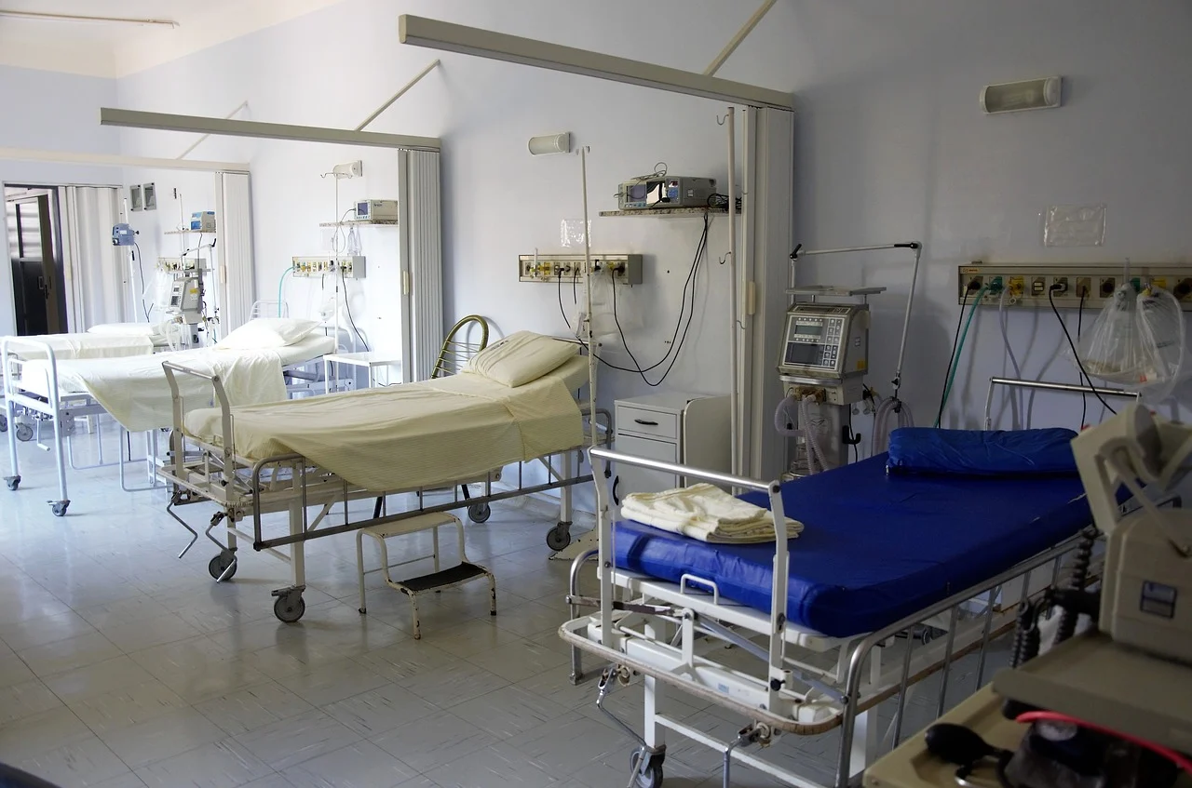
What happens at the hospital?
Notes:
Note: add in images or symbols to the grid to best support your learner and their experiences. An example can be seen in the online worksheet resource.
Use the grid to talk through each image. Ask your learner if they can say or point to what happens at the hospital? Draw a circle around or point to the correct answers. Can you think of any more things that happen at the hospital? Who else works at the hospital?

Slide 18
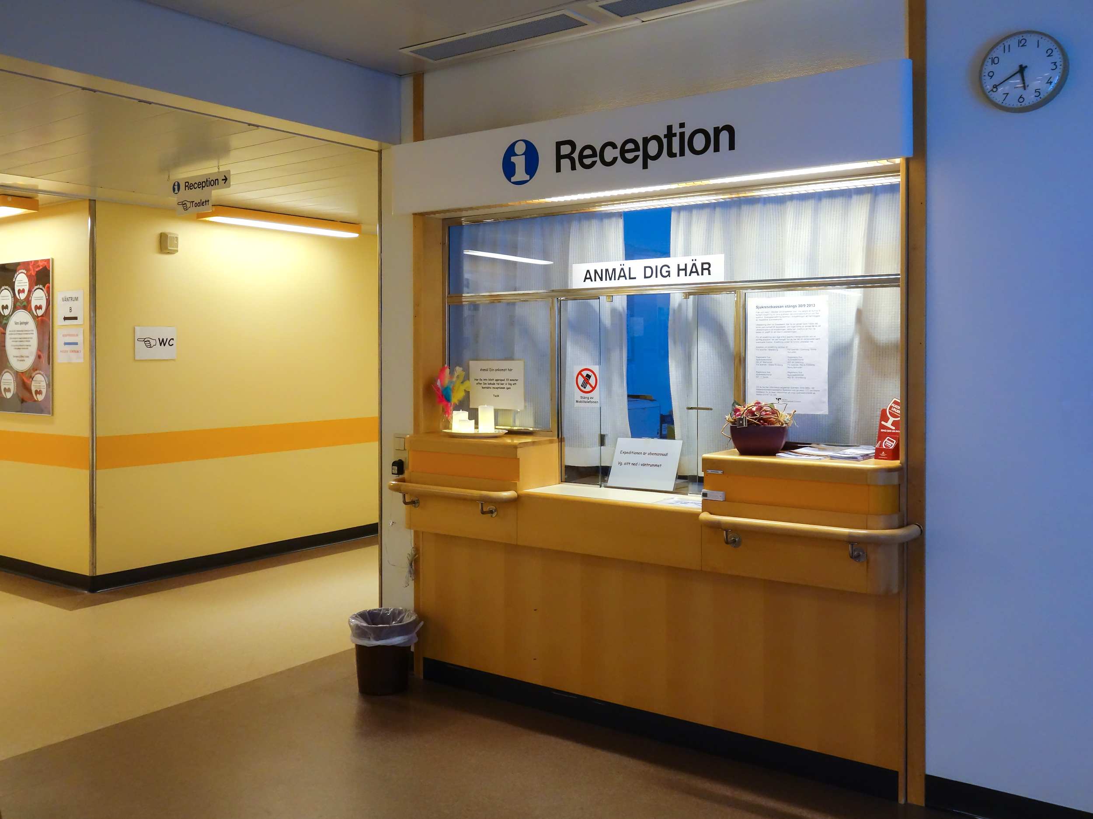
What happens at the doctors?
Notes:
Note: add in images or symbols to the grid to best support your learner and their experiences. An example can be seen in the online worksheet resource.
Use the grid to talk through each image. Ask your learner if they can say or point to what happens at the doctors? Draw a circle around or point to the correct answers. Can you think of any more things that happen at the doctors surgery? Who else works at the doctors surgery? Pretend you are going to the doctors, can you stand very still whilst you measure each others heights?

Slide 19
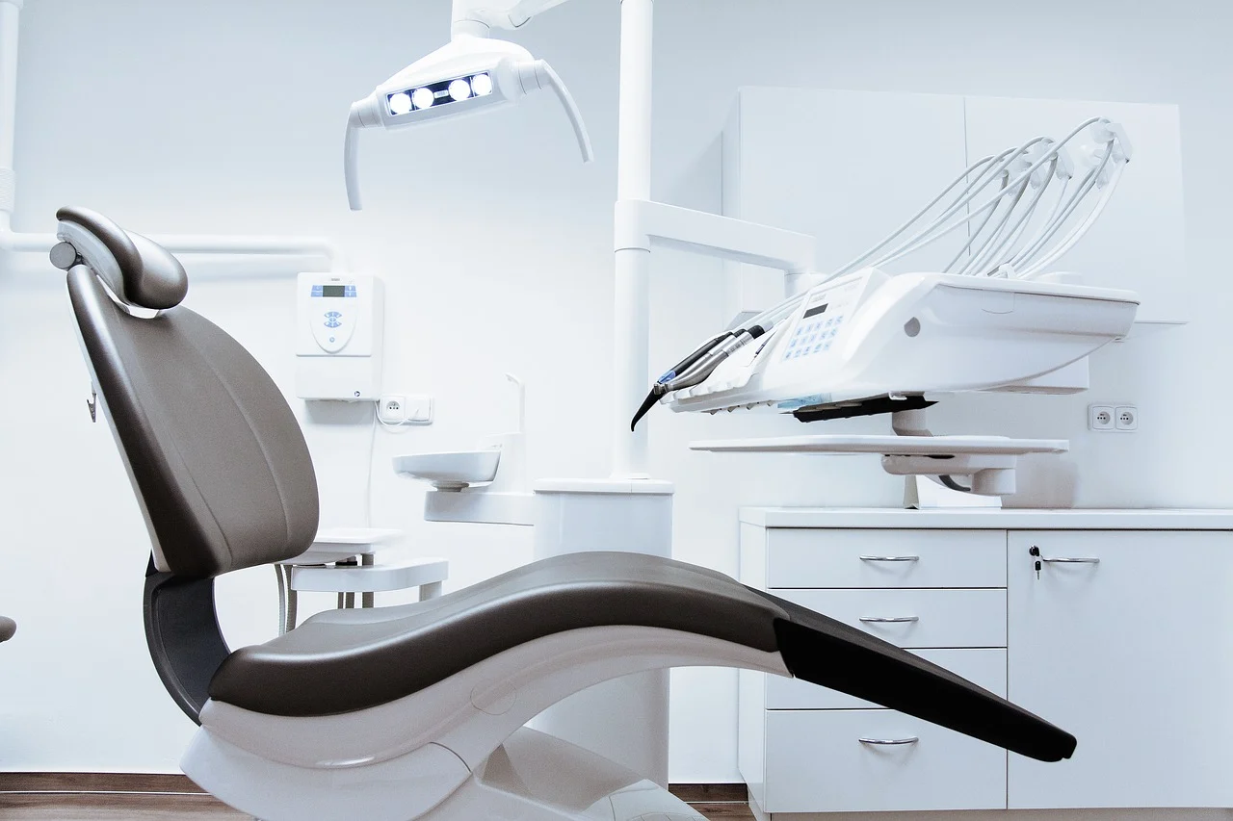
What happens at the dentist?
Notes:
Note: add in images or symbols to the grid to best support your learner and their experiences. An example can be seen in the online worksheet resource.
Use the grid to talk through each image. Ask your learner if they can say or point to what happens at the dentist? Draw a circle around or point to the correct answers. Can you think of any things that happen at the dentist? Who else works at the dentist? Pretend you are at the dentist and practice looking looking in each others mouths or brushing your teeth.

Slide 20
Mental Health
‘Mental health’ means looking after our minds and keeping them healthy.
Notes:
Note: add in images or symbols to best support your learner and their experiences. An example can be seen in the online worksheet resource.
Use this slide to introduce what ‘mental health’ means and what professionals can help keep our mind healthy e.g. psychologist, psychiatrist, psychotherapist.

Slide 21
Independent Living Community Living
Familiar health services: Suggested adaptations for teachers / parents / carers.
Make it easier
Make it harder
More ideas
Match each person to their place of work.
Role play the different jobs.
Find the address of your doctors, dentist or hospital.
Discuss what an emergency is. What number do you call in an emergency?
Can you name items that you can find at the dentist, doctors or hospital?
Find a story about someone visiting one of these places. How are they feeling?

Slide 22
Further Learning with Oak National
Independent Living:
Applying Learning- Health support in the community (Unit 4)
Applying Learning- People who help us (Unit 4)
Notes:
Insert info for subject/lesson name/stage (if appropriate)

Slide 23
References
Slide 5-9: Doctor, Pixabay / Young nurse, Public Domain Pictures / Paramedic at Vauxhall Helicopter Crash, Flickr Attribution-ShareAlike 2.0 Generic (CC BY-SA 2.0) / Doctors, Pxfuel
Slide 11-12: White and blue hospital beds, PickPik
Slide 13-14: Reception desk for Clinical Physiology - NÄL hospital 1, W.Carter, Wikimedia Commons
Slide 15-16: Dentist chair, Sergio Santos, Flickr Attribution 2.0 Generic (CC BY 2.0)

