Slide 1
What is a physical change and how can we identify them?
Worksheet
Science
Miss Couves

Slide 2
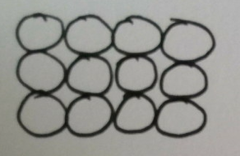
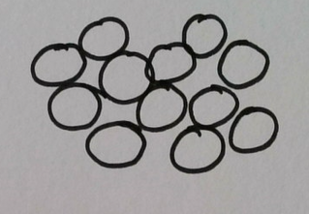
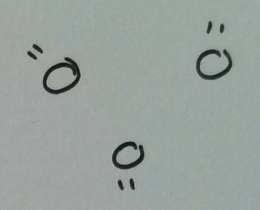
Properties of solids, liquids and gases
State of matter | Can be compressed | Can flow | Can change shape
Solid
Liquid
Gas

Slide 3
Complete the diagram in your notes:
Solid
Liquid
Gas
_____________ temperature - particles have ________ _________

Slide 4
Which state change does each arrow represent?
Solid
Liquid
Gas

Slide 5
What is a physical change?

Slide 6
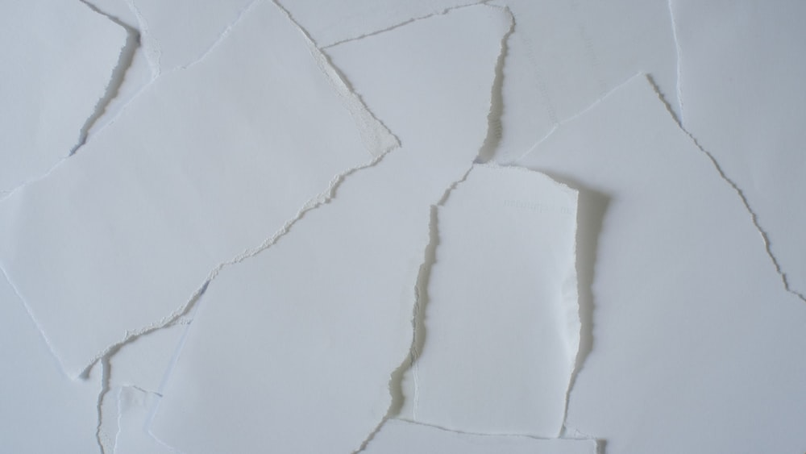
Name three physical changes
A change in the form or arrangement of a substance.
Credit: Images from Unsplash

Slide 7
What is a physical change?
A change in the ________ or ___________________ of a substance.
Ice cream melting
Paper tearing
Glass smashing
Credit: Images from Unsplash

Slide 8
Is this a physical change?
Water boiling in a saucepan.
What particles are present at the start?
What particles are present at the end?
Has the arrangement of the particles changed?

Slide 9
Is this a physical change?
Ice melting in my drink.
What particles are present at the start?
What particles are present at the end?
Has the arrangement of the particles changed?
Credit: image from Unsplash

Slide 10
Is this a physical change?
A bonfire burning.
What particles are present at the start?
What particles are present at the end?
Has the arrangement of the particles changed?
Credit: image from Unsplash

Slide 11
Is this a physical change?
Salt dissolving in water.
What particles are present at the start?
What particles are present at the end?
Has the arrangement of the particles changed?

Slide 12
What happens to chocolate when we heat it?
Solid
Liquid
_____________ temperature - particles have ________ _________

Slide 13
Method
Place one square of chocolate on a plate.
Place the lamp facing the chocolate.
Turn on the lamp.
Watch what happens to the chocolate for 3 minutes.
Turn off the lamp.
Safety: the lamp should be at least 30 cm away from the chocolate.

Slide 14
Conclusion questions
What happened to the chocolate when you placed it under the lamp?
What happened to the energy of the particles during this process?
Draw a particle diagram to represent the particles at the end of the investigation.
Is this a physical change?
How do you know?

