Slide 1
Indices and Radicals
Mathematics
Miss Oreyomi
Miss Oreyomi

Slide 2
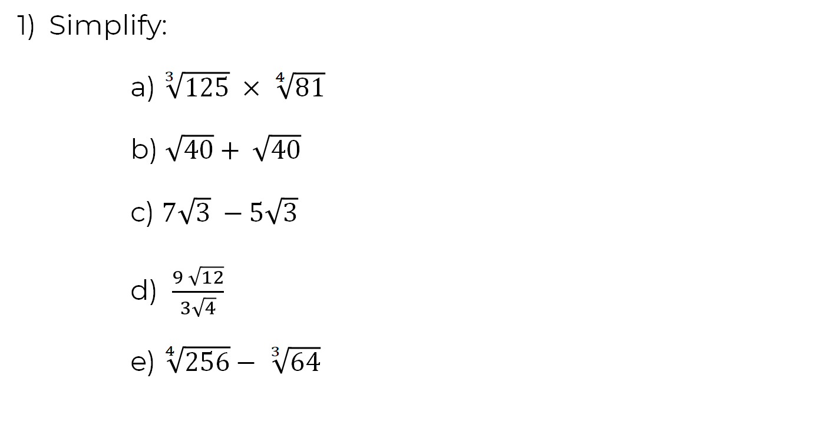
Questions

Slide 3
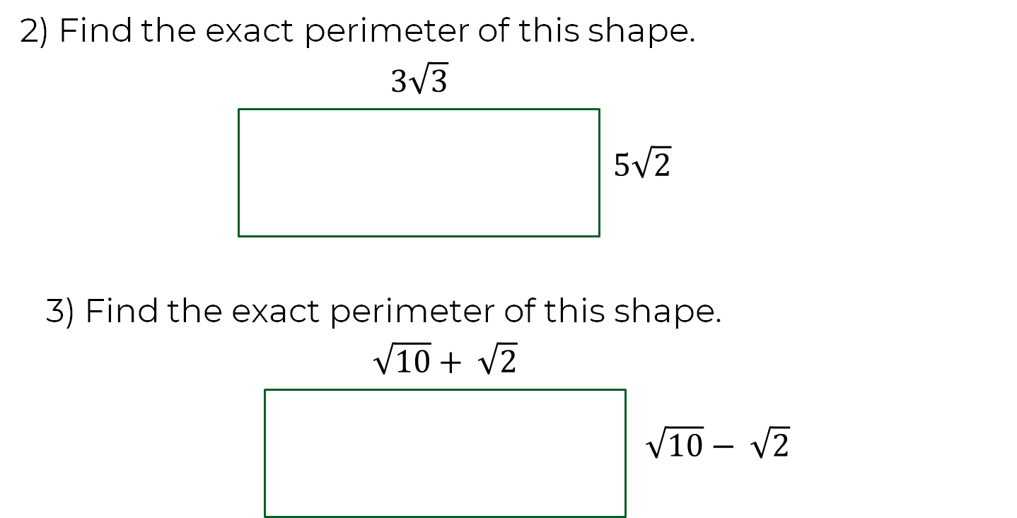
Questions

Slide 4
Questions

