Slide 1
Discussing reading habits [2 / 3]
Using definite and indefinite articles after verbs
German
Frau Bolton

Slide 2
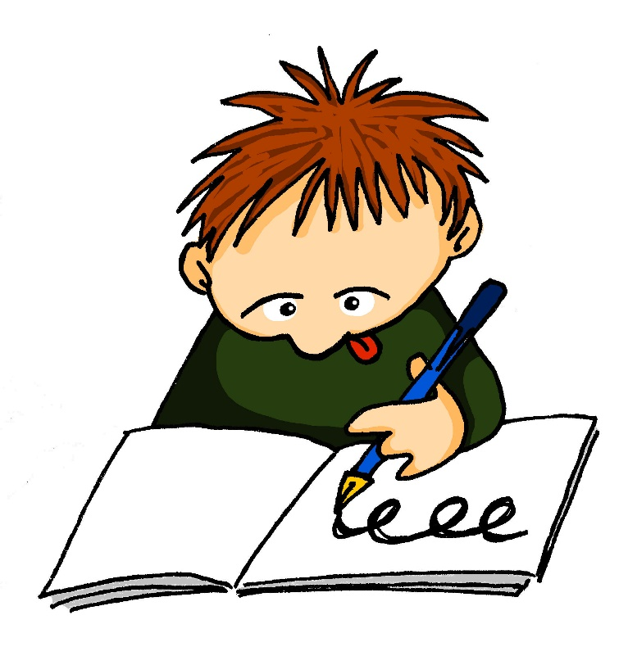
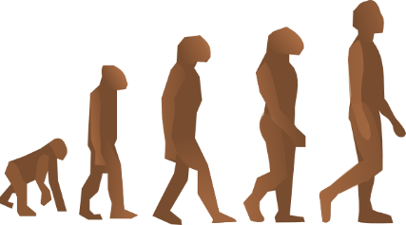
[sch]
schnell
falsch
[fast]
schwarz
zwischen
Mensch
schreiben

Slide 3
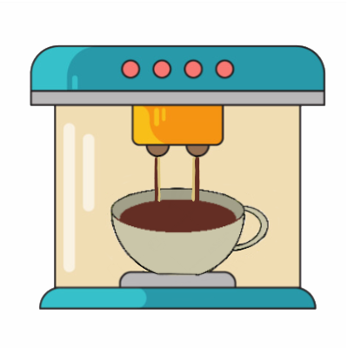
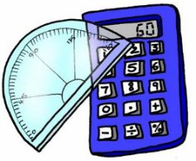
[ch]
nochmal
machen
Nacht
acht
Buch
Fach

Slide 4
der Comic | comic book
der Fantasyroman | fantasy novel
der Krimi | detective/crime story
die Biografie | biography
die Liebesgeschichte | love story
die Horrorgeschichte | horror story
die Zeitung | newspaper
die Zeitschrift | magazine
das Magazin | magazine
das Science-Fiction-Buch | sci-fi book

Slide 5
German has three words for the
and three words for a(n):
masculine
feminine
neuter
der Comic
die Biografie
das Magazin
ein Comic
eine Biografie
ein Magazin

Slide 6
After a verb the masculine words for the and a(n) change*:
masculine
Which word in each German
sentence is the verb?
Ich lese den Comic.
Ich lese einen Comic.
*This change happens after all verbs except “to be” (sein)

Slide 7
After a verb the masculine words for the and a(n) change:
masculine
Ich lese den Comic.
Ich lese einen Comic.

Slide 8
After a verb the masculine words for the and a(n) change:
Only the masculine changes. Feminine and neuter words for the and a(n) stay the same!
masculine
Ich lese den Comic.
Ich lese einen Comic

Slide 9
Ich lese...
The feminine and neuter words for the and a(n) stay the same
masculine
feminine
neuter
den Comic
die Biografie
das Magazin
einen Comic
eine Biografie
ein Magazin

Slide 10
Summary of our learning
The three words for the are (masculine) __________ , (feminine ) __________ and (neuter ) __________ .
The three words for a(n) are (masculine) __________ , (feminine ) __________ and (neuter ) __________ .
After a verb the masculine word for the changes to _____________ and the masculine word for a(n) changes to _____________ .
Eg. ich lese _____________ Comic.
After a verb feminine and neuter words for the and a(n) stay the same / change.

Slide 11
Summary of our learning
The three words for the are (masculine) der, (feminine ) die and (neuter ) das.
The three words for a(n) are (masculine) ein, (feminine ) eine and (neuter ) ein.
After a verb the masculine word for the changes to den and the masculine word for a(n) changes to einen.
Eg. ich lese den Comic.
After a verb feminine and neuter words for the and a(n) stay the same / change.

