Slide 1
Microscopes, Magnification and Resolution
(Downloadable student document)
Combined Science - Biology - KS4
Cell Biology
Miss Wong

Slide 2
Quick recap: millimetres and micrometres

Slide 3
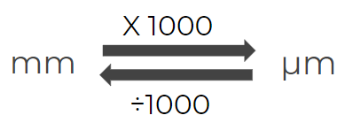
Quick concept check:
Express the following in standard form.
10mm = __?__ μm
60μm = __?__ mm
1 x10⁴ μm
6 x 10⁻² mm
Resume once you’re finished

Slide 4
Quick concept check:
Express the following in standard form.
10mm = __?__ μm
60μm = __?__ mm
Resume once you’re finished

Slide 5
Observing cells using a microscope

Slide 6
The need for microscopes
Why do we need to wash our hands using soap often?

Slide 7
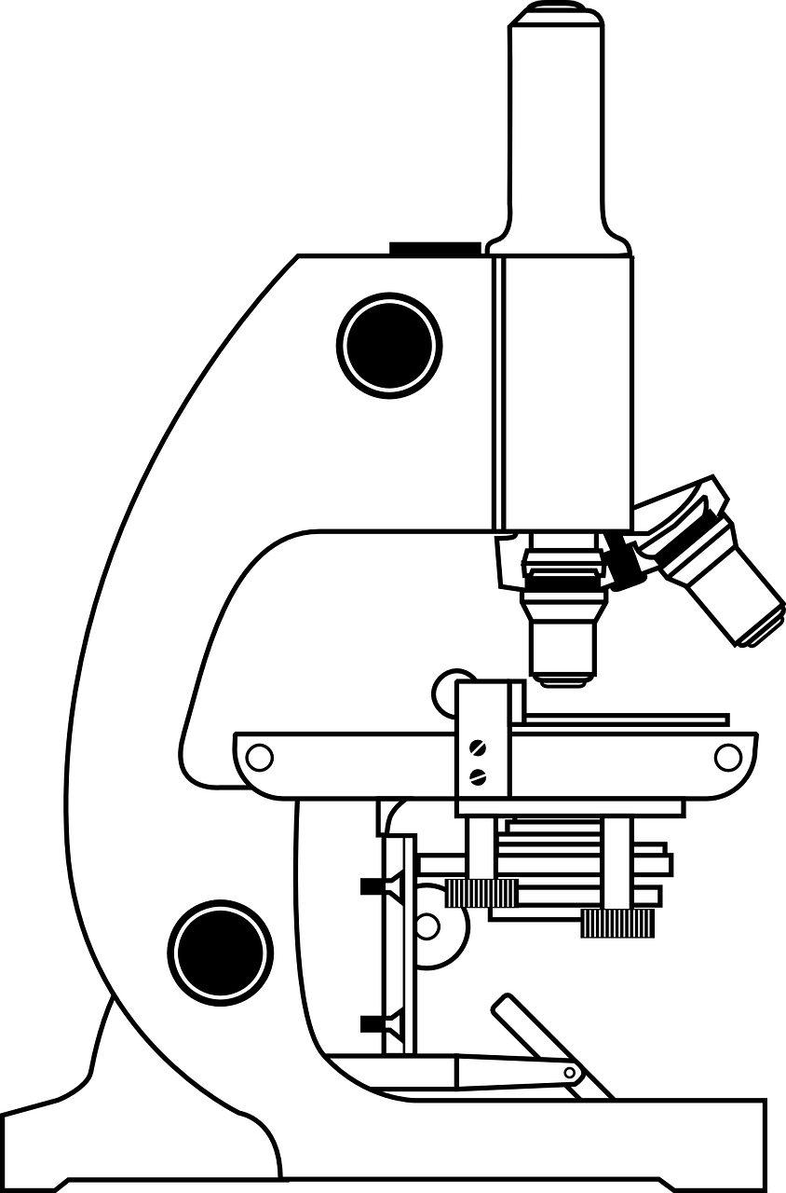
Structure of a microscope
Eyepiece lens (10x)
Coarse focus knob
Nosepiece
Objective lens (10x, 20x, 40x)
Remember the structures and their functions.
Stage
fine focus knob
Mirror/ light
Microscope, Pixabay
Notes:
Introduce the parts and functions. Link to year 7 knowledge.

Slide 8
How to view a specimen using a microscope?
Make sure the objective lens with the lowest magnification is in use.
Put the specimen on the stage.
Turn the coarse focus knob to manually focus the image.
Switch to an objective lens with a higher magnification.
Use the fine focus knob to focus the image under the microscope.

Slide 9
Multiple choice quiz on the parts of microscopes
Pick the best answer for each of the questions below.

Slide 10
Multiple choice quiz
Where do we place the specimen onto the microscope?
Coarse focus knob
Stage
Fine focus knob
Objective lens

Slide 11
Multiple choice quiz
Where do we place the specimen onto the microscope?
Coarse focus knob
Stage
Fine focus knob
Objective lens

Slide 12
Multiple choice quiz
Which of the below should I use to focus the image at a low magnification?
Coarse focus knob
Stage
Fine focus knob
Objective lens

Slide 13
Multiple choice quiz
Which of the below should I use to focus the image at a low magnification?
Coarse focus knob
Stage
Fine focus knob
Objective lens

Slide 14
Multiple choice quiz
Which of the below should I use to focus the image at a high magnification?
Coarse focus knob
Stage
Fine focus knob
Objective lens

Slide 15
Multiple choice quiz
Which of the below should I use to focus the image at a high magnification?
Coarse focus knob
Stage
Fine focus knob
Objective lens

Slide 16
Multiple choice quiz
Which of the below comes in three different magnification on the microscope?
Coarse focus knob
Eyepiece lens
Fine focus knob
Objective lens

Slide 17
Multiple choice quiz
Which of the below comes in three different magnification on the microscope?
Coarse focus knob
Eyepiece lens
Fine focus knob
Objective lens

Slide 18
Multiple choice quiz
Which of the below comes in only one magnification on the microscope?
Coarse focus knob
Eyepiece lens
Fine focus knob
Objective lens

Slide 19
Multiple choice quiz
Which of the below comes in only one magnification on the microscope?
Coarse focus knob
Eyepiece lens
Fine focus knob
Objective lens

Slide 20
Finding the magnification

Slide 21
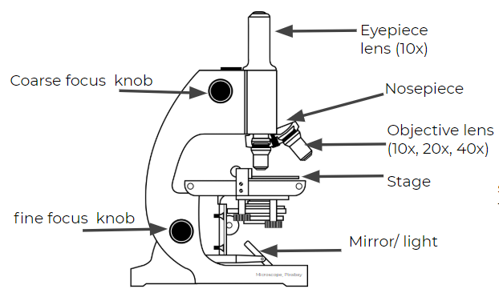
The two lenses that magnifies the cell

Slide 22
Finding the total magnification
For example,
When the objective lens of 10x magnification is in use, the total magnification will be:
10 x10
=100x

Slide 23
Finding the total magnification
Let’s try this one
When the objective lens of 20x magnification is in use, what is the total magnification?
10 x 20
=200x

Slide 24
Finding the total magnification
When the objective lens of 40x magnification is in use, what is the total magnification?
10 x 40
= 400x

Slide 25
What is the total magnification?
There is a microscope. The eyepiece lens has a magnification of 5x.
A student was using the objective lens of the highest power at 40x. What is the total magnification?

Slide 26
What is the total magnification?
There is a microscope. The eyepiece lens has a magnification of 5x.
A student was using the objective lens of the highest power at 40x. What is the total magnification?
5 x 40 = 200x

Slide 27
Types of microscopes and their differences

Slide 28
Resolution
Resolution is the ability to distinguish between two points on an image, i.e. the amount of detail.
Notes:
Ask students to think about the differences in the two images on the right.

Slide 29
Comparison of electron and light microscope
Resolution
Colour
Magnification
The electron microscope image shows more details so it has a higher resolution.
Light microscope has colour but the electron microscope is monochromatic.
Electron microscope images are more highly magnified.

Slide 30
Answer the true or false questions below.
True or false: the higher the magnification, the higher the resolution.
True or false: the light microscope provide images of cells with colours.
True or false: turning the fine focus on the light microscope can increase the resolution.

Slide 31
Answer the true or false questions below.
True or false: the higher the magnification, the higher the resolution.
True or false: the light microscope provide images of cells with colours.
True or false: turning the fine focus on the light microscope can increase the resolution.
False
True
False

Slide 32
Independent practise

Slide 33
Independent practice
What does the word ‘magnify’ mean?
What are the two parts that magnify cells in a light microscope?
Define the term resolution.
Why is micrometers or nanometers commonly used when measuring the width of cells?
Calculate the magnification for the following combinations on the right.
Objective lens | Eyepiece lens | Total magnification
20x | 10x
250x | 10x
 | 10x | 450x
 | 5x | 75x
5x |  | 900x
Notes:
Pause the video and solve the questions

Slide 34
Answers to independent practice
To enlarge.
The objective lenses and the eyepiece lens
Resolution is the ability to distinguish between two points on an image, i.e. the amount of detail.
The cells are very small in size. Smaller units are more appropriate.
Calculate the magnification for the following combinations:
Objective lens | Eyepiece lens | Total magnification
20x | 10x | 200x
250x | 10x | 250x
45x | 10x | 450x
15x | 5x | 75x
5x | 180x | 900x
Notes:
Pause the video and solve the questions

