Slide 1
Mathematics
Groups
Lesson 1 of 8
Downloadable Resource
Miss Kidd-Rossiter

Slide 2
How many different ways can you put 8 apples into 2 bags?
For example, you can put 5 in one bag and 3 in the other.
How many different ways can you put 8 apples into 3 bags?
Notes:
Teacher note Q1: there are 5 ways of doing so (0 + 8, 1 + 7, 2 + 6, 3 + 5 and 4 + 4) assuming the apples and the bags are identical. Emphasise that systematic listing is helpful.
Teacher note Q2: systematic listing is key here. One strategy is to fix, say, 1 apple in the first bag and then share 7 between the other two (7 + 0, 6 + 1, 5 + 2, 4 + 3). Look out for ‘double counting’: the sharing “1, 4, 3” might be counted again when the sharing “3, 1, 4” is added to the list.

Slide 3
can be described as 5 : 3
Draw some sharings of 10 apples between two or more bags and write them using ratio notation.
Can every bag contain an odd number of apples?
can be described as 2 : 6
or 1 : 3
can be described as 1 : 3 : 4

Slide 4
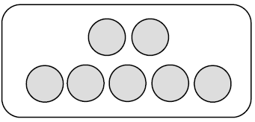
Asif puts in 2 sweets and Sally puts in 5 sweets to make a group.
How many sweets are there in the group?
If they make 10 of the same groups, how many sweets will Asif put in?
If they make 24 of the same groups, how many sweets will Sally put in?
If they make 50 of the same groups, how many sweets will Asif and Sally put in?

Slide 5
I make a group of green and yellow counters with 11 counters in total.
Which of these could be the ratio of green counters to yellow counters?
2 : 9 11 : 1 1 : 1 0 : 11 7 : 4
Explain your answer (s).

Slide 6
Antoni saves £4 a month. Binh saves £9 a month. Cala saves £7 a month.
They put the money together to give to charity.
How much will they have altogether after one year?

Slide 7
A bowl of fruit contains 3 apples, 2 oranges and 6 bananas.
Maja sells 𝑛 bowls like this at the market. How many bananas did she sell?
If she sold 𝑛 apples, how many bowls did she sell?
If she sold 𝑛 bowls, how many pieces of fruit did she sell in total?

Slide 8
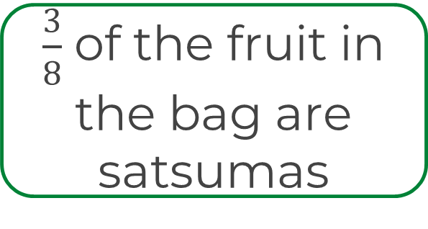
In this bag, there are 5 plums and 3 satsumas.
The greengrocer is choosing a label for the bag.
Contains 8 fruits
The ratio of plums to satsumas is 5 : 3
Which of these are still true if the greengrocer doubled the amount of each fruit in the bag?
What about if she added two more of each fruit to a bag?
2 more plums than satsumas
What’s the same and what’s different about the labels?
Which label should the greengrocer put on the bag?

