Slide 1
Exchanging coins in a real-life setting:
Lesson 4 of 4
Numeracy: Money - Applying Learning
James

Slide 2
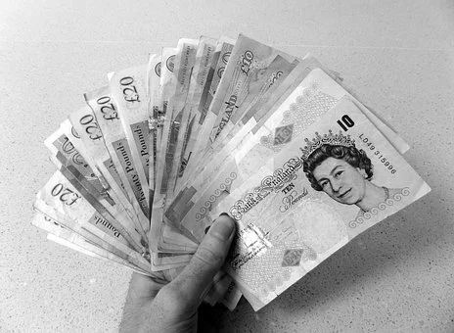
What am I learning today?
Objectives
To exchange the appropriate amount of coins for an item in a real-life setting.
N.B. It is not necessary for the learner to understand the values of each coin nor to count the coins individually to give to the clerk.
Vocabulary
pound pence notes
Needpix & Pixabay Images

Slide 3
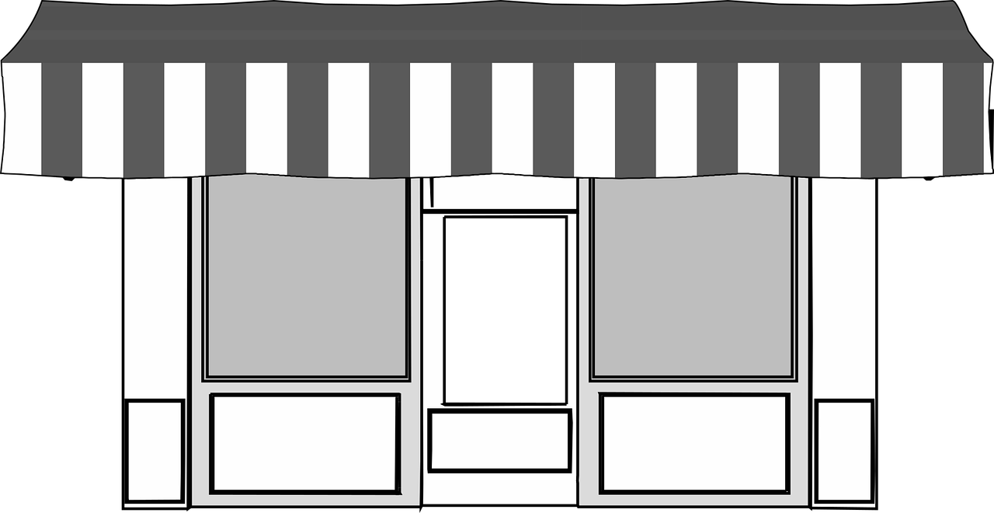
For this lesson, you will need:
Money
Shop or Market
Explanatory Note
An explanatory note is provided at the end of this resource. Adults may print this out or make a similar one themselves.

Slide 4
At the shop...
3p
Credit: Pixabay

Slide 5
At the shop...
2p
Credit: Pixabay

Slide 6
Challenge:
Exchanging money in a shop
Credit: Pixabay
Create a shopping list
Choosing items
Choose some items that you are going to buy at the shop or market.
Encourage your learner to identify the items they put on the shopping list verbally or through gesture.
Wait for the cost from the clerk
Exchanging coins
Allow your child to hear the cost from the clerk.
Support the learner to count coins and hand these to the clerk, waiting to receive their goods.

Slide 7
Money
Lesson 4: Exchanging coins in a real life setting.
Make it easier
Make it harder
More ideas
Give the learners the coins needed to exchange for their items.
Purchase items with round numbers such as £1.
Use pictures of coins for children to match their values.
Begin to introduce the concept of coins with different values.
Begin to order the values of coins and notes to give context to their values.
Encourage your learner to be more independent in their use of money.
Encourage them to anticipate being required to hand over the money before they get their items.

Slide 8
Explanatory note
Thank you for your patience whilst I support this learner with learning difficulties to understand exchanging money for items. This may take a little longer than usual but is an important life skill which I am teaching in order to prepare this young person for adulthood.

