Slide 1
Circle Theorems: Angles in a cyclic quadrilateral
Maths
Mr Chan

Slide 2
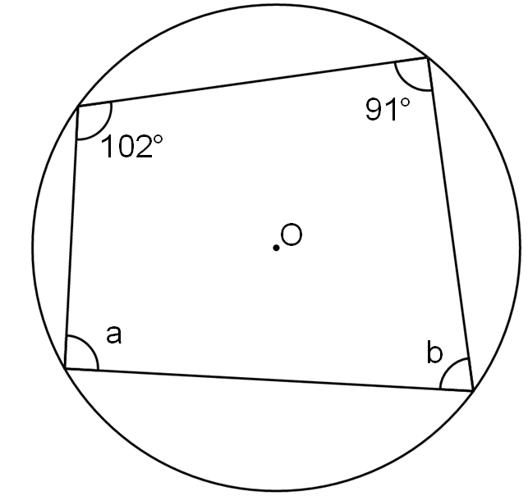
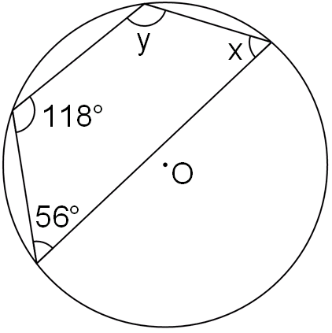
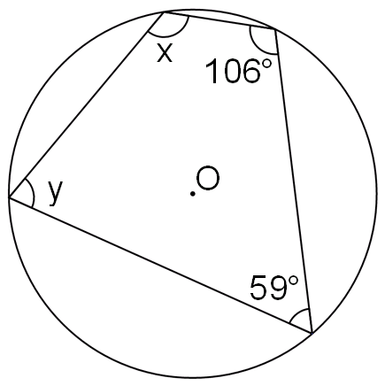
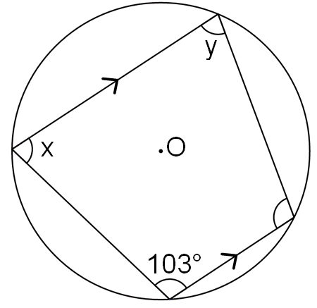
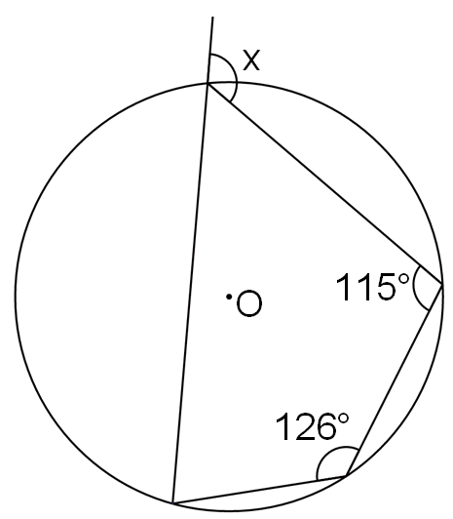
Circle Theorems: Angles in a cyclic quadrilateral
1. Work out the size of each angle marked with a letter.
Give a reason for your answers.
2. Work out the size of each angle marked with a letter.
Give a reason for your answers.
a) b)
c) d)

Slide 3
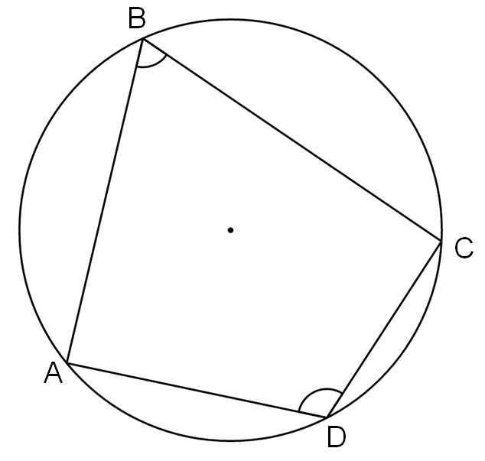
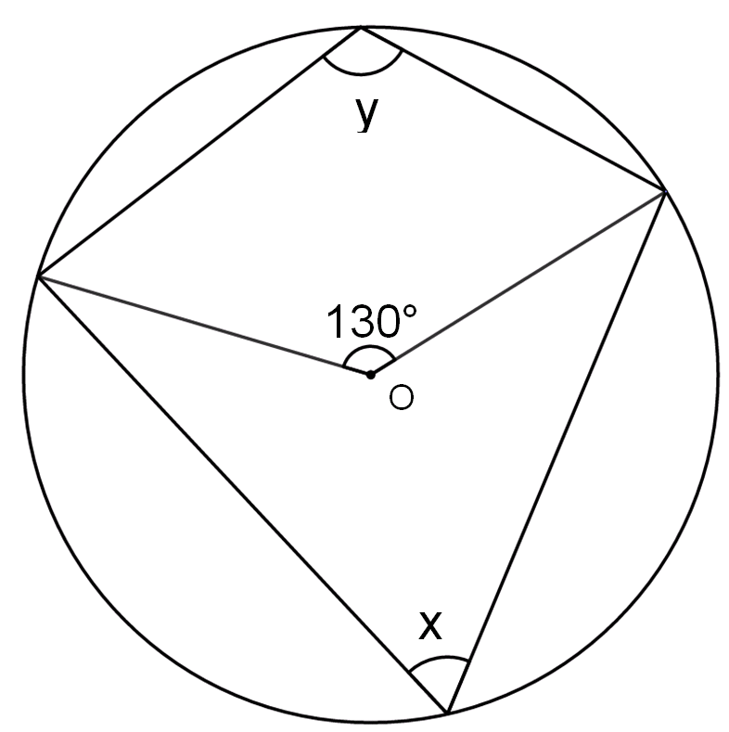
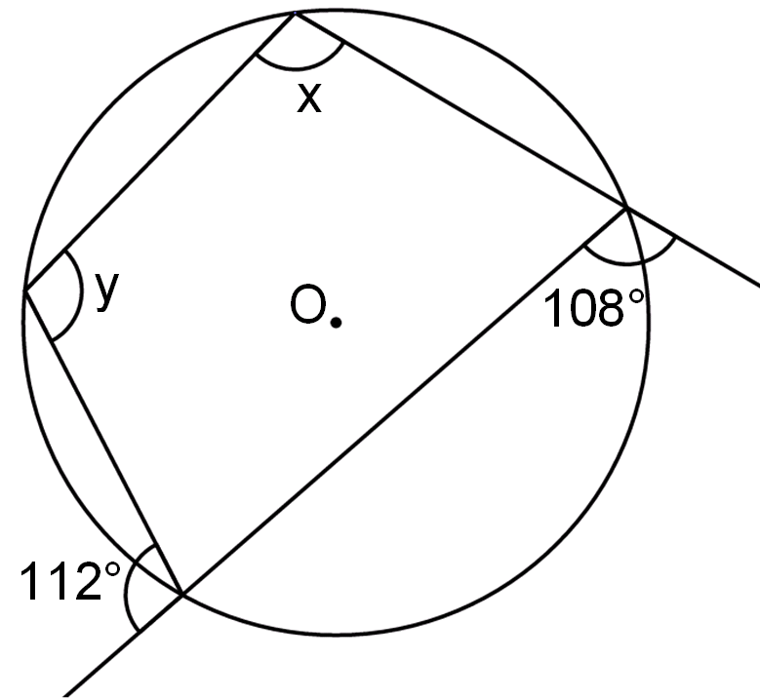
Circle Theorems: Angles in a cyclic quadrilateral
3. Work out the size of each angle marked with a letter.
Give a reason for your answers.
a) b)
4. Prove that opposite angles in a cyclic quadrilateral add up to 180º.

Slide 4
Answers

Slide 5
Circle Theorems: Angles in a cyclic quadrilateral
1. Work out the size of each angle marked with a letter.
Give a reason for your answers.
2. Work out the size of each angle marked with a letter.
Give a reason for your answers.
a) b)
c) d)
x = 62º y = 124º
x = 121º y = 174º
a = 89º
b = 78º
Opposite angles in a cyclic quadrilateral add up to 180º
x = 126º
x = 77º y = 77º

Slide 6
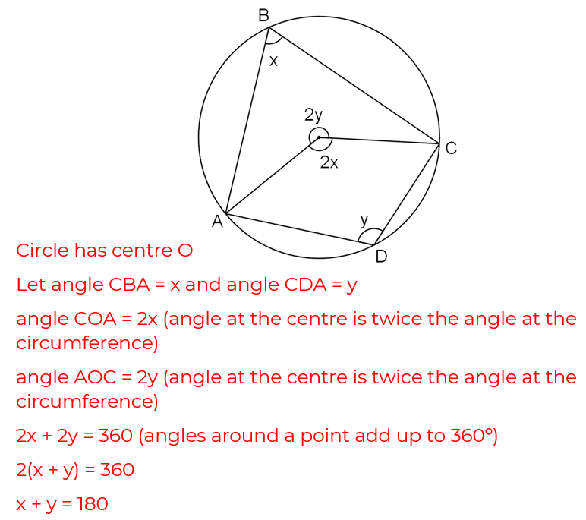
Circle Theorems: Angles in a cyclic quadrilateral
3. Work out the size of each angle marked with a letter.
Give a reason for your answers.
a) b)
4. Prove that opposite angles in a cyclic quadrilateral add up to 180º.
x = 65º y = 115º
x = 112º y = 108º

