Slide 1
To describe and classify 2-D shapes
Mathematics
Miss Charlton

Slide 2
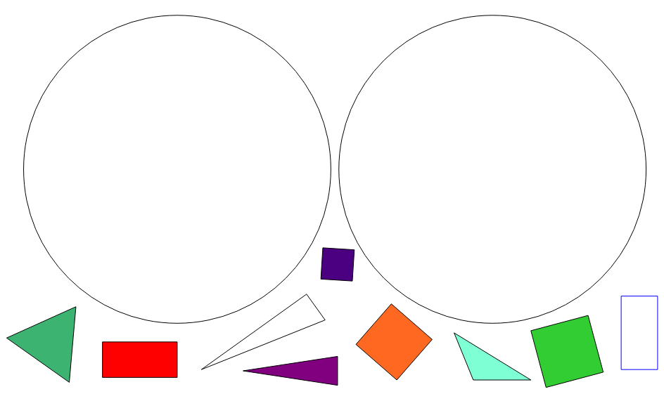
Independent task
is a triangle
is not a triangle

Slide 3
Answers
is a triangle
is not a triangle

