Slide 1
Maths
Miss Davies
Please note some slides do have colour font on them

Slide 2
Sketch graphs of simple cubic functions
‹#›

Slide 3
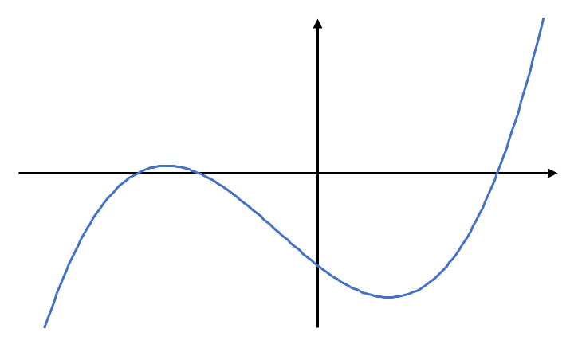
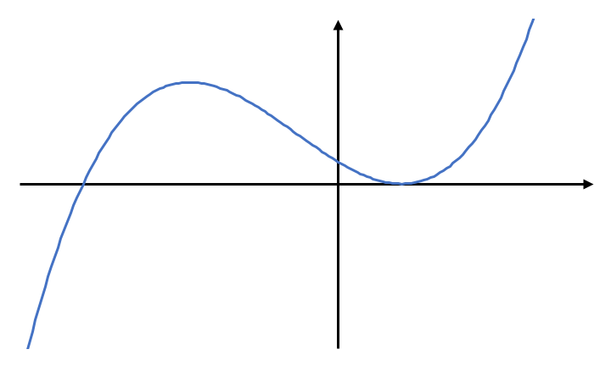
Sketch graphs of simple cubic functions
(-3, 0)
(-2, 0)
(3, 0)
(0, -18)
(0,4)
(-4,0)
(1, 0)
‹#›

Slide 4
Answers

Slide 5
Sketch graphs of simple cubic functions
(0,6)
(-4,0)
(-1,0)
(2,0)
(-2,0)
(1,0)
(3,0)
(0,-8)
‹#›

Slide 6
Sketch graphs of simple cubic functions
(-3, 0)
(-2, 0)
(3, 0)
(0, -18)
(-3, 0)
(0,4)
(2,0)
(-4,0)
(1, 0)
(0,-18)
‹#›

