Slide 1
Are elections truly fair?
Citizenship
Miss Elmi

Slide 2
Glossary
Candidate - A political candidate is someone who stands for election to a political office.
Plurality- The number of votes cast for a candidate who receives more than any other but does not receive an absolute majority.
‘Safe seats’- A parliamentary seat that is likely to be retained with a large majority in an election.
Proportional representation - An electoral system in which parties gain seats in proportion to the number of votes cast for them.
First past the post- An electoral system in which a candidate or party is selected by gaining the most votes.
Elections- A formal group decision-making process by which a population chooses an individual to hold public office.
Legitimacy - In politics it means the right and acceptance of an authority.
Representation- The act of doing something on behalf of others.
Constituency- An area whose voters elect a representative to a legislative body.
Constituent - A constituent is a voting member of a community or organisation.

Slide 3
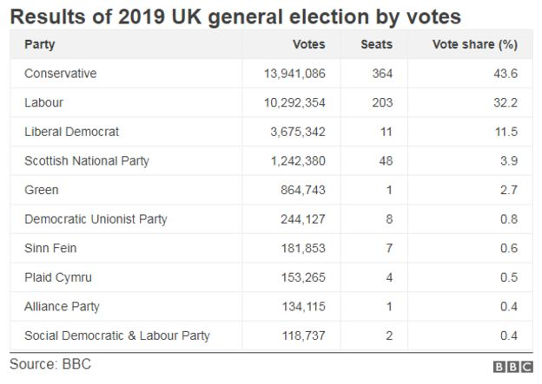
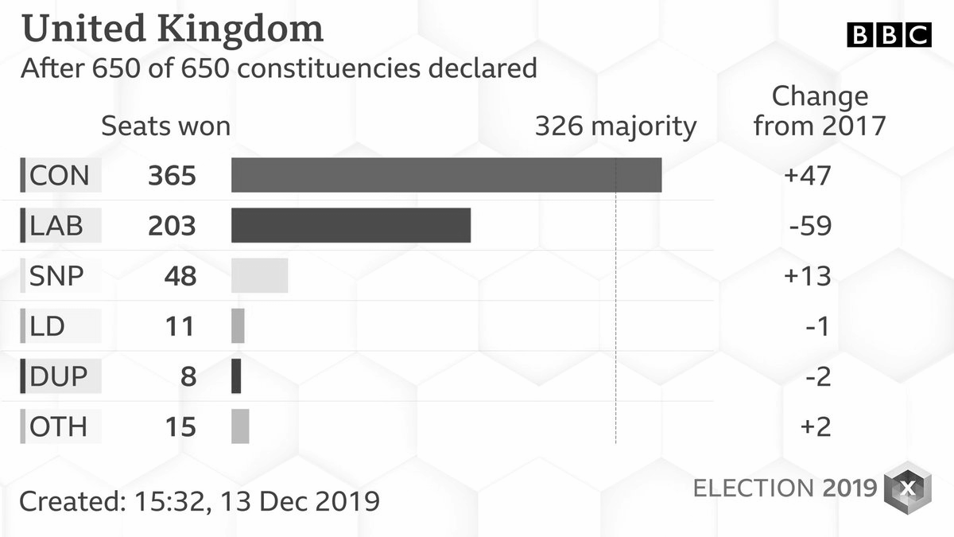
I see, I think, I wonder

Slide 4
Task: comprehension questions
Use the text in the previous slides to try and answer these questions in full sentences (try to use the wording of the question in your answer). A possible sentence starter for the first one is done for you.
What is the role of elections in a democracy? The role of elections in a democracy is to...
Explain the first past the post system.
Explain two criticisms that can be made of the first-past-the-post system.
Explain one way a proportional representational system could be seen as fairer than the first past the post system.

Slide 5
Take away task
Find out
One example of a country that uses PR and one that uses FPTP.
Examples of parliaments/assemblies in the UK which use PR.
The view on PR of the following UK political parties.
Conservatives
Labour
Green
Liberal Democrats
Scottish National Party

