Slide 1
Sensory Story:
A Christmas Carol
Early Development: Celebrations & Festivals (Secondary)
Emma Pemberton

Slide 2
For this lesson, you will need:
A book
A notepad and pen
An ice pack
Chains or coins
A torch
Pale or sheer material
Holly
Cinnamon
A dark blanket
A hot water bottle

Slide 3
Let’s get ready
Find a quiet space to work away from distractions.
Ensure that your learner is comfortable.
Make sure your resources are nearby.
You may also want to darken the room during this lesson, so make sure you have access to the lightswitch or are able to draw your curtains.

Slide 4
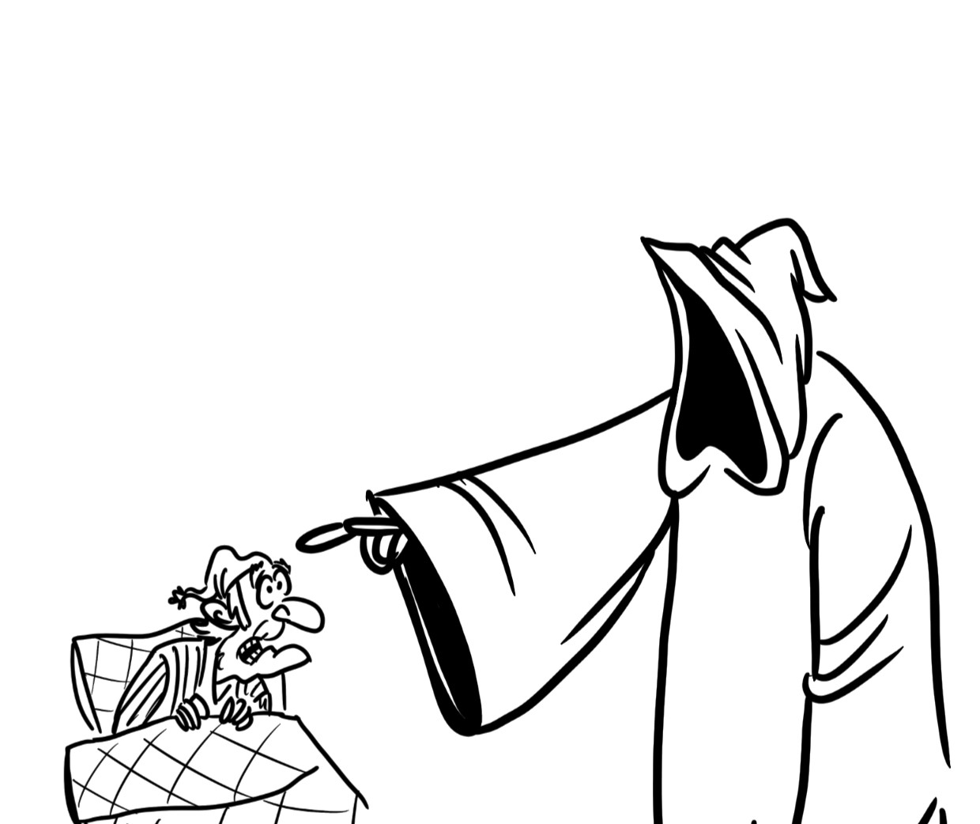
Today’s story
A Christmas Carol
By Charles Dickens
A Christmas Carol (Abridged Version)
by Charles Dickens
Illustrations by Lisa Jo Robinson,
Oak National Academy

Slide 5
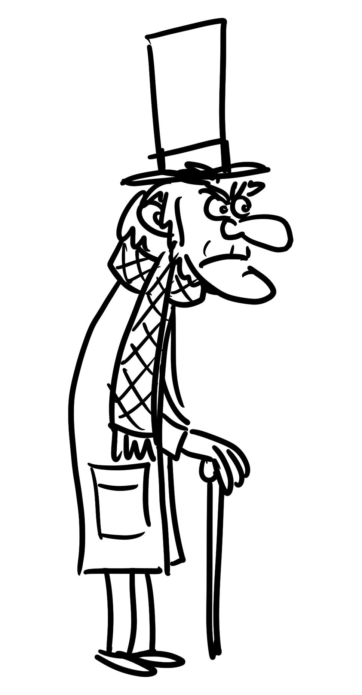

Slide 6
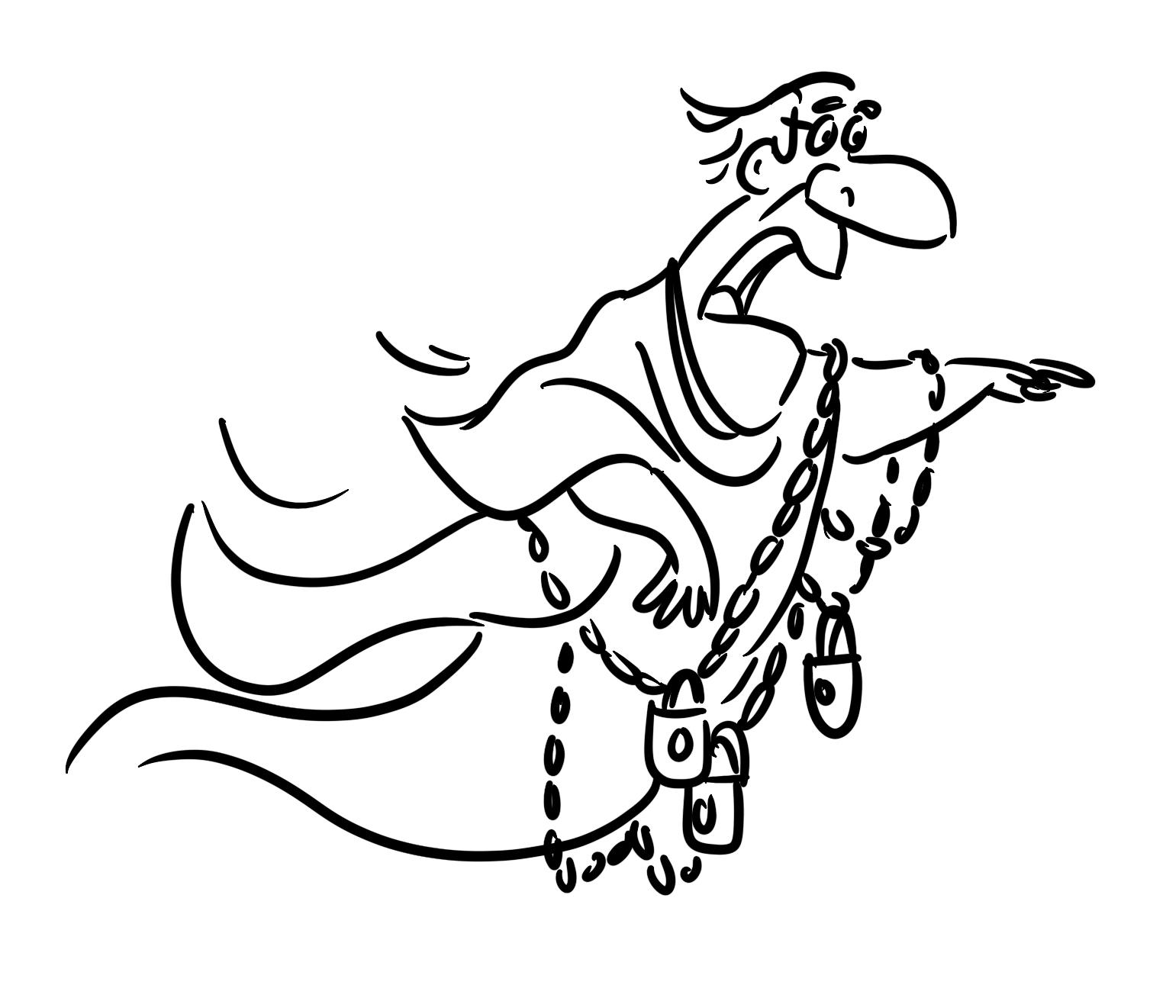

Slide 7
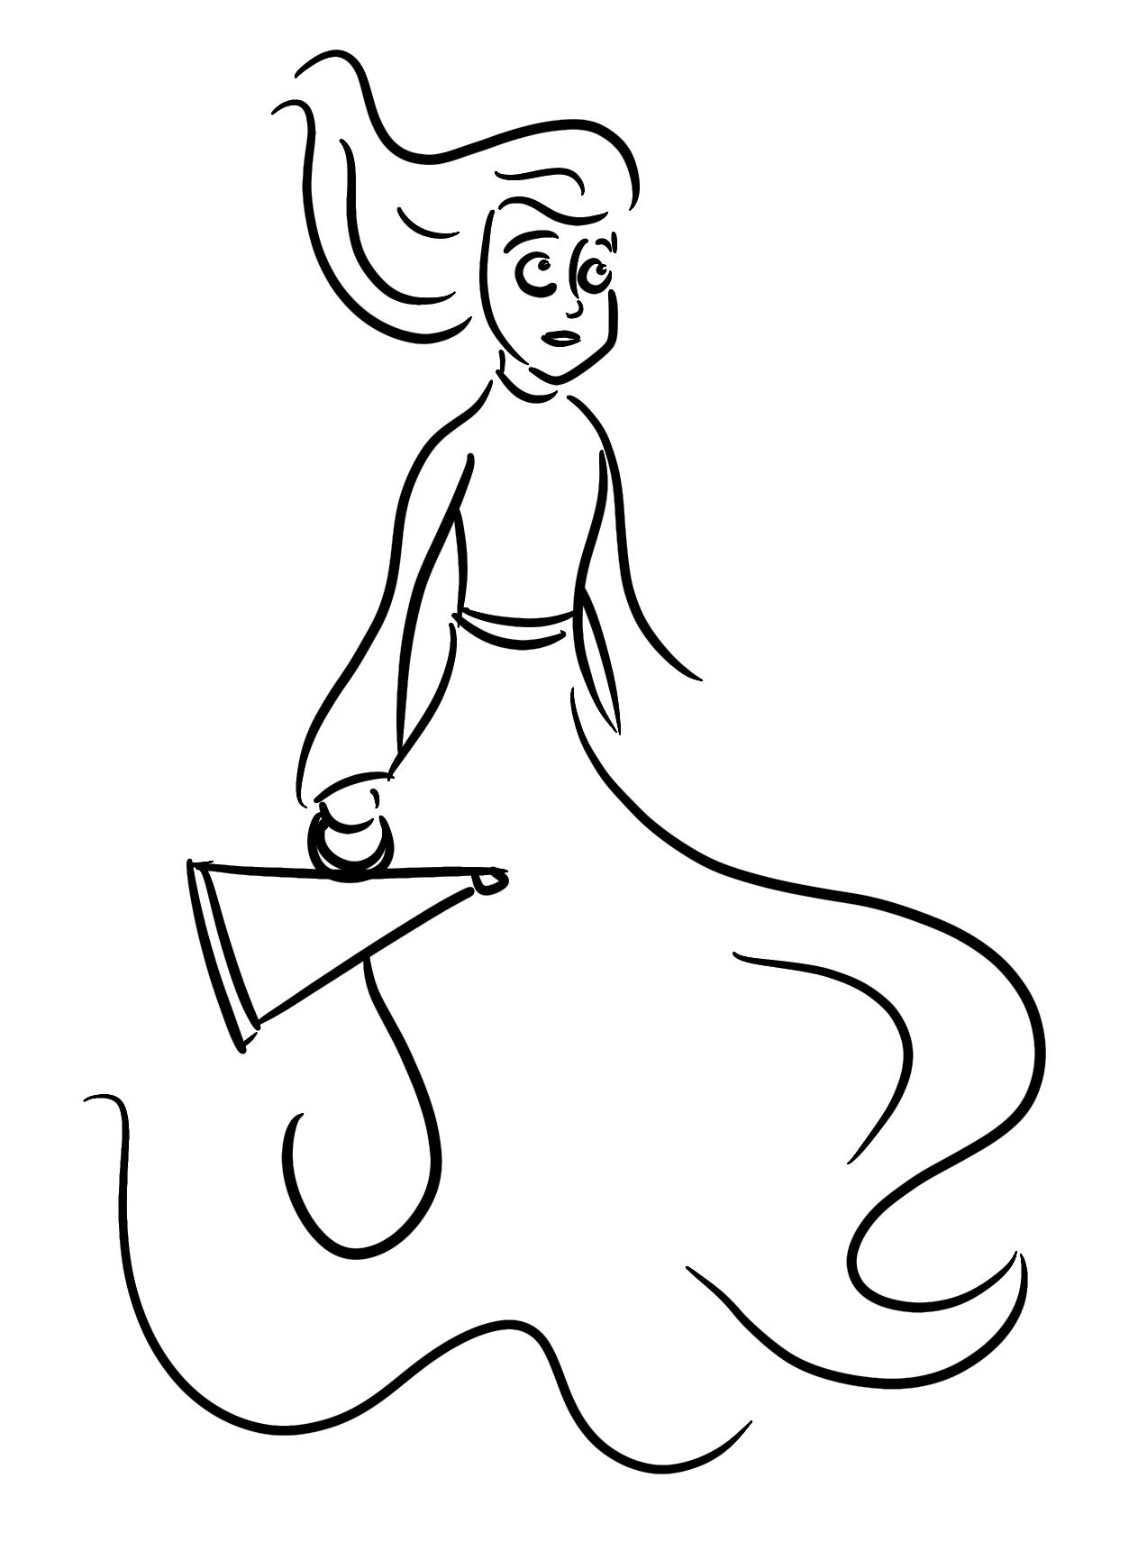

Slide 8
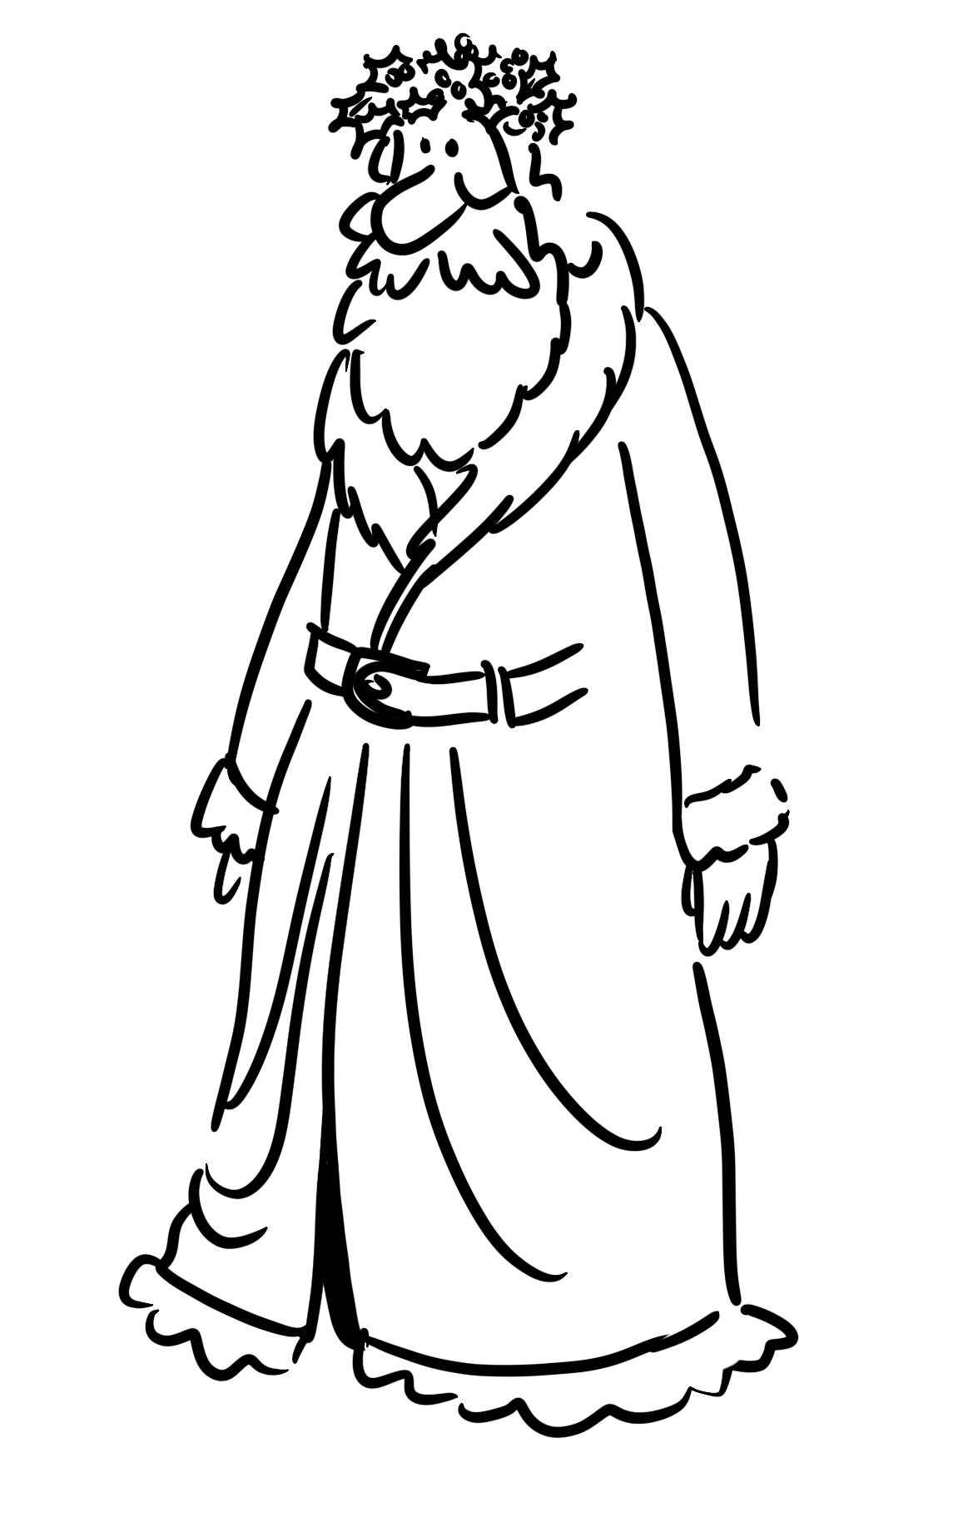

Slide 9
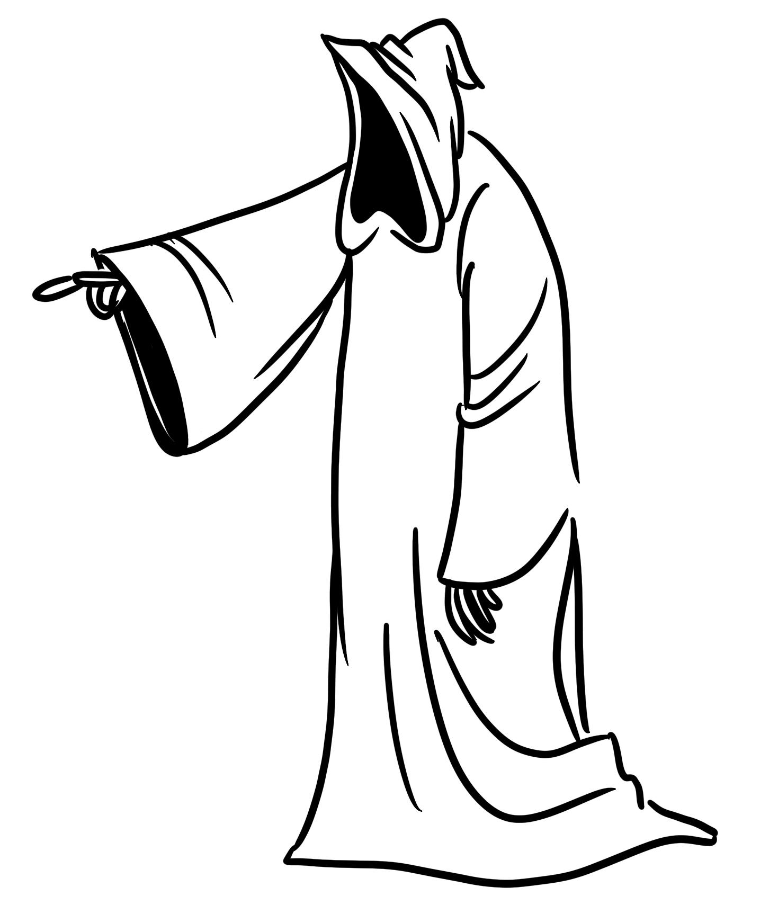

Slide 10
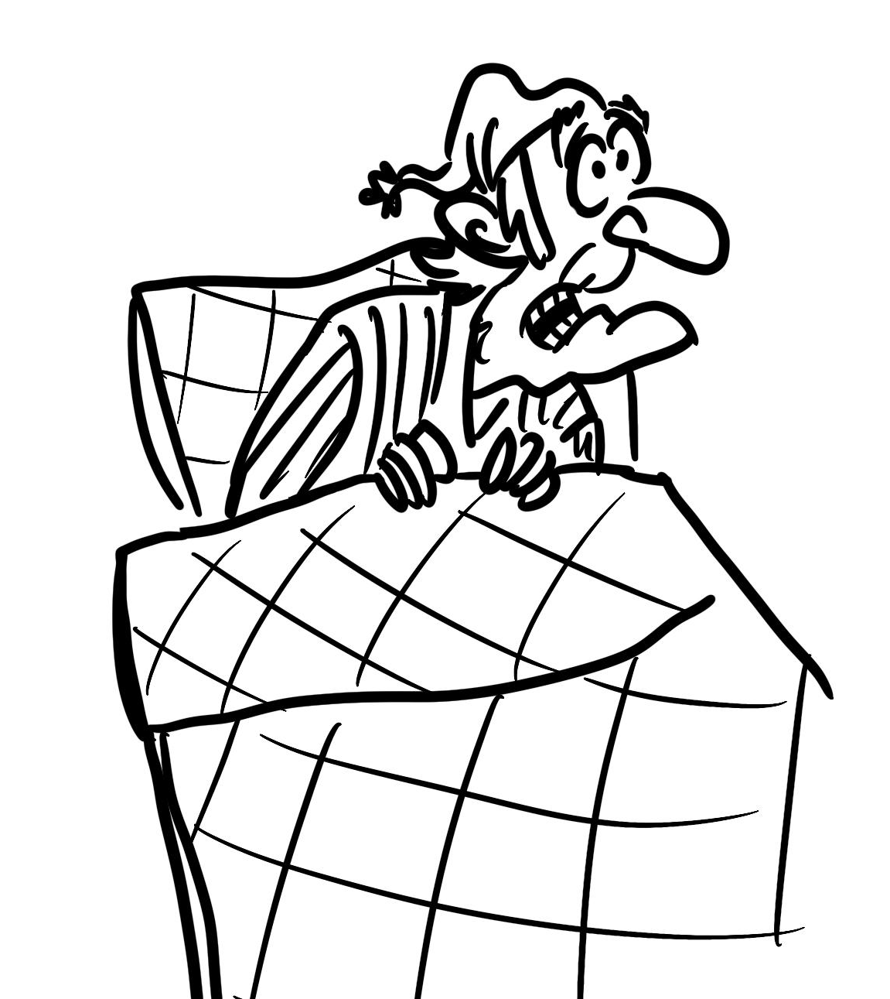

Slide 12
Make it easier
Make it harder
More ideas
Use resources that your child is already familiar with.
Add additional characters from the story.
Use symbols or photos of faces to represent ‘mean’, ‘scared’ and ‘happy’ and use these when exploring the associated resource.
Create a sensory bin or sensory bottle to represent each of the ghosts.
Explore different festivals as sensory stories, for example: Christmas, Hanukkah and Diwali.

Slide 13
References
Illustrations on slides 4 - 11: Lisa Jo Robinson, Oak National Academy

